Slide 1
Human Resource Development
Student Training
Infrastructure

Slide 2
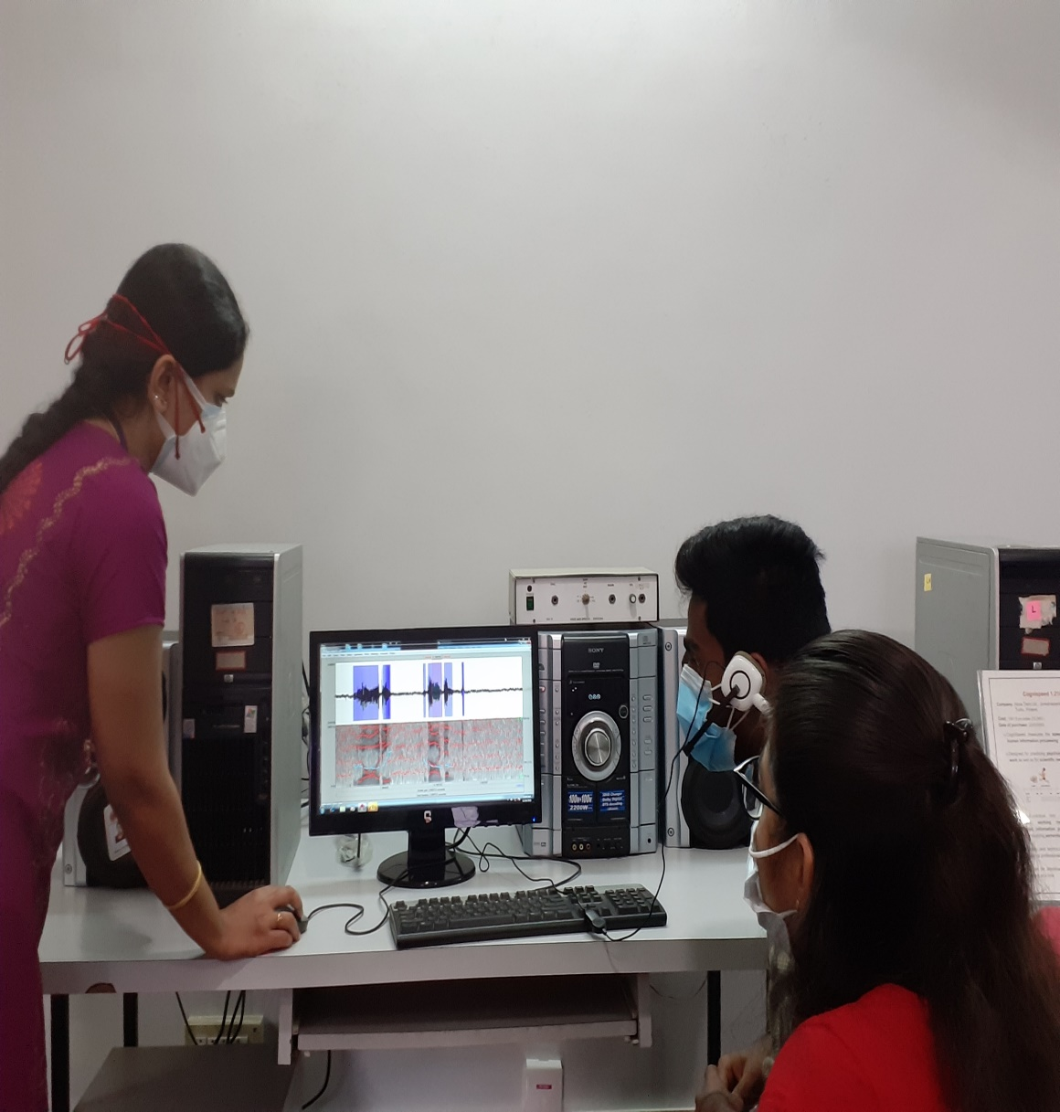
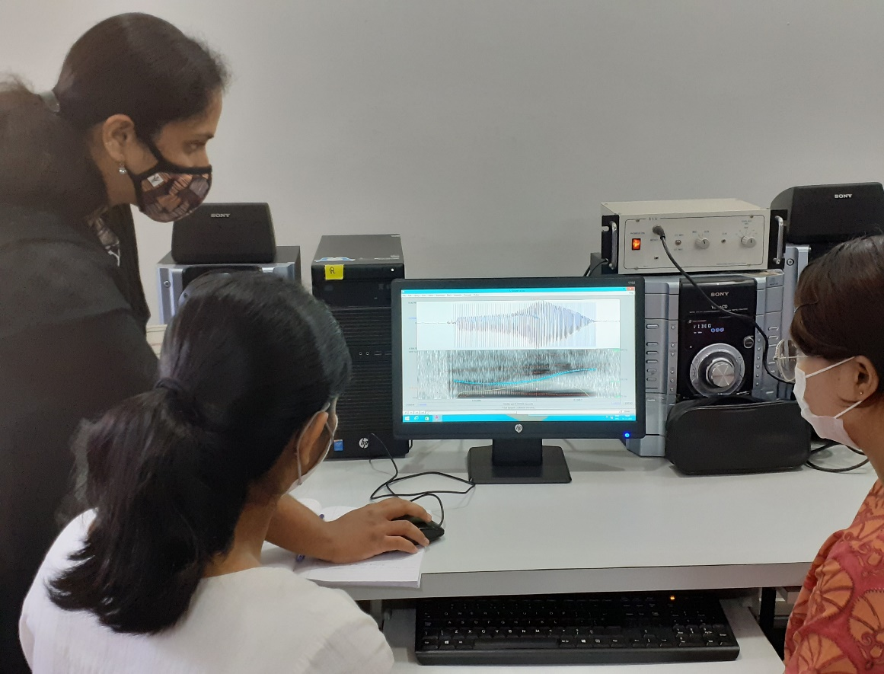
STUDENT TRAINING
UG Students
Internship Students
PG Students
Clinical Postings
Clinical Module

Slide 3
Equipment available in SLS Labs
Respiratory, Articulatory and Resonatory Systems
Aerometer
Nasometer
Phonatory System
Lingwaves system
Neuroscan – 64 channel Evoked potential system
SALT 18 Research Software for windows
Language and Cognition Systems
Raven’s Educational CPM/CVS (DST Project)
E-prime professional
128 channel geodesic EEG system 400 with 1 Mac
Functional Near Infrared Spectroscope
Computerized speech lab
Dr. speech hardware
Electroglottograph (CSL)
Digital Voice Recorders
Ambulatory Phonation Monitor
EGG’s for singers
Vaghmi
Speech Science Lab (SSL)
Electroglottograph
Aeroview system
Vitalograph 2120
Spirometer
Ultrasound imaging system
Work bench for articulatory synthesis
Micro Ultrasound System

Slide 4
Voice Analysis:Dr.Speech

Slide 5
ERP Recording: Neuroscan

Slide 6
Acoustic Analysis:Praat

Slide 7
Resonance Analysis:Nasometer

Slide 8
RESEARCH

Slide 9
Publications by SLS Faculty

Slide 10
International Journal Publications

Slide 11
Publications in National Journals
Student Research at AIISH: Articles based on dissertations done at AIISH | 21
Journal of All India Institute of Speech and Hearing | 17
International Journal of Mind Brain and Cognition | 10
Journal of Indian Speech Language and Hearing Association | 8
Research & Reviews: Journal of Neuroscience | 6
Compendium of Research Funded by ARF | 4
Indian Journal of Applied linguistics | 3
Guru Journal of Behavioral and Social Sciences | 2
International Journal of Computational Biology and Bioinformatics | 2
Journal of Advanced Linguistic Studies | 2
Research & Reviews: A Journal of Bioinformatics | 2
Research & Reviews: A Journal of Health Professions | 2
Indian Journal of Ancient Medicine and Yoga | 1
International Educational Scientific Research Journal | 1
International Jounal of Molecular Bio Technology | 1
International Journal of Dravidian Linguisitics | 1
International Journal of Research In Educational Studies | 1
International School of Dravidian Linguistics | 1
Journal of Acoustical Society of India | 1
Journal of Laryngology and Voice | 1
Language in India | 1
Research & Reviews: Journal of Medical Science and Technology | 1
Research & Reviews: Journal of Oncology and Hematology | 1

Slide 12
Impact Factor: 6.856
Publications: 1
Impact Factor: 2.538
Publications: 3
Impact Factor: 2.288
Publications: 1
Impact Factor: 2.009
Publications: 5

Slide 13
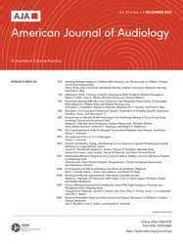
Impact Factor: 2.12
Publications: 1
Impact Factor: 1.733
Publications: 1
Impact Factor: 1.493
Publications: 1
Impact Factor: 1.471
Publications: 1

Slide 14
Impact Factor: 1.34
Publications: 1
Impact Factor: 1.167
Publications: 1
Impact Factor: 0.77
Publications: 1
Impact Factor: 1.12
Publications: 1

Slide 15
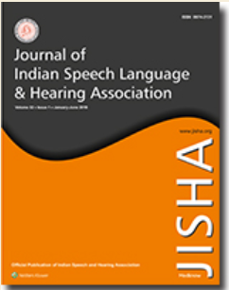
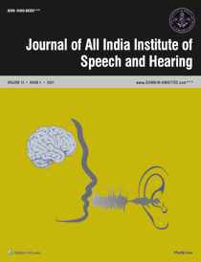
Impact Factor: 0.544
Publications: 1
Impact Factor: 0.595
Publications: 1
Publications: 6

Slide 16
Research Collaboration -SLS Faculty

Slide 17
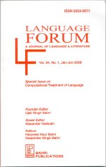
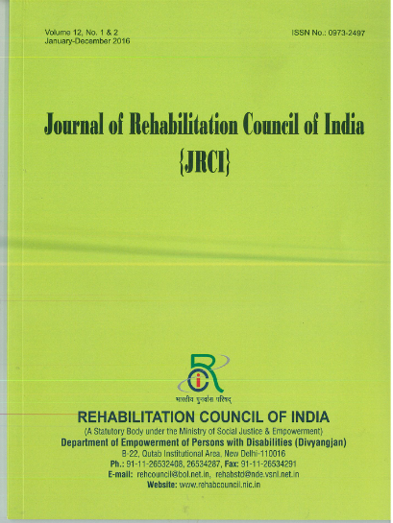
Editors / Reviewers International and National journals

Slide 18
SERB
DST
Efficacy of articulation and prosody intervention program for children with hearing impairment using hearing aids
To provide therapy and evaluate the efficacy of articulation and prosodic therapy in children with hearing impairment using hearing aids
Dr. N Sreedevi
Dr. Sangeetha Mahesh
23 Lakhs
Effect of cognitive load on speech and voice characteristics across lifespan
To measure the effect of cognitive load on Voice and Speech parameters and speaker verification using acoustic analysis.
Dr. T. Jayakumar
Dr. K Yeshoda
28 Lakhs
Auditory processing and auditory-cognitive measures in carriers of mutated genes that cause hearing loss
To investigate the auditory cognitive measures in individuals with hidden hearing loss and identifying the responsible biomarkers/genes
Dr. Sandeep M.(PI)
Dr. Santosh M
Dr. Srinivas K
49 Lakhs
Auditory & Multisensory processing in Persons with Stuttering
To investigate auditory processing in children and adults who stutter. To investigate audio-visual processing in children and adults who stutter
Dr. Santosh M
Dr.Ajith Kumar U
13.9 Lakhs
Development of Speech Rhythm in Kannada speaking children (F0)
To establish the rhythm pattern in Kannada speaking children based on F0
Dr. S.R. Savithri (PI)
Dr. N. Sreedevi
14.2 Lakhs
Development and validation of screening tool to identify learning disability (teacher administered screening tool)
To develop screening tool for children with learning disability
Dr. Prema K.S.Rao
Dr. Nandini Singh
(PI)
14 Lakhs
Feedback controls in Persons with Stuttering
To see the pattern of feedback control mechanisms in PWS compared to normal controls
Dr. Y.V. Geetha (PI)
Ms. Sangeetha M.
Ms. Sahana V.
Dr. H. Sundara Raju
13.09 Lakhs
Extra mural projects (07)
Grant amount
TITLE
Objectives
Investigators
1
6

Slide 20
Projects
PhD-Doctoral Thesis
Intra Mural Projects
Extra Mural Projects

Slide 21
Education Infographic
Research
Activities
PhD Doctoral Thesis
Intra Mural Prjoects
Extra Mural Projects

Slide 22
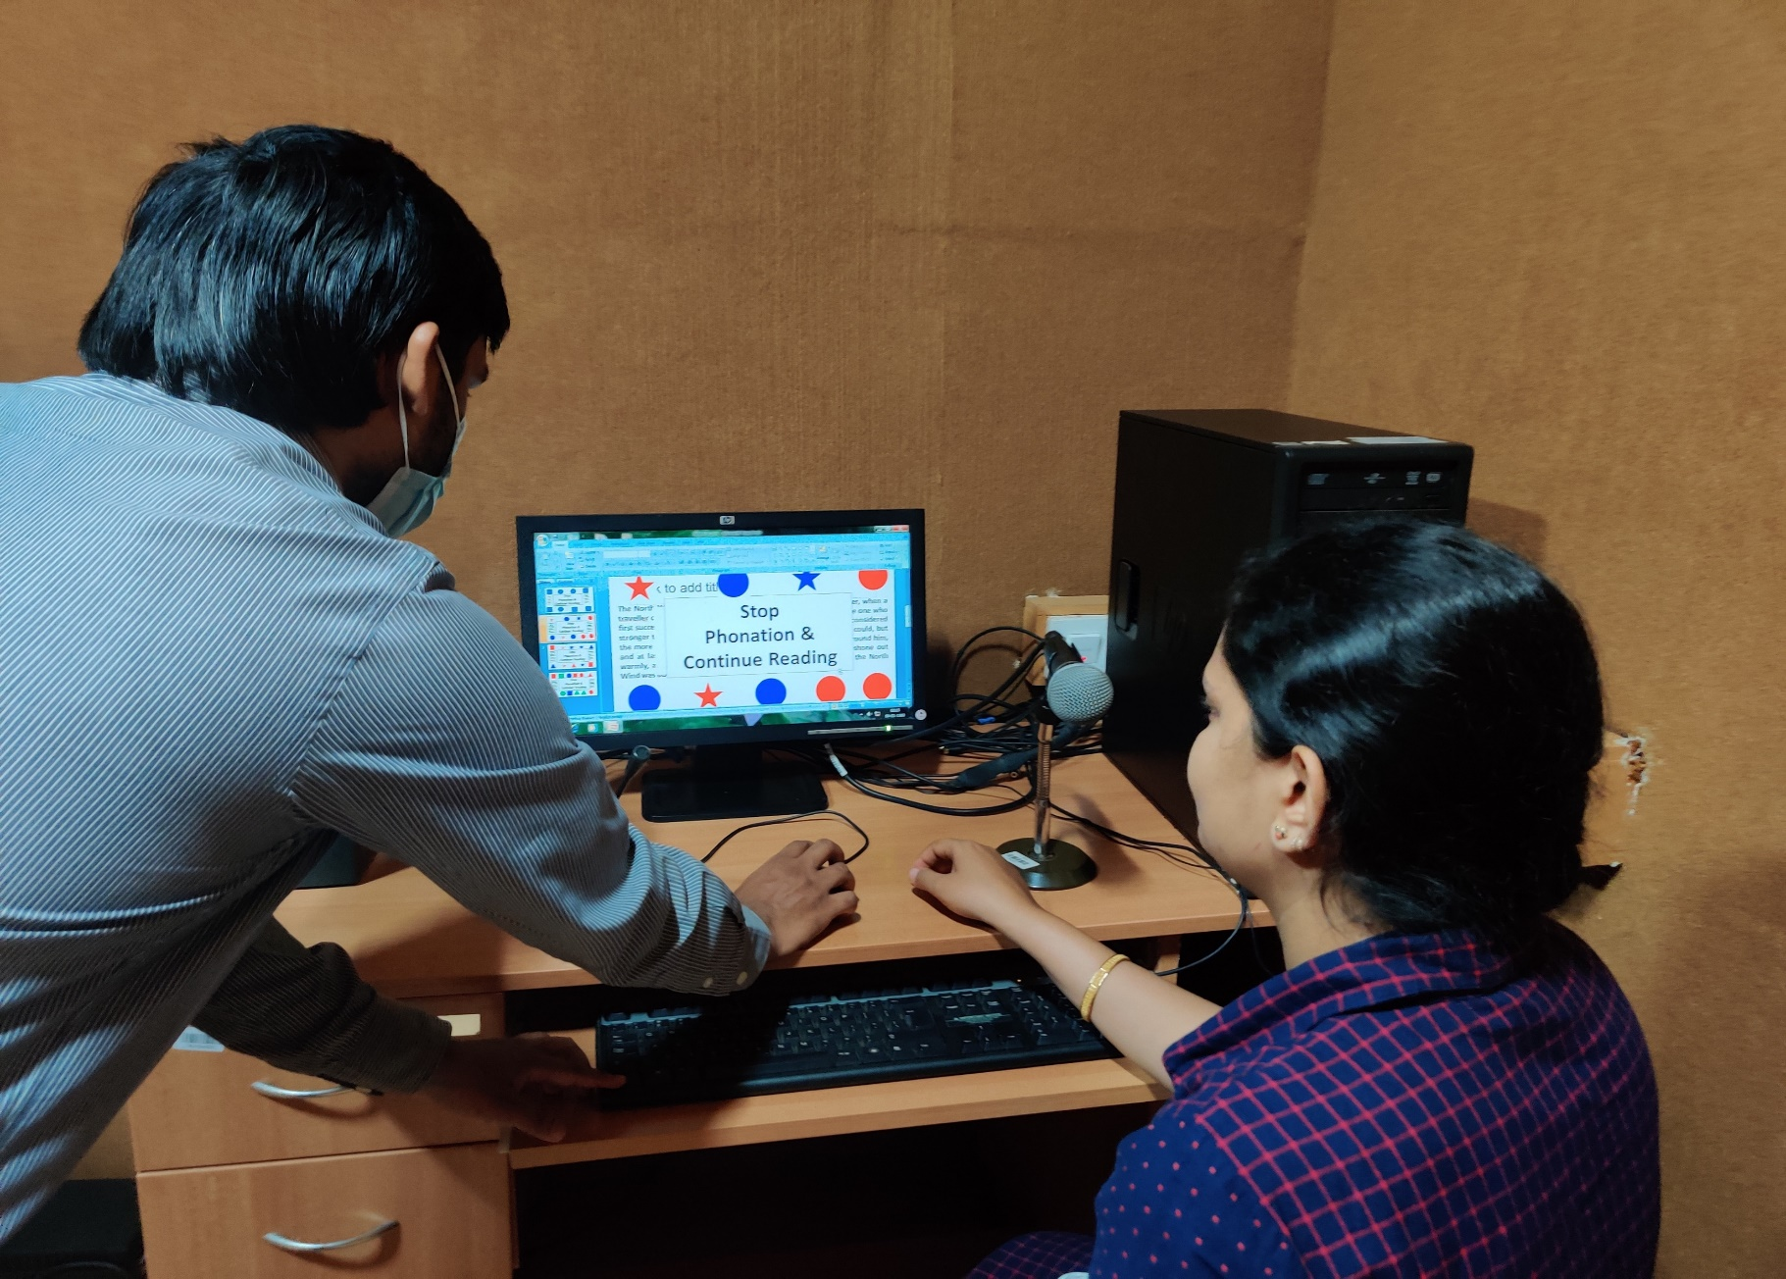
Ongoing Extra Mural Projects
Efficacy of articulation and prosody intervention program for children with hearing impairment using hearing aids
Effect of cognitive load on speech and voice characteristics across lifespan

Slide 23
WORKSHOP / SEMINARS

Slide 24
Sl. No. | Title of workshop | Coordinator | Date
1 | National seminar on genetics in communication disorders | Dr. N. Sreedevi | 20th Nov. 2015
2 | National workshop on voice assessment | Dr. Rajasudhakar R | 30th Mar – 1st April 2016
3 | National workshop on assessment and management of stuttering | Dr. Santosh M. | 20th – 21st Oct 2016
4 | RCI-CRE National Workshop on Professional Voice: Assessment and Management | Dr. Rajasudhakar R. | 11th – 13th October, 2017
5 | National Workshop on Speech Language Processing | Dr. Hema N. | 27th & 28th March 2018

Slide 25
Sl.No. | Title of workshop | Coordinator | Date
6 | National Workshop on Educating the Educator | Dr. M. Santosh | 10th & 11th May 2018
7 | National Workshop on Systematic Reviews & Meta-Analysis | Dr. M. Santosh | 8th December 2018
8 | International Stuttering Awareness Day | Dr. M. Santosh | 14th December 2018
9 | Recent Advances in Visualization of Vocal Folds | Dr. M. Santosh | 23rd February 2019
10 | National Workshop on Neuro-imaging in Communication Sciences and Disorders | Dr. Hema. N | 23rd March 2019
11 | Voice Training for School Teachers | Dr. K. Yeshoda | 21st May 2019

Slide 26
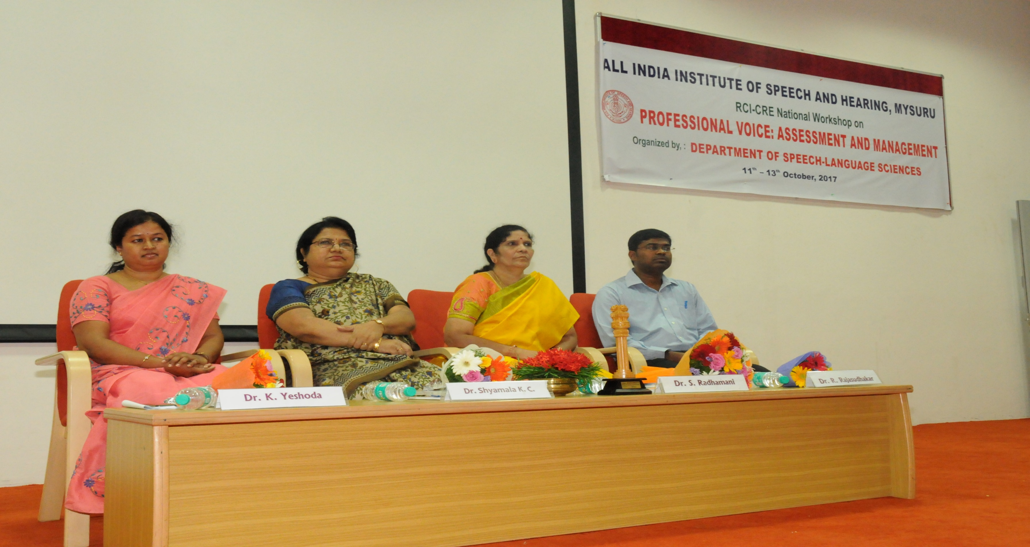
RCI-CRE National Workshop on
Professional Voice: Assessment and Management -2017

Slide 27
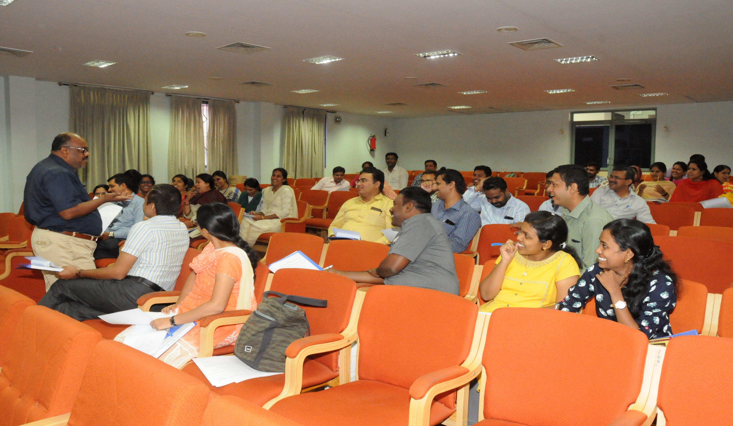
National Workshop on Educating the Educator -2018

Slide 28
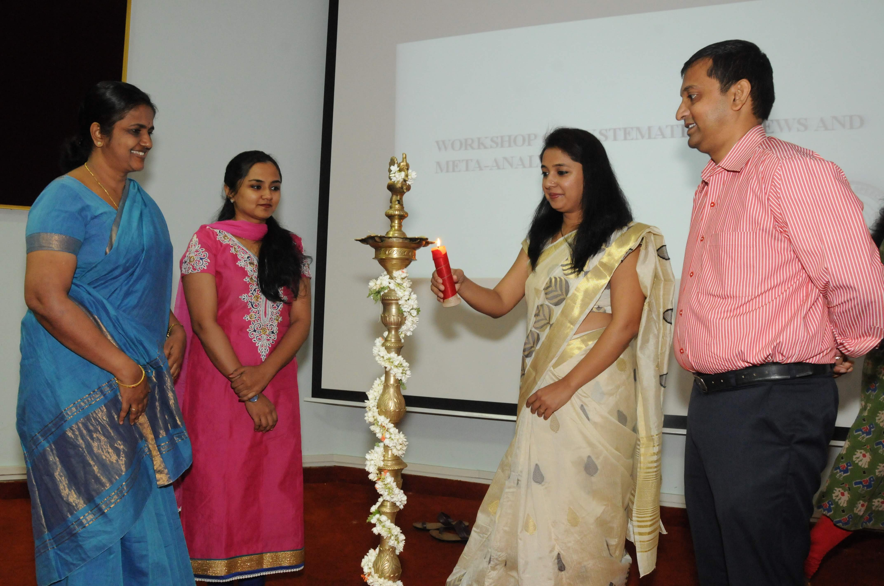
National Workshop on Systematic Reviews & Meta-Analysis -2018

Slide 29
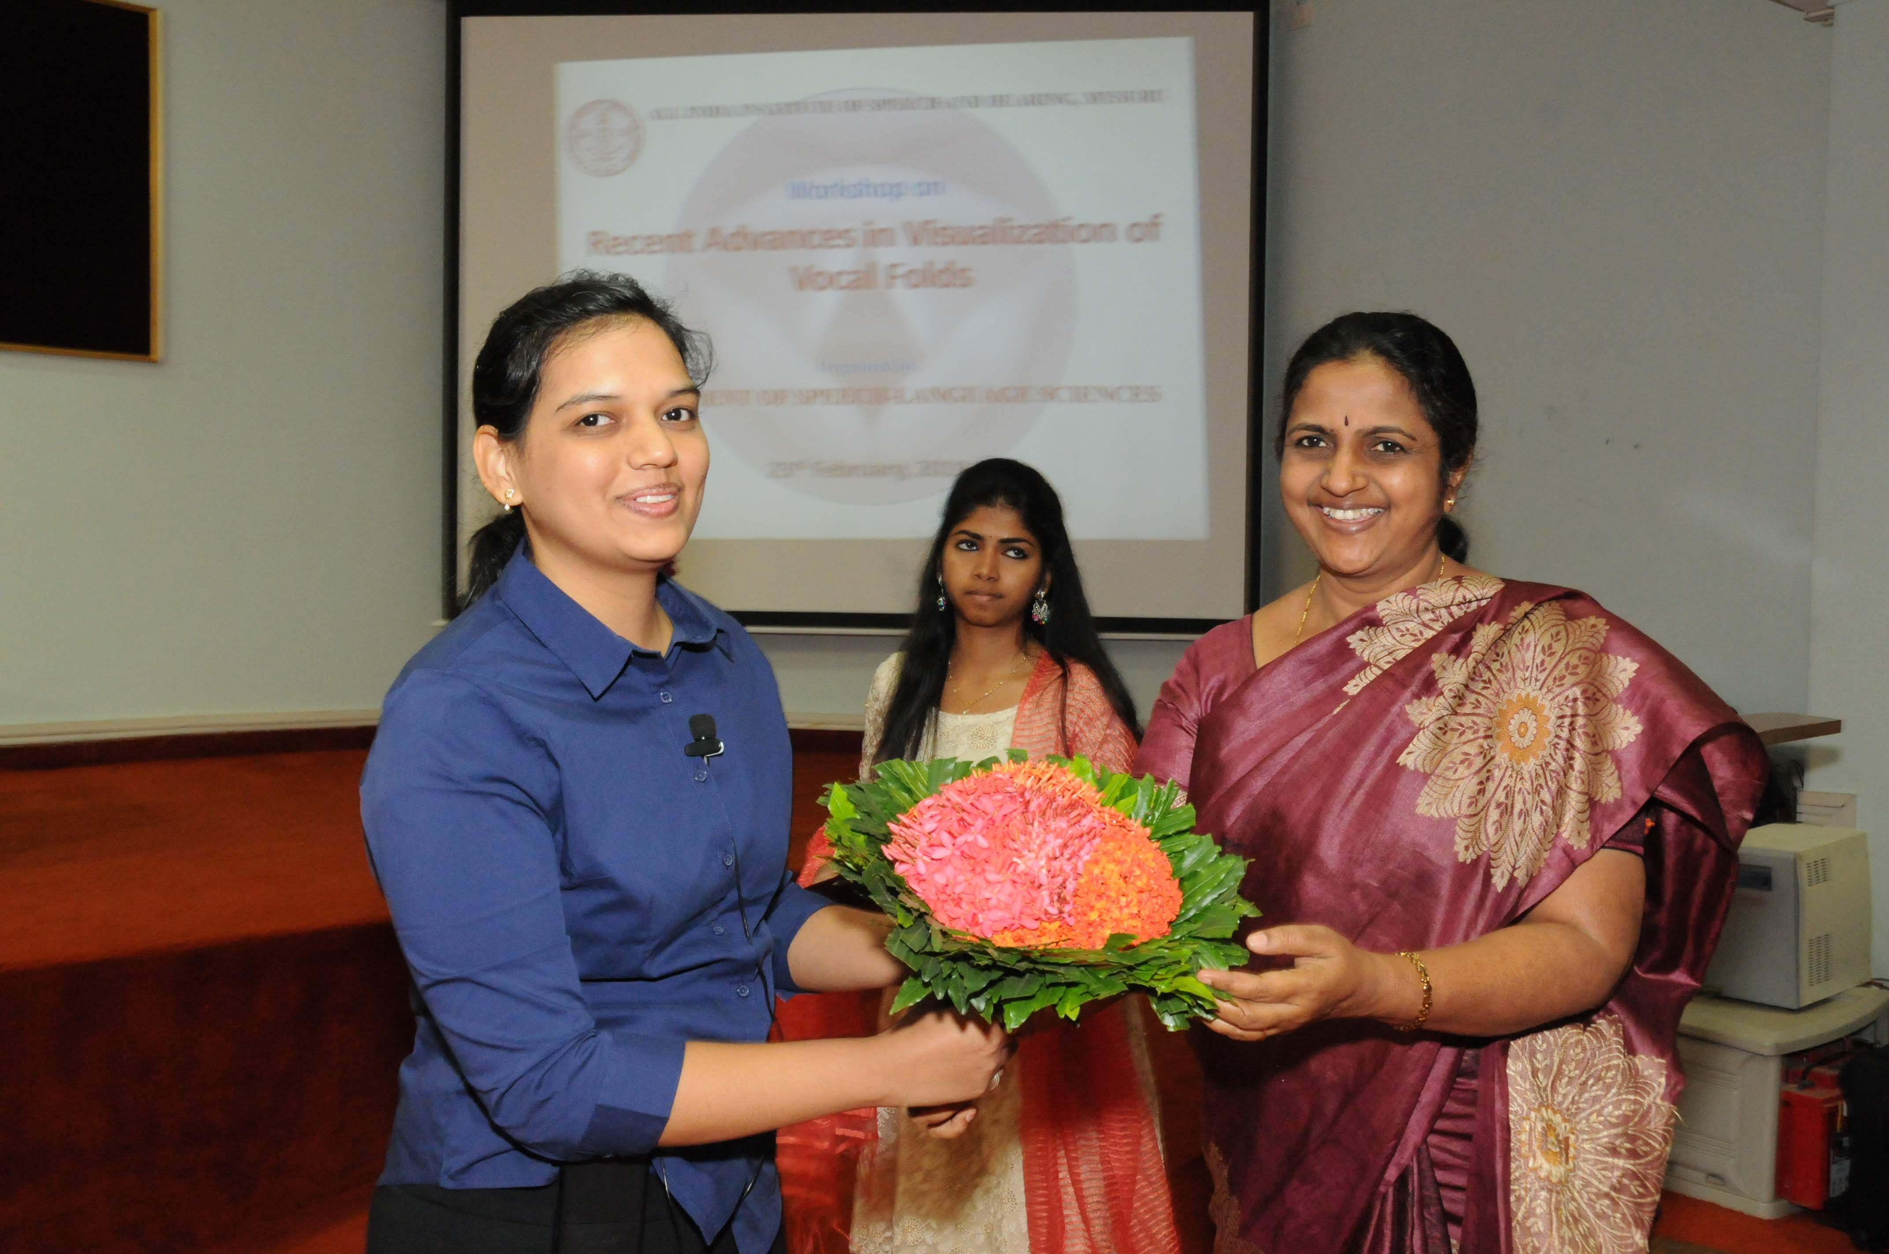
Recent Advances in Visualization of Vocal Folds -2019

Slide 30
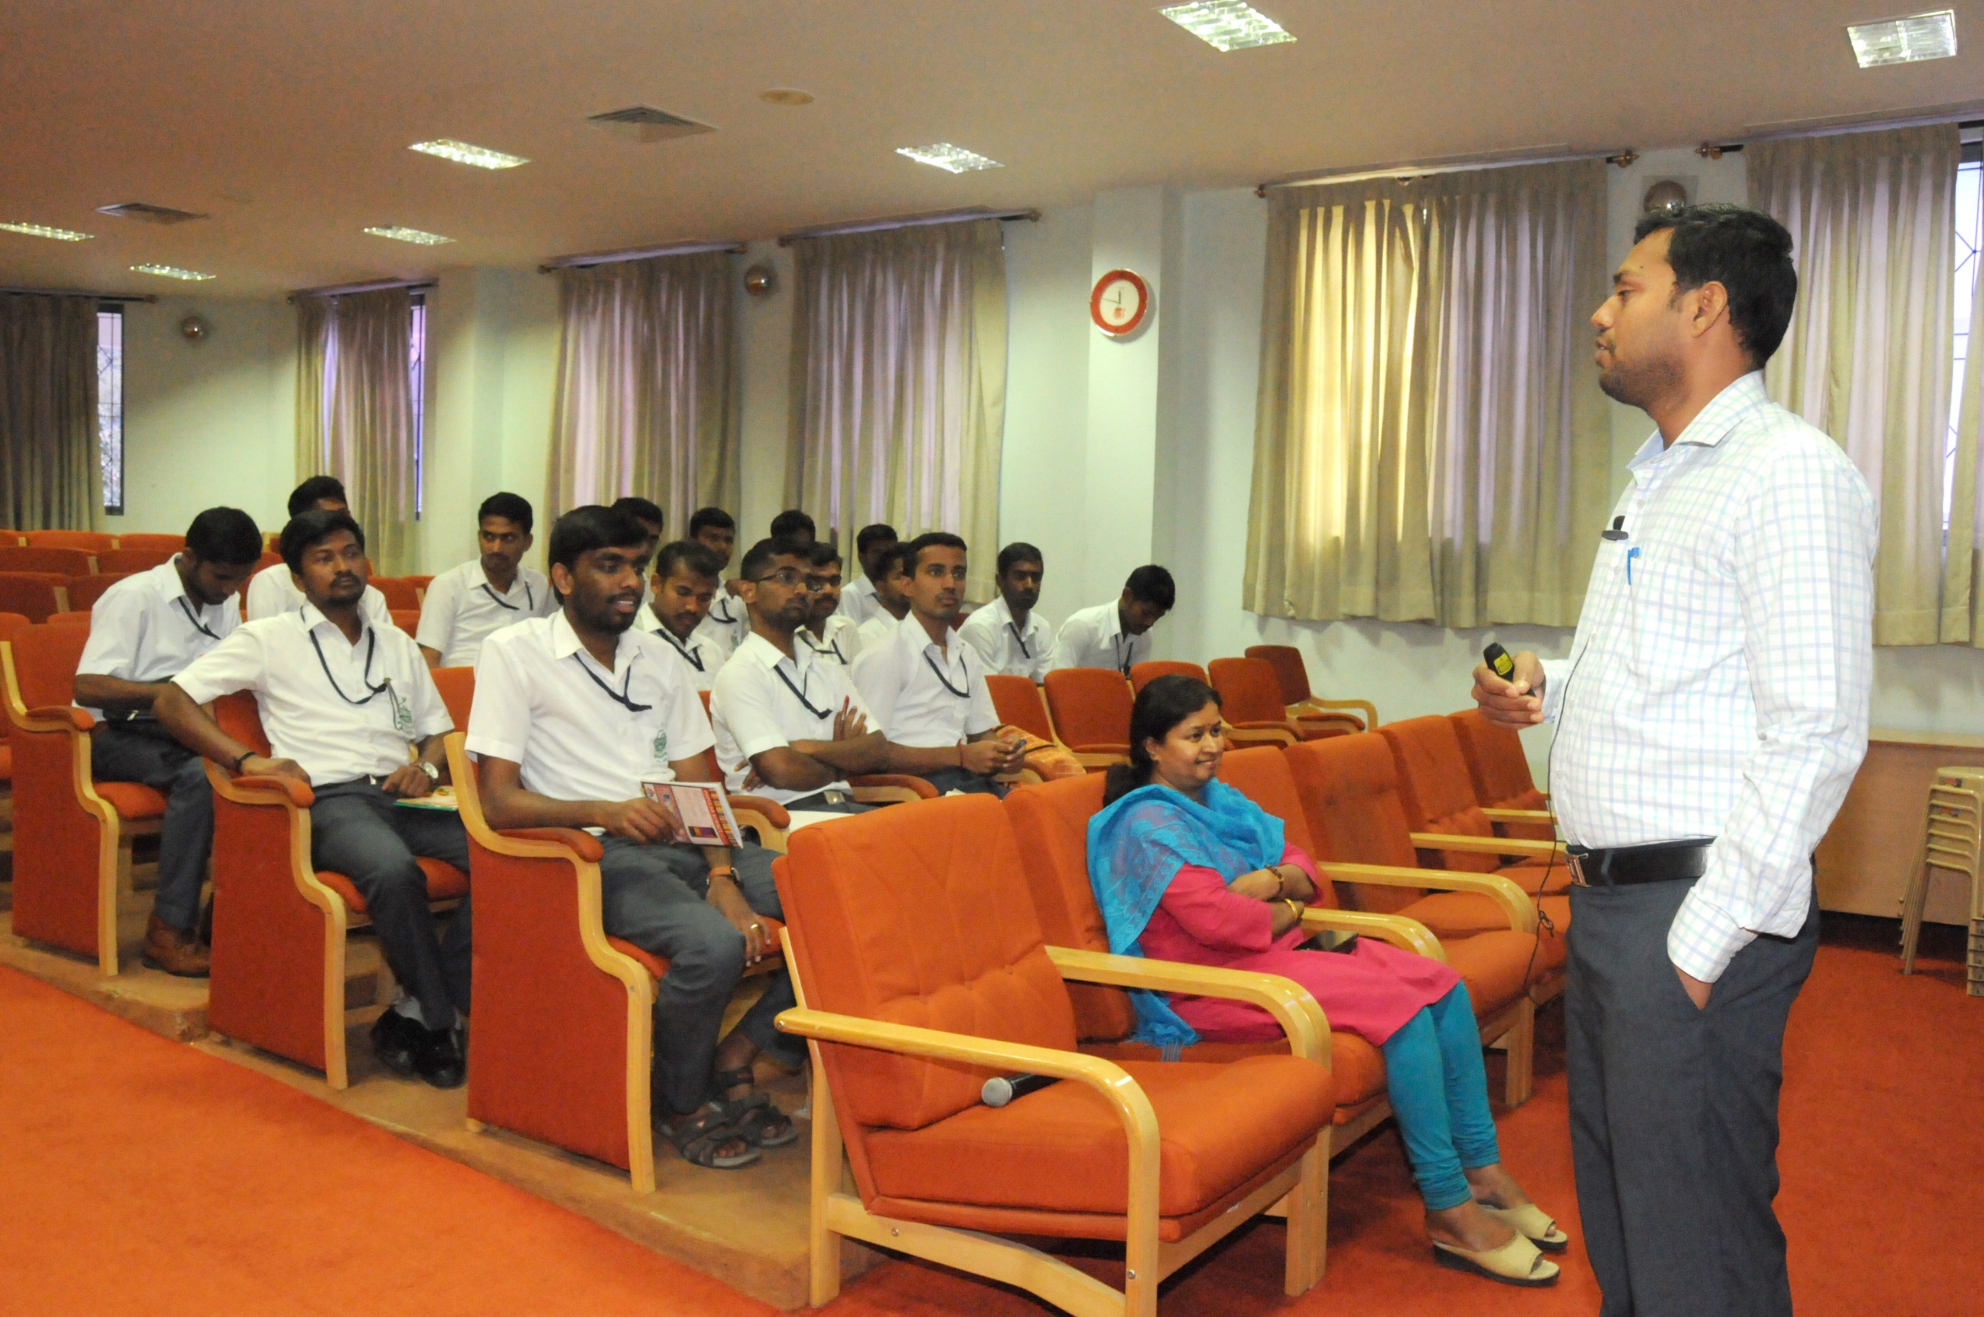
Voice Training for School Teachers -2019

Slide 31
Clinical Activities
OPD Consultation and Supervision
Therapy Supervision
Special Clinics
▶ Voice clinic/PVC
▶ Phonology clinic

Slide 32
 | Diagnostic supervision | Therapy Supervision
2015-16 | 2354 | 1485
2016-17 | 1982 | 1331
2017-18 | 2519 | 1195
2018-19 | 1493 | 1006
2019-20 | 1126 | 1081
Total

Slide 33
Special Clinics
Voice clinic/PVC
Phonology Clinic

Slide 34
Clinical Activities
OPD Consultation and Supervision
Therapy supervision
Special Clinics
PVC/Voice clinic
Phonology Clinic

Slide 35
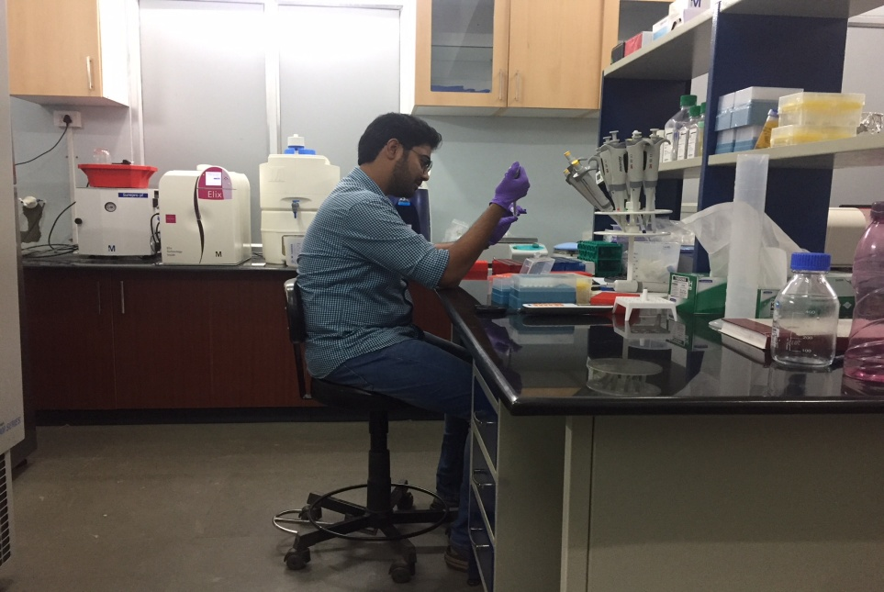
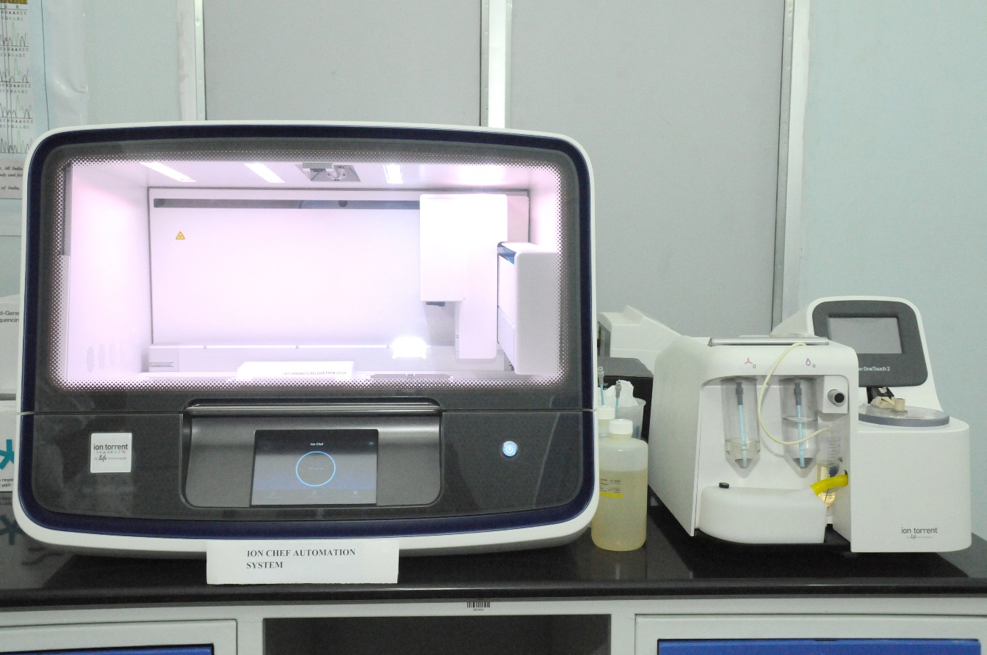
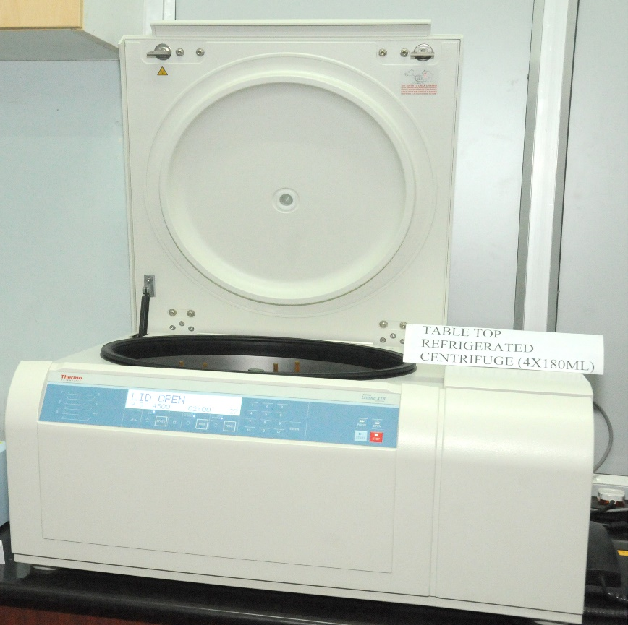
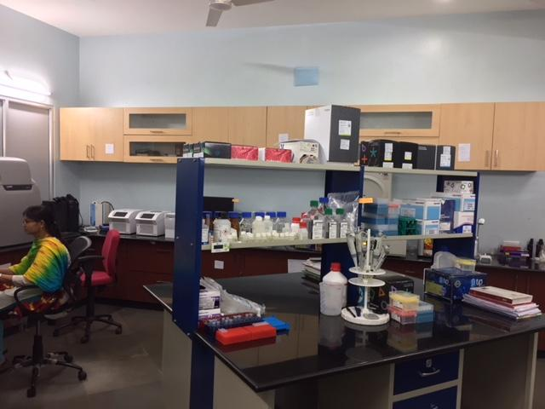
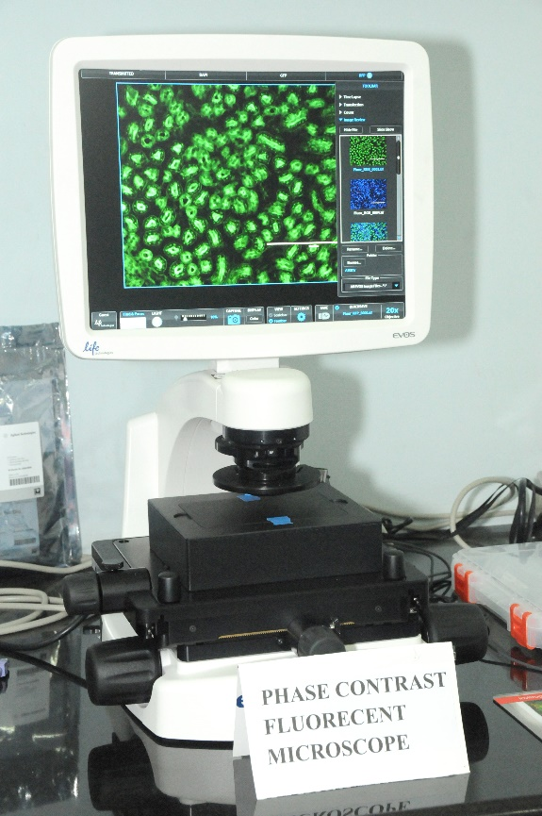
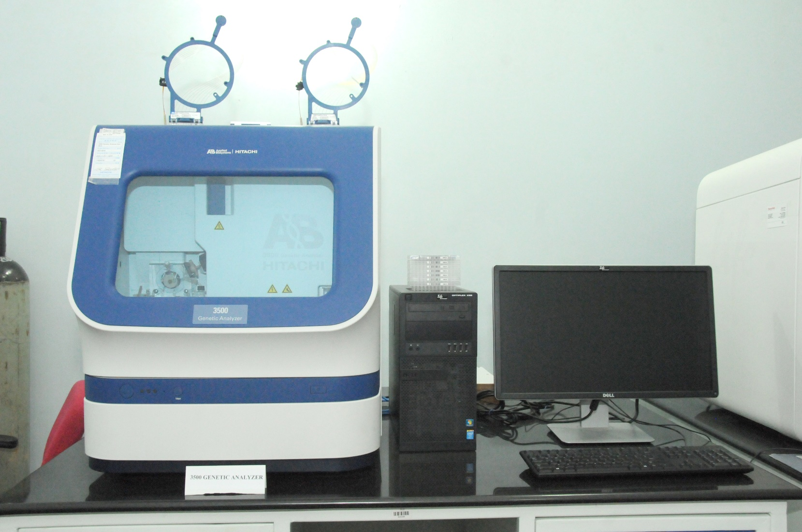
Unit for Human Genetics

Slide 36
Real Time - PCR

Slide 37
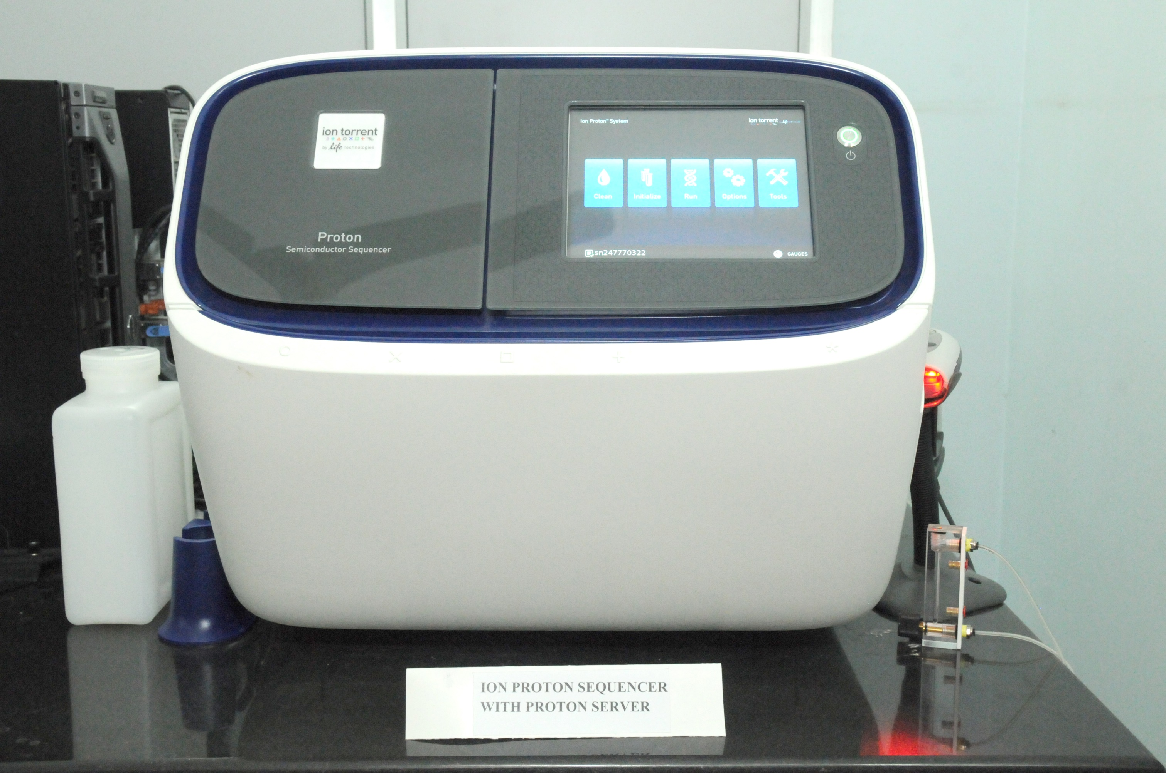
DNA SEQUENCER PCR

Slide 38
PUBLIC EDUCATION
ORIENTATION PROGRAMS
COMMEMORATION DAY
ARTICLES
FACEBOOK VIDEO
PHONE-IN-PROGRAMS
AIR PROGRAMS (FM)
YOUTUBE VIDEO
TELEVISION TALKS

Slide 40
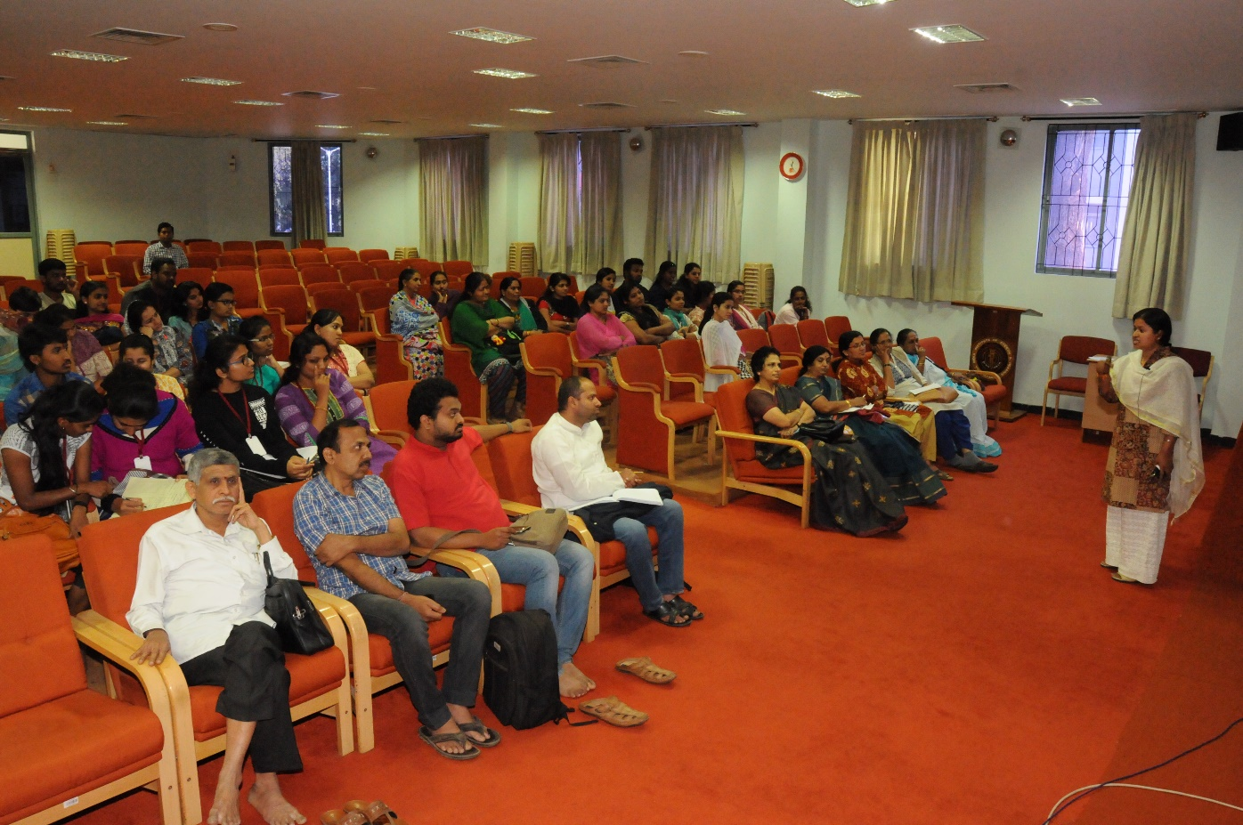
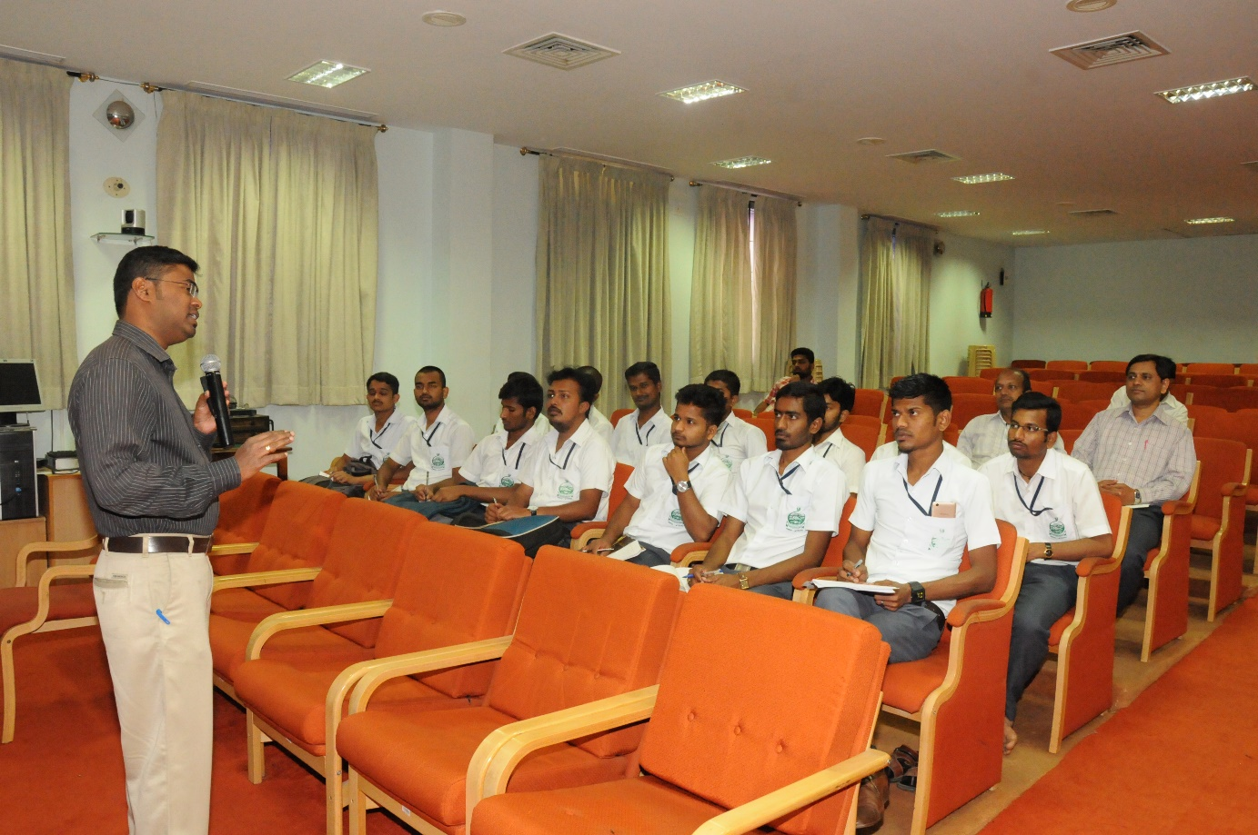
Orientation programs-Voice

Slide 41
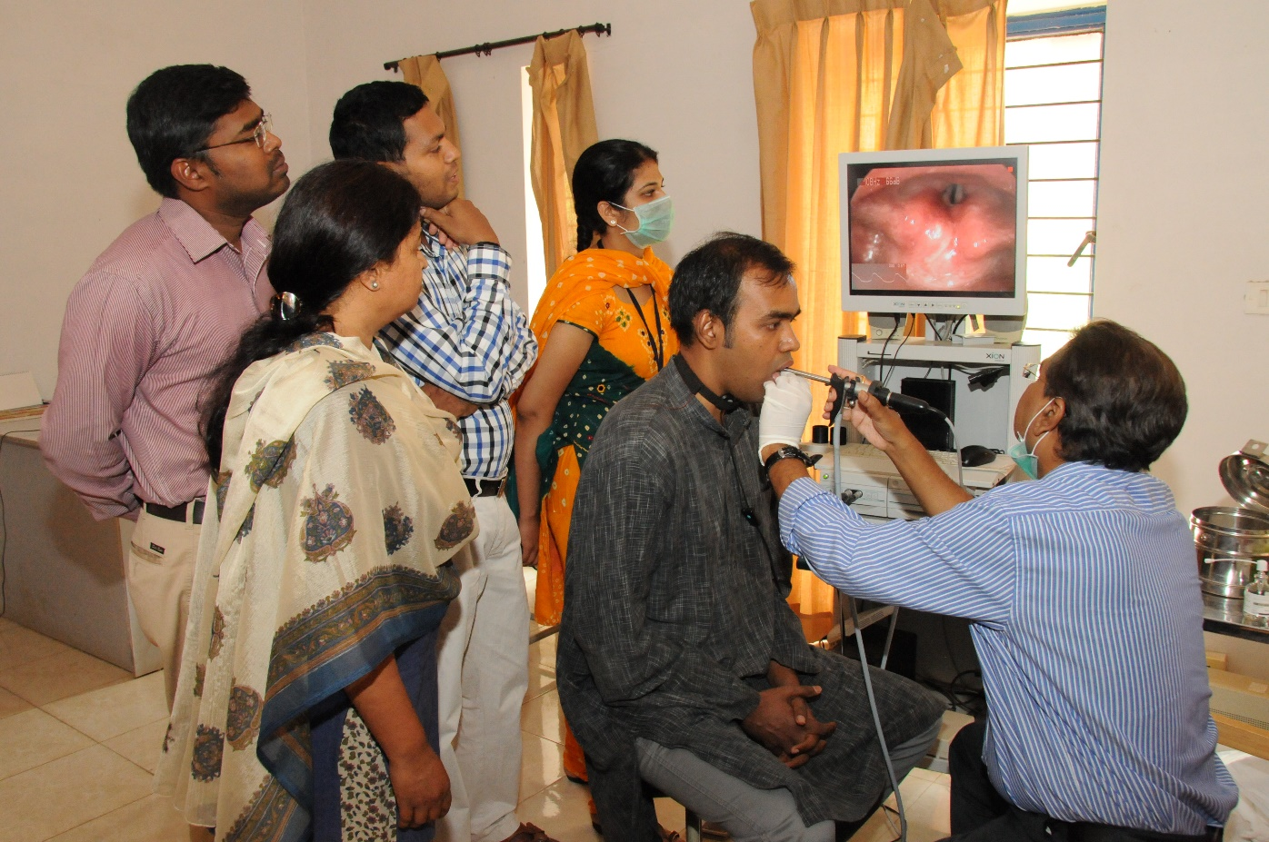
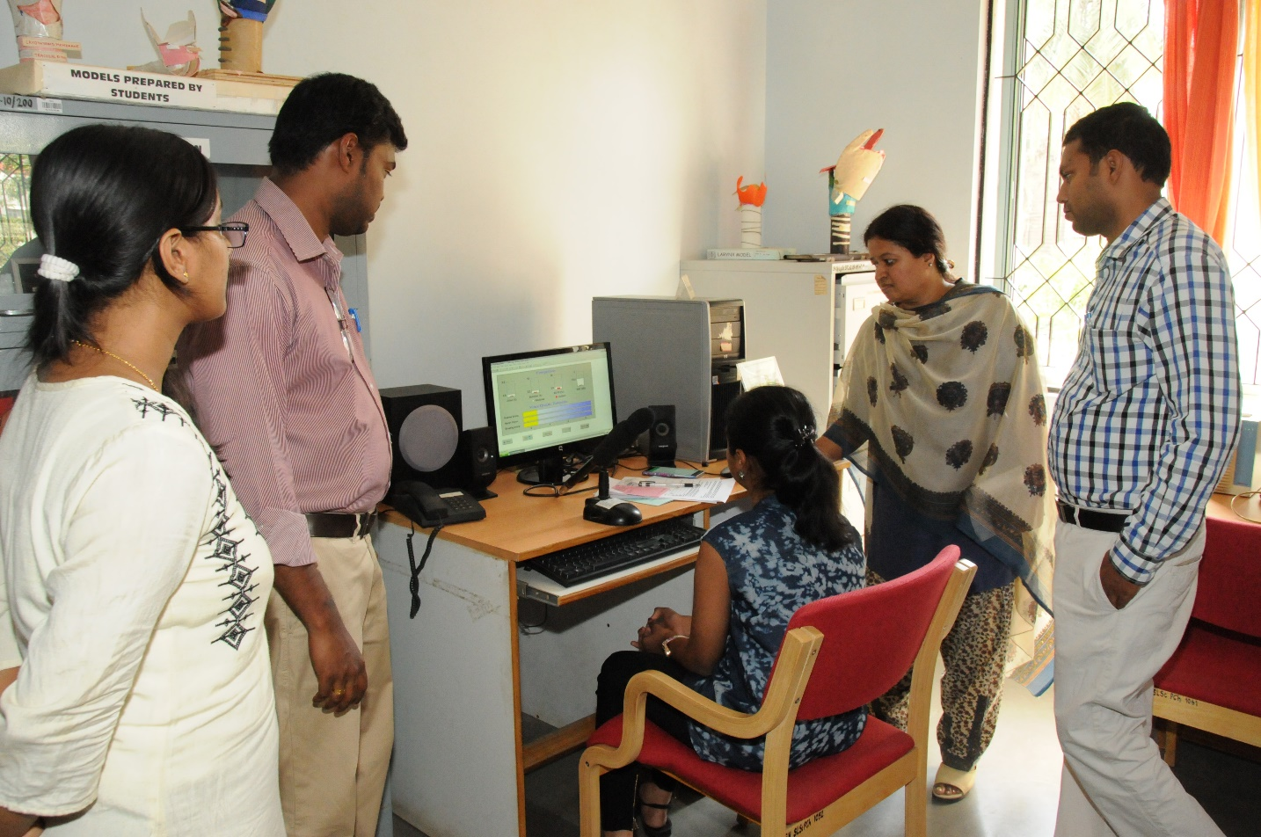
World Voice day Free Voice Checkup for Public

Slide 42
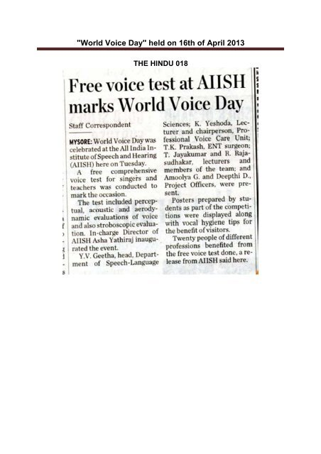
Voice Conservation- 02
NEWSPAPER ARTICLES

Slide 43
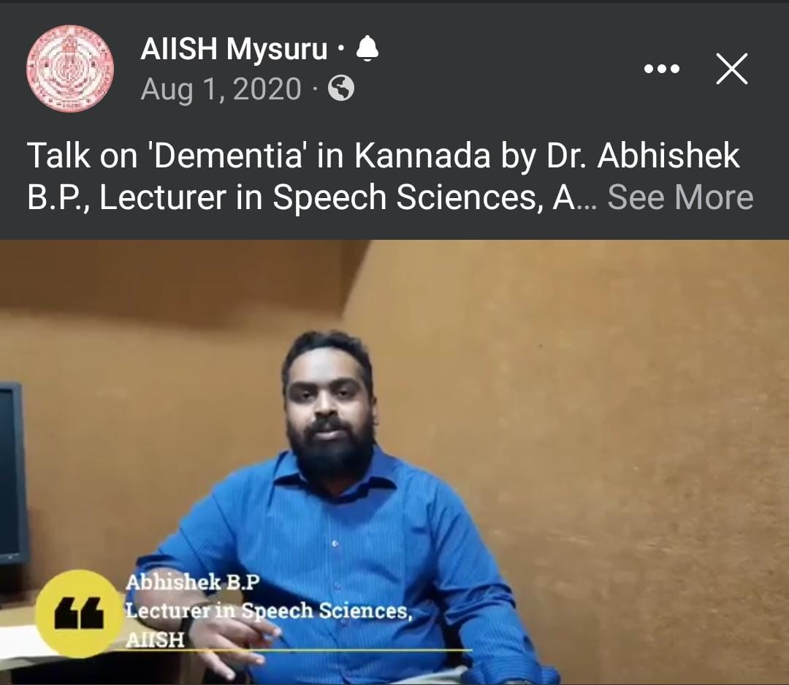
Voice conservation Programs- 01
Communication disorders-02
Speech Sound disorders- 02

Slide 44
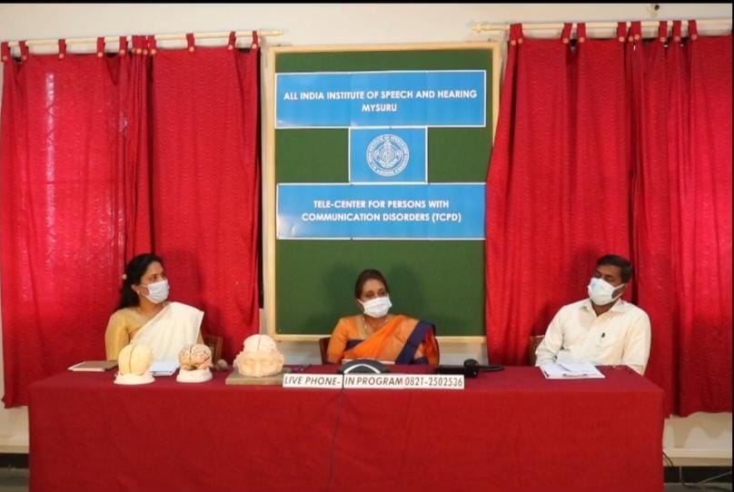
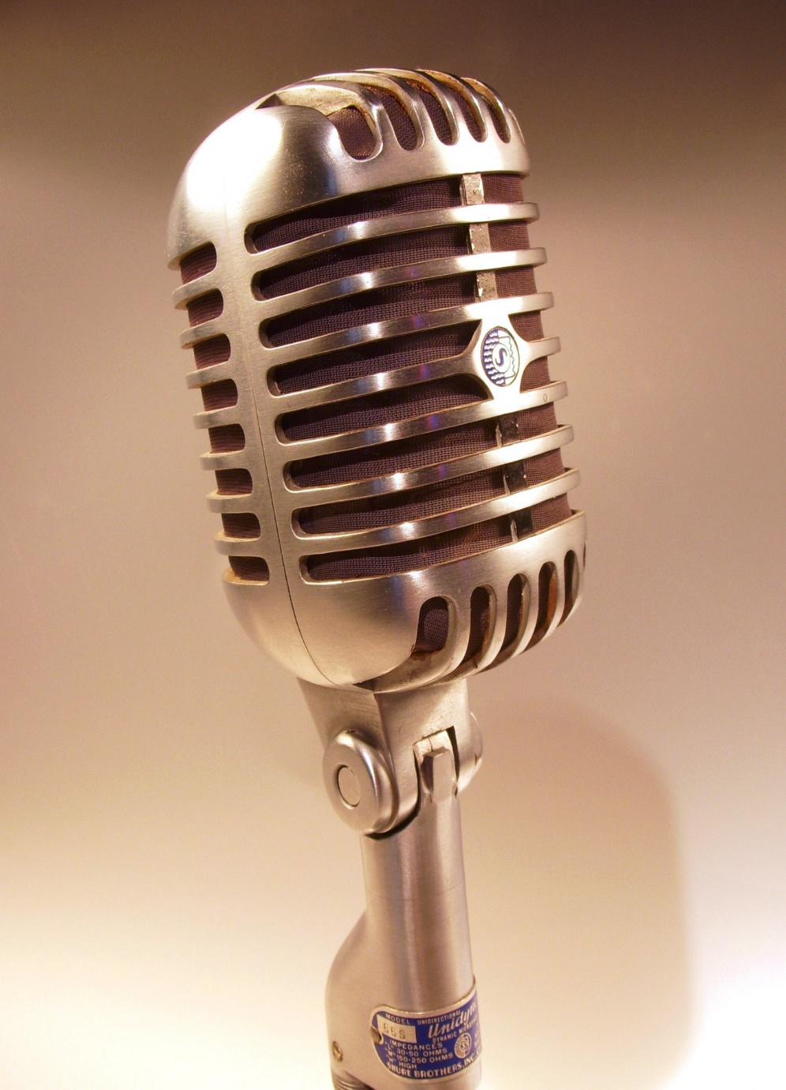
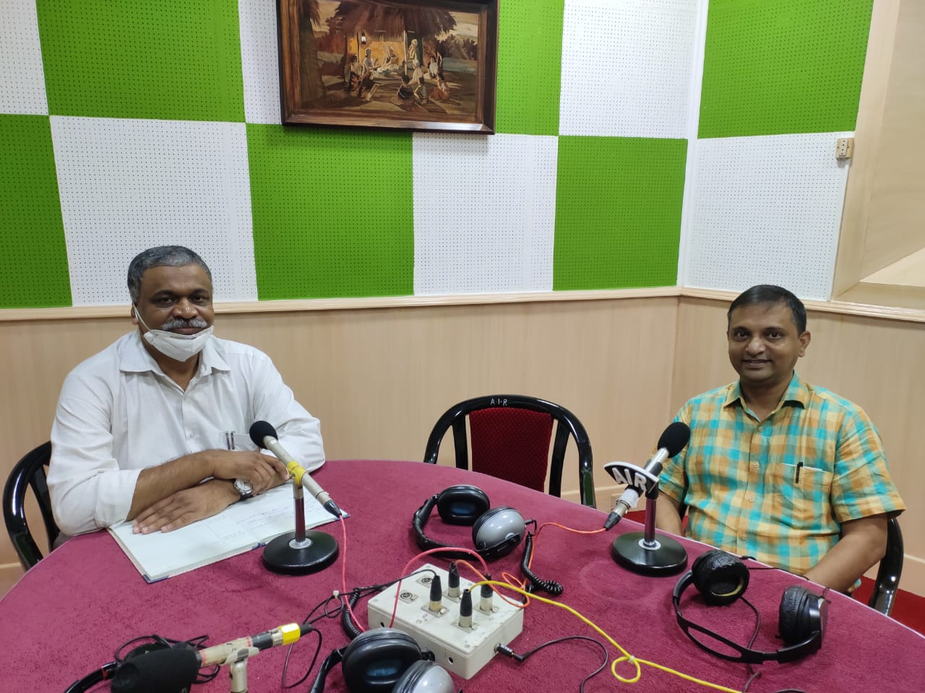
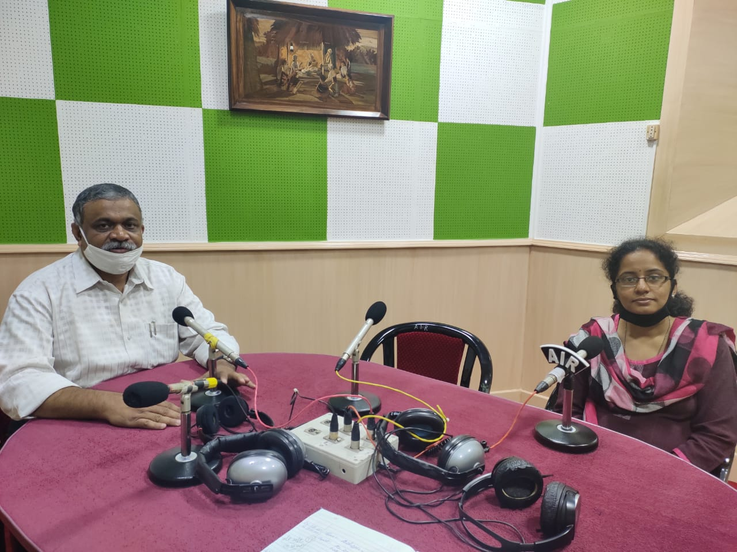
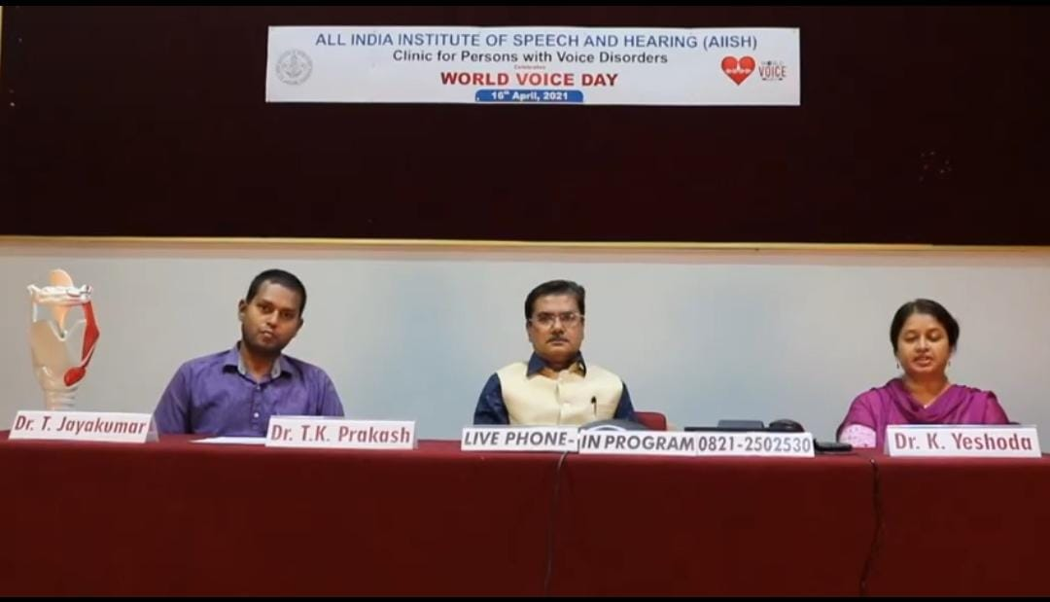
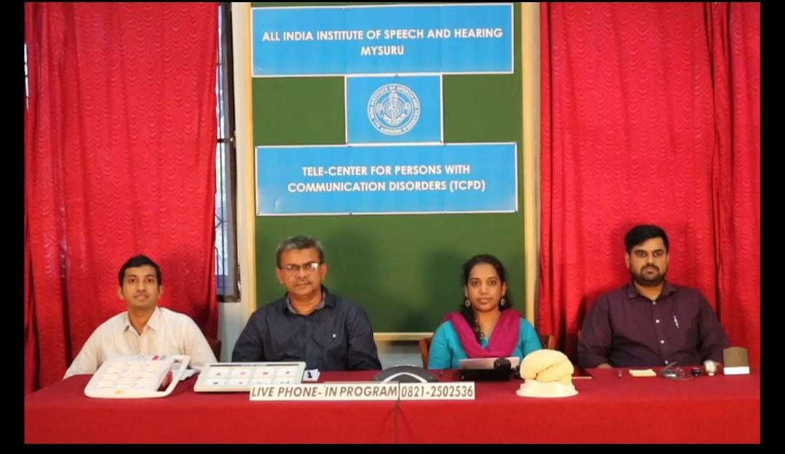
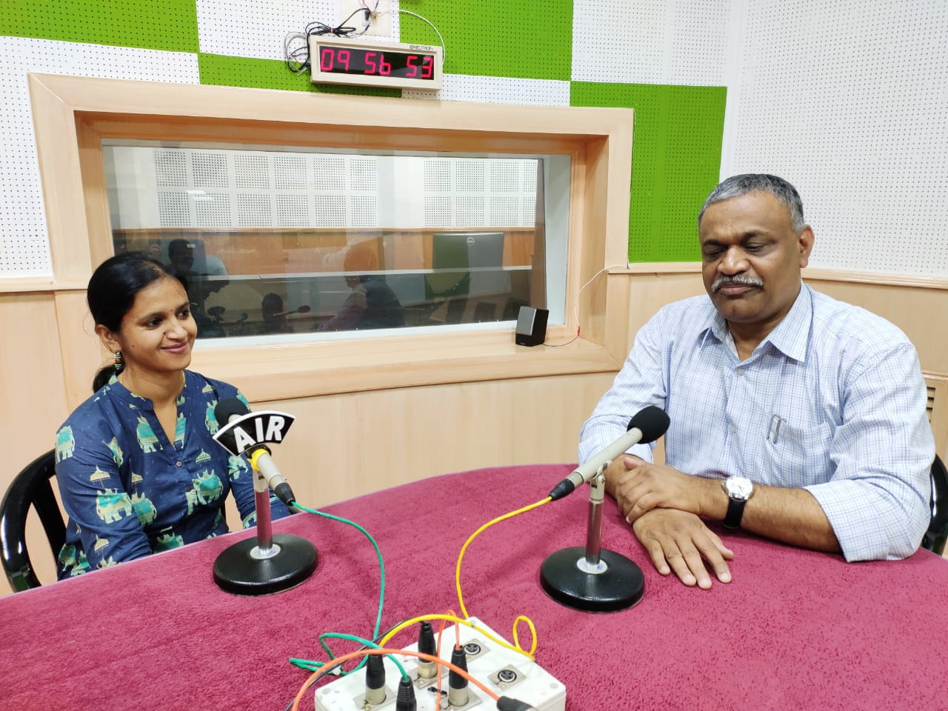
Phone-in-programs and AIR programs
Voice- 01
Speech Sound disorder- 02
Fluency disorder- 01
Communication disorder- 03

Slide 45
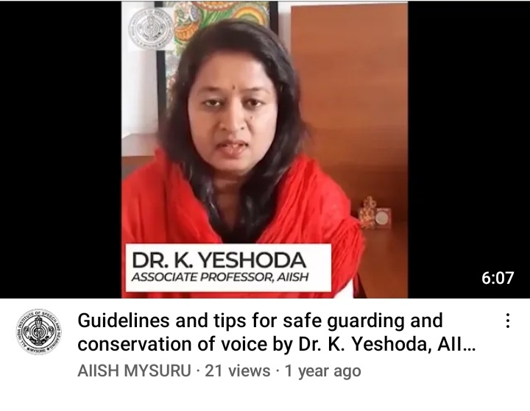
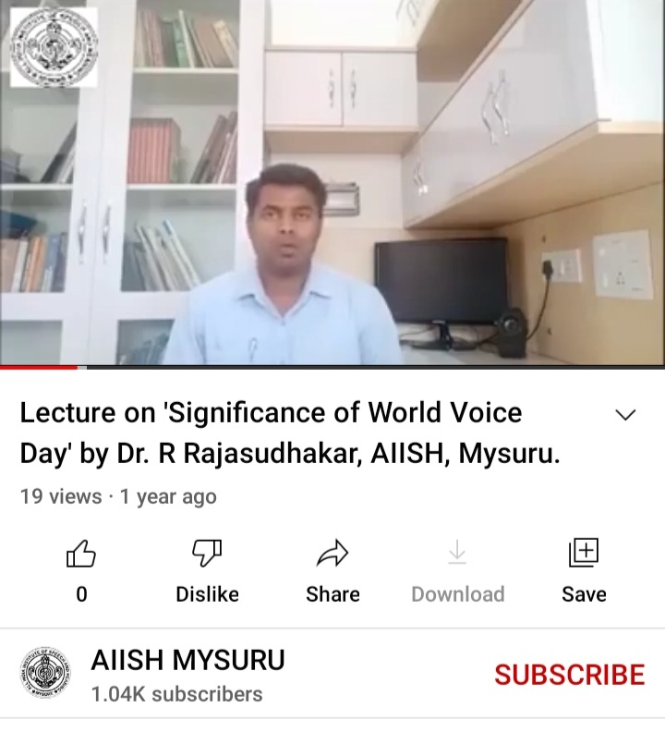
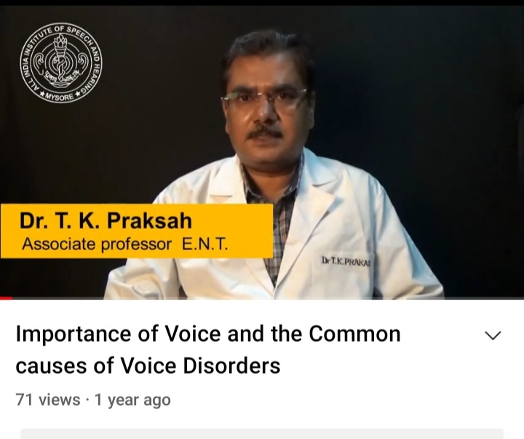
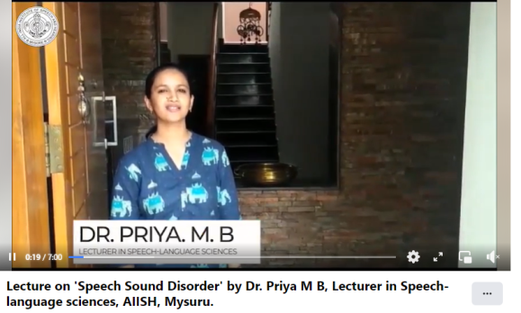
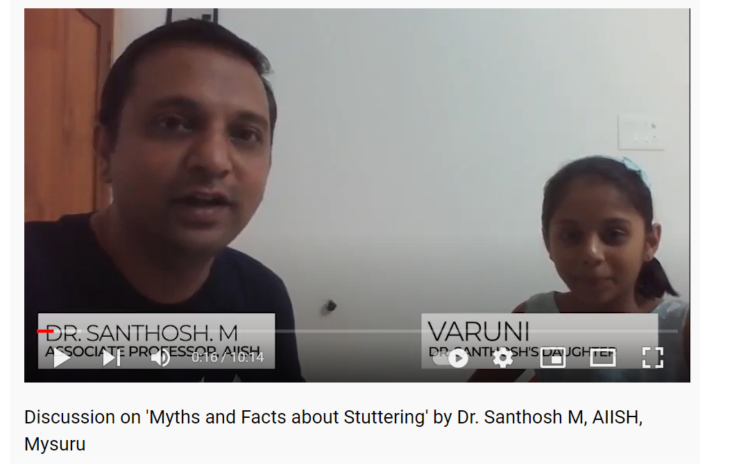
Voice conservation Programs- 03
Fluency disorders-01
Speech Sound disorders- 01

Slide 46
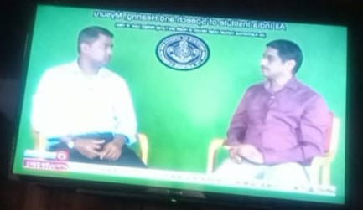
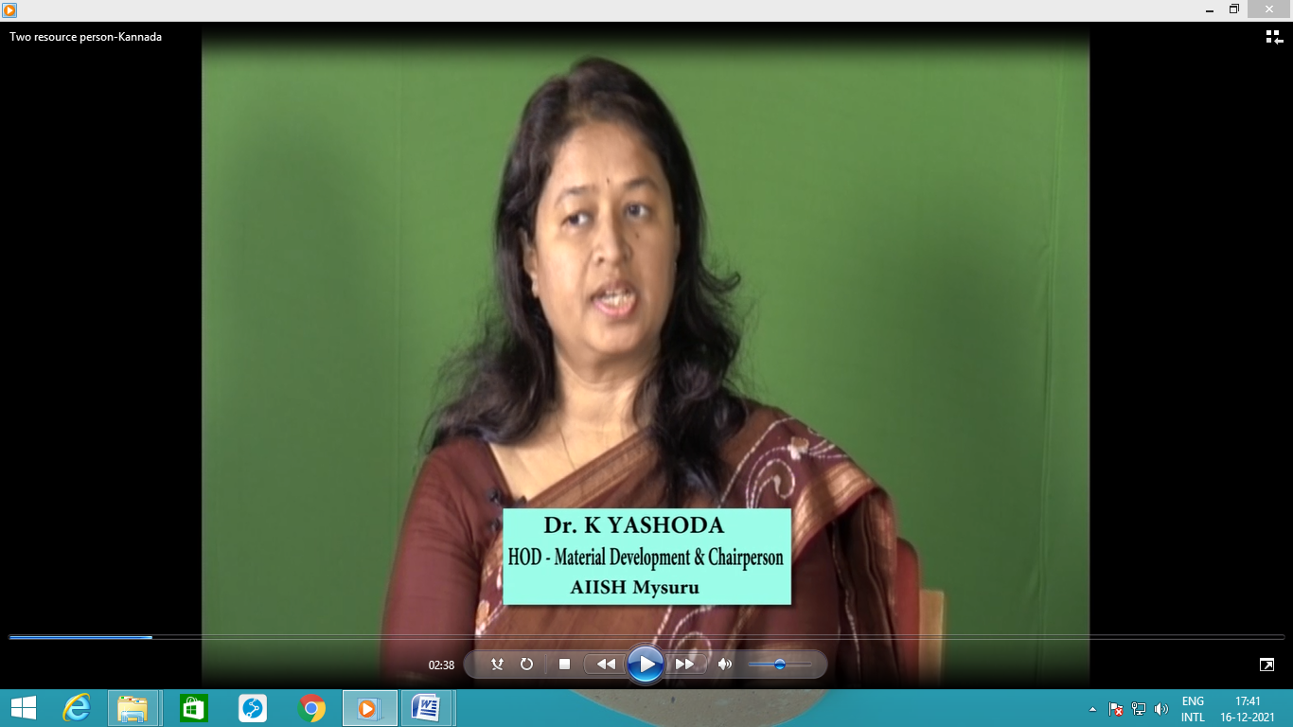
DD Chandana/ Podhigai talks
Voice- 01 ( Kannada)
Language disorder- 01 ( Tamil)
Communication disorder- 01 ( Malyalum)

