Slide 1
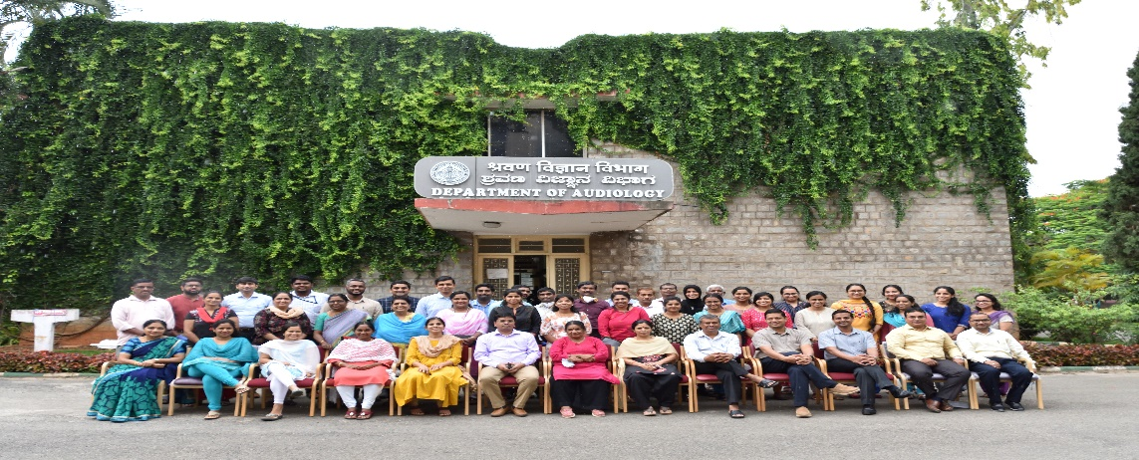
20.12.2021
WELCOME
DEPARTMENT OF AUDIOLOGY
Presenter
Dr. Prawin Kumar
HOD-Audiology
NAAC TEAM

Slide 2
Resources and Infrastructure
Core members | Strength | Support
Professors Associate professors Readers Assistant professors | 04 05 02 03 | Teaching Faculty
Scientists | 01 | Research
Audiologists Grade I Clinical supervisor Audiologist Grade II | 02 01 02 | Clinical Staff
Audiologist and SLP Grade II | 07 | Clinical Staff
Technical staff | 06 | Supporting Staff
Junior Research Fellow | 12 | PhD Scholars
Research Officers | 07 | Research
Total : 52

Slide 3
OBJECTIVES
Human Resource Development
Research
Clinical Services
Public Education

Slide 4
Activities
Academic training
Professional Training Programs
JC/CC Guidance
Student Practical Training
Administrative Activities
Human Resource Development

Slide 5
ACADEMIC TRAINING (Year 2015-16 TO 2019-20)

Slide 6
STUDENT AND PROFESSIONALS TRAINING

Slide 7
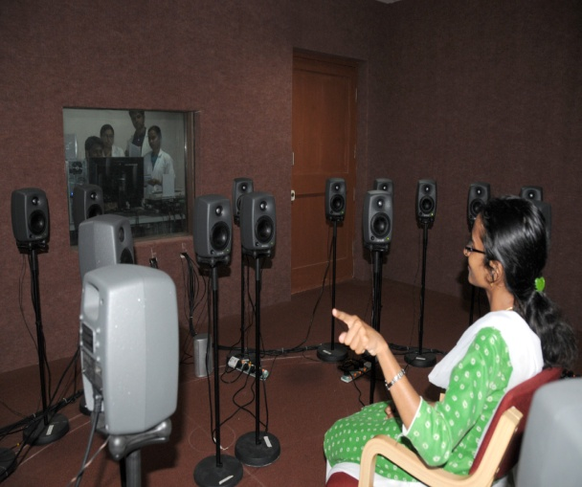
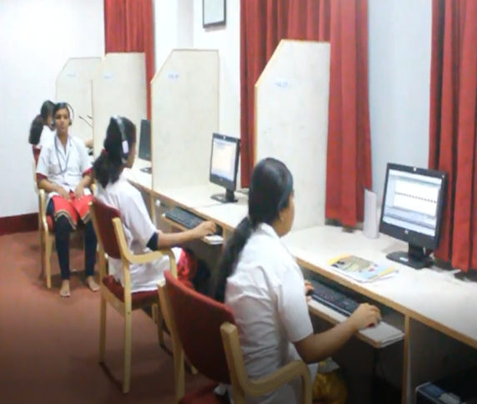
STUDENT PRACTICAL TRAINING
Primary Objective:
Practical training to UG & PG students.
Psycho-acoustical experiment.
Train to operate basic and advanced software modules for sound generation, editing and presentation.
Secondary Objective:
Basic and applied research in Psycho-acoustics.
1. Psycho-acoustic Lab (PAL)
Objective
UG , & PG training
Localization Unit
Work Stations (22)

Slide 8
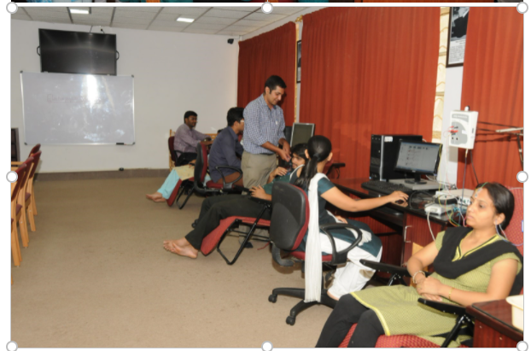
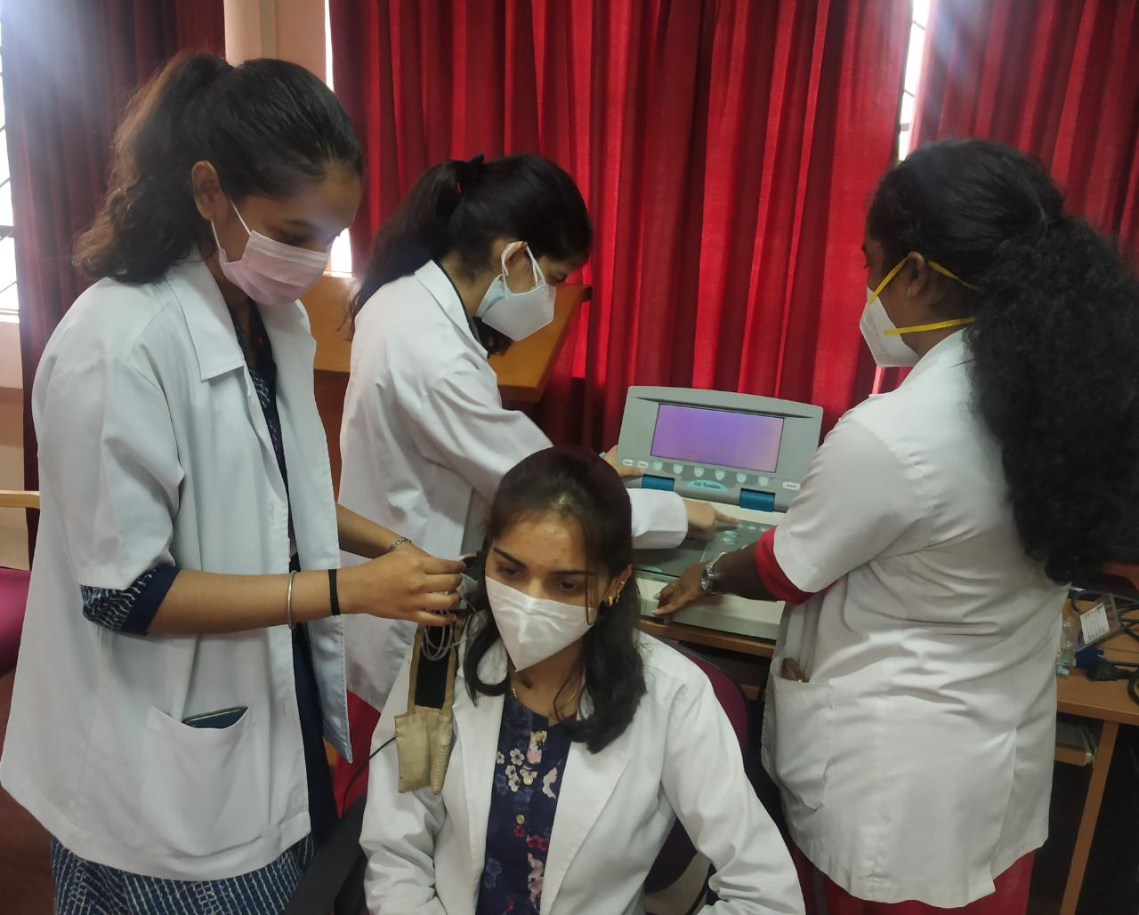
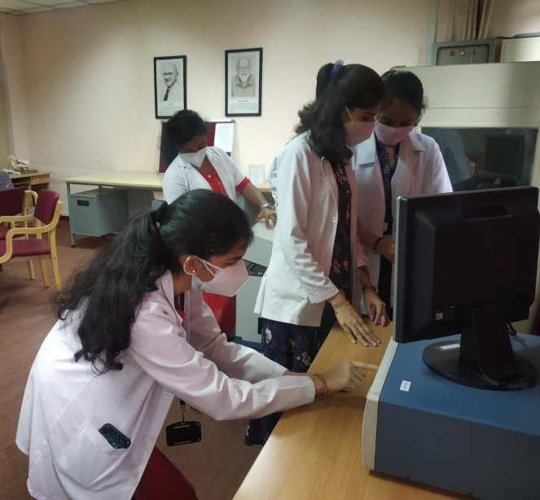
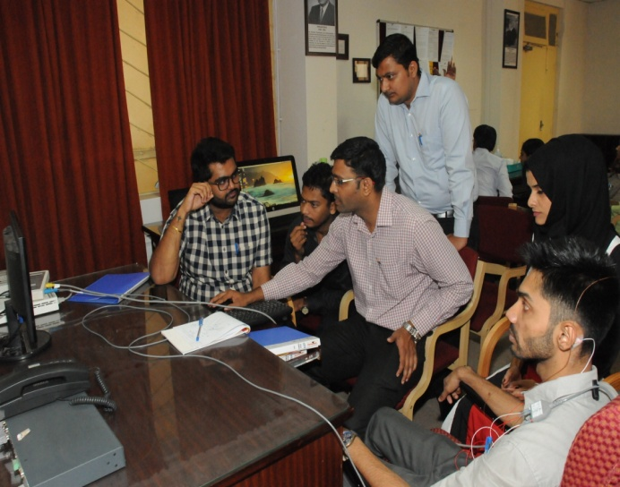
Primary Objective: Practical Hands-on training to UG, PG & PhD students; Electrophysiology based experiment. Train to operate basic and advanced AEP equipment's to record, analyze and interpret the AEP waveforms.
Secondary Objective: Basic and applied research in Electro-physiology.
2. Electrophysiology (EP) Lab
OUTPUT
UG & PG hands-on training; Dissertations, Scientific Paper & Publications
AEP: ABR, MLR, ASSR
Cortical Potentials
vHIT & VNG
3. PRACTICAL LAB
Objective
UG Practical Classes & In-house workshop
HA Analyzer
Immittance
Audiometer

Slide 9
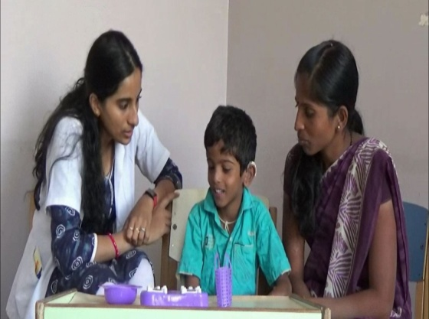
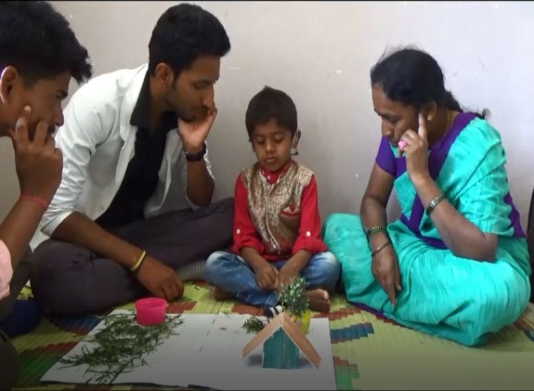
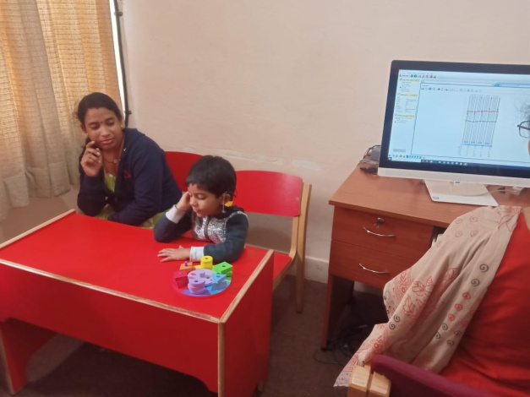
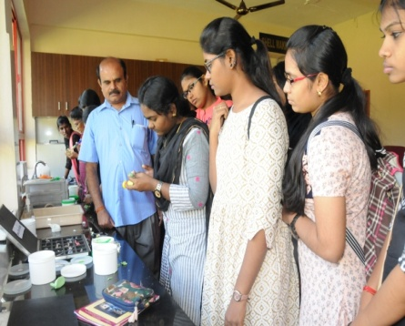
4. Listening Training Unit (LTU)
Objective
Listening training for H/Aid users & CI users
UG & PG Students (Role Play)
Listening Training
AVT, APD Training
& TRT
5. Implantable Hearing Device Unit (IHDU)
Objective
CI mapping; BAHA, trouble shooting
UG & PG Observation
IHD Hardware & Software
6. Prosthetic (EM) Lab
Objective
Hard & Soft Moulds
DHAET, DHLS, & UG Hands-on training
Ear Mould Equipments

Slide 10
Professionals Training
Guest lectures/ invited talks within & Outside AIISH
Number of talks

Slide 11
ADMINISTRATIVE ACTIVITIES
 | 2015-16 | 2016-17 | 2017-18 | 2018-2019 | 2019-20
Director |  |  | ✓
Director (I/C) |  | ✓ | ✓ | ✓ | ✓
Academic Co-ordinator | ✓ |  | ✓ |  | ✓
POCD –HOD | ✓ |  |  |  | ✓(I/c)
Hostel Warden: (Boys & Girls) | ✓ ✓ |  | ✓ | ✓ | ✓
Assistant warden |  | ✓ |  | ✓ | ✓
Nodal officers |  |  |  |  | ✓
Guest house (I/C) | ✓
CBCS coordinator | ✓ | ✓ | ✓ | ✓ | ✓
NSS Officer | ✓ (I/C) | ✓ | ✓ | ✓ | ✓
JC/CC Co-ordinator | ✓ | ✓ |  |  | ✓
Vigilance Officer: |  |  |  |  | ✓
1st Appellate Authority |  | ✓ | ✓ |  | ✓
RTI Cell (CPIO) |  |  |  |  | ✓
Hostel Committee: (Chairperson) |  |  |  |  | ✓
Internship Cell: |  |  |  |  | ✓
Canteen Committee: 01 (Chairperson) |  |  |  |  | ✓
DPE-Member Secretary |  |  |  |  | ✓
Gymkhana- President/Vice President /Joint secretary /EC -Member |  | ✓ | ✓ |  | ✓
NAAC committee coordinator |  | ✓ | ✓ |  | ✓
NPPCD coordinator |  | ✓ |  |  | ✓
Coordination section |  |  | ✓ |  | ✓
Anti-ragging squad –Chairperson |  |  |  | ✓
My ISHA general secretary |  |  |  | ✓
OLIC member |  |  |  |  | ✓
Swatcha Bharath chairperson |  |  |  |  | ✓
Social media committee |  |  |  |  | ✓

Slide 12
Research
Activities
Student
research
Projects
Publications
Presentations
Reviewers& Editorial members
Research Reviewers

Slide 13
STUDENTS RESEARCH: DISSERTATIONS & PhD

Slide 14
SCINETIFIC PAPER PRESENTATIONS
(UG, PG, PhD & Staff)

Slide 15
SCIENTIFIC PAPER PUBLICATIONS
(UG, PG, PhD & STAFF)
Total in last 5 years
International:165
National:24
In-House (DBA):144

Slide 16
EXTRAMEURAL & INTRAMEURAL PROJECTS

Slide 17
AWARDS & HONOURS RECEIVED

Slide 18
Reviewers (Teaching and Clinical Staff) in various journals
American Journal of Audiology
Audiology & Neuro-otology
Archives of Acoustics
Biological Psychology
British Medical Language & Hearing
Disability & Rehabilitation Journal
Europ Arch of Otolaryngol
Int Arch of Otolaryngol
Int Jour of Otolaryng
International Journal of Audiology
Journal of Audiology and Otology
Journal of Otology
Journal of Clin Endocrin & Metabol
JISHA
JAIISH
JASA
Noise and Health
Scientific Reports

Slide 19
Activities
OPD
Hearing Evaluation
HDDU
IHDU
Ear Mould
Disability Certificate
Hearing Aid Trial
LTU
Audiology Clinical Services

Slide 20
Audiology Clinical Services
Clinical Services

Slide 21
AUDIOLOGY CLINICAL SERVICES
Revenue generated through HDDU (in Lakhs)

Slide 23
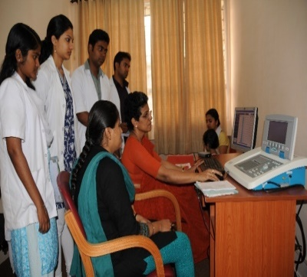
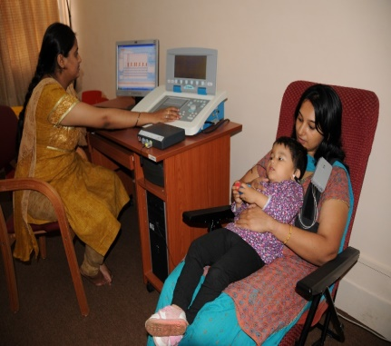
Implantable Hearing Device Unit (IHDU)
REVENUE GENERATED (Rs)

Slide 24
LISTENING TRAINING UNIT
(HEARING AID & CI USERS; OTHERS)

Slide 25
OVERALL NUMBER OF PATIENTS RENDERED
AUDIOLOGY CLINICAL SERVICES(2015-2020)

Slide 26
Client Feedback (%) for Clinical Services

Slide 27
PUBLIC EDUCATION

Slide 28
PUBLIC EDUCATION
Speech and Hearing awareness week: ‘e-quiz bee’ and ‘pick and speak’
World Hearing Day
Camps and Orientation programs for School children and Teachers
AIISH AISIRI Radio Programs
WORK FROM HOME
Video of various aspects of Hearing and its disorders
Videos are uploaded in AIISH official FB page
Resource Persons for Public Lecture Series
Speech and Hearing Fortnight – Various activities
Development of various PEPs regarding hearing and related disorders
Live Phone in Programs
Live Phone in program: 4 teaching staff
AIISH Aisiri Radio Programs: 6 Teaching Staff
Monthly Public Lecture Series: 2 Staff
Public Education Pamphlets prepared by Faculty and Clinical Staff: 8
Public Education Videos prepared by Faculty and Clinical Staff: 27

Slide 29
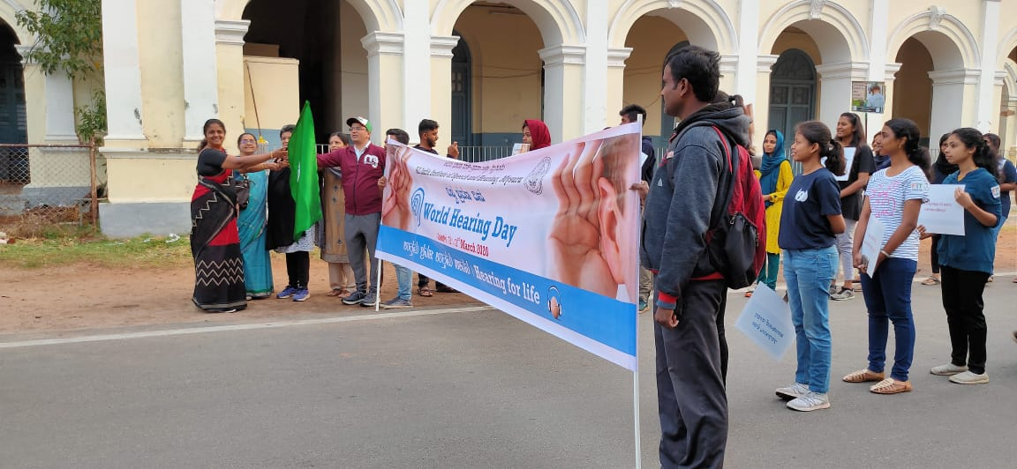
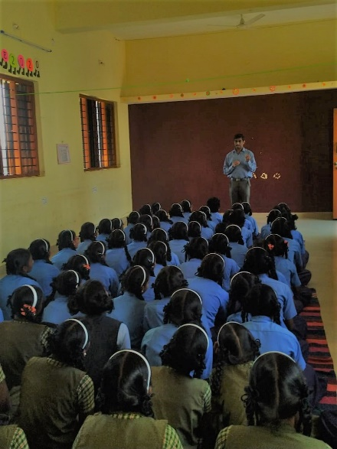
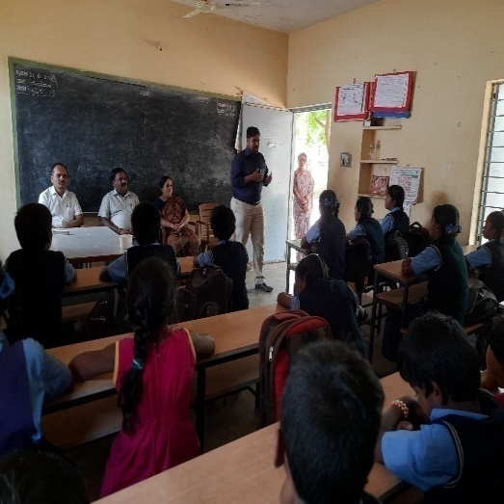
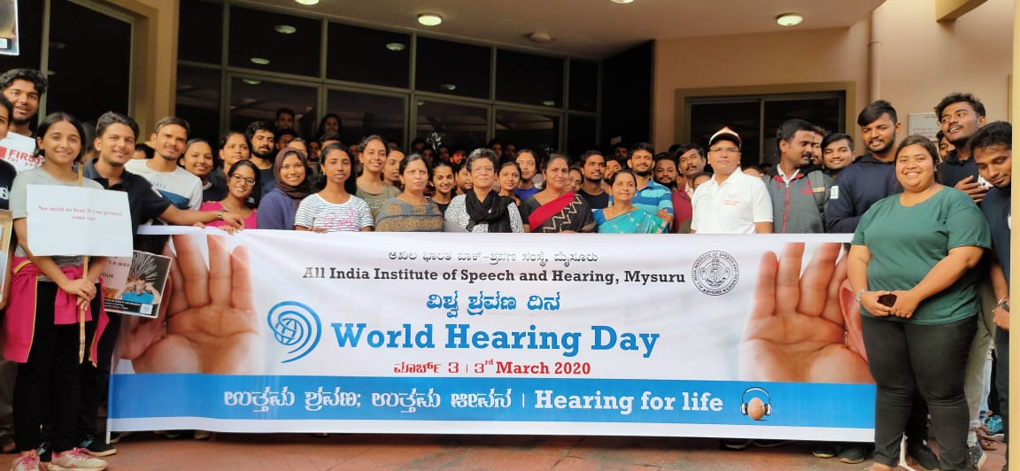
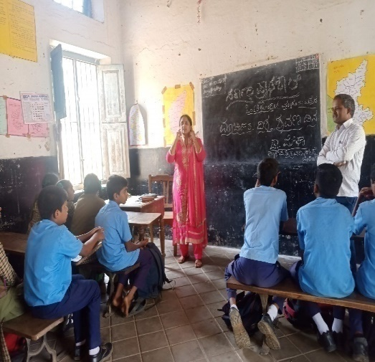
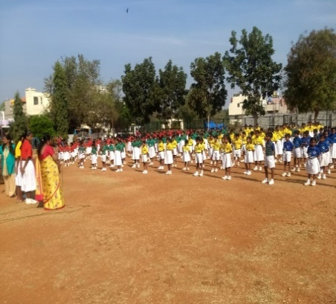
WORLD HEARING DAY 2020
Walkathon on 3rd March 2020
Orientations to School Children and teachers – Total 18 schools by 14 Staff including Faculty and Clinical Staff

Slide 30
SELF STUDY
STRENGTH
WEAKNESS
OPPORTUNITIES
THREATS

Slide 31
SWOT ANALYSIS
STRENGTH
One of the Core Department
Maximum number of Human Resources
Both experienced as well as young, dynamic teaching and clinical Staff
Specialized teaching and clinical Staff
WEAKNESS
Divided attention AWAY FROM primary responsibilities (Teaching/Clinical/Research)
Abundant Administrative responsibilities
OPPORTUNITIES
Availability of the experienced staff lead to easy handling of matters
World class Infrastructure might help young researchers to learn better.
Writing Books/Chapters
THREAT (CHALLENGES/LIMITATIONS)
No promotional avenue for the clinical Staff
Limited Space to cater the patient load

Slide 32
THANK YOU

