Slide 1
20.12.2021
FINANCE & ACCOUNTS
NAAC TEAM

Slide 2
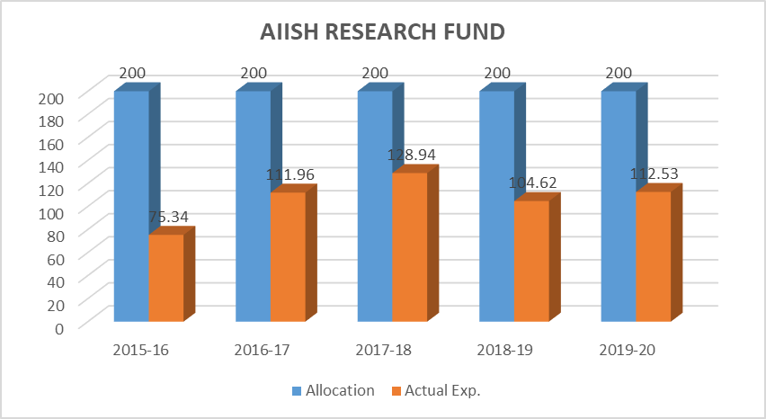

Slide 3
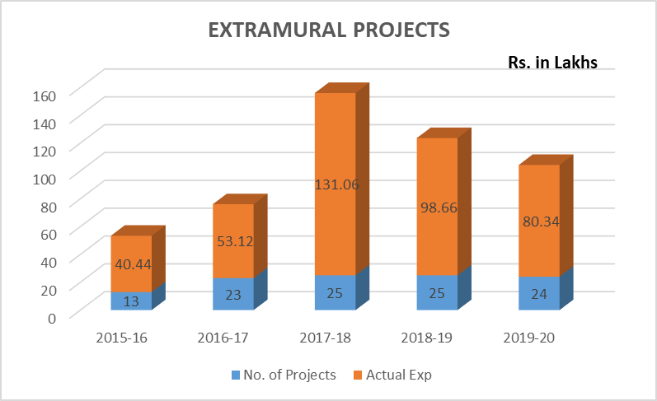

Slide 4
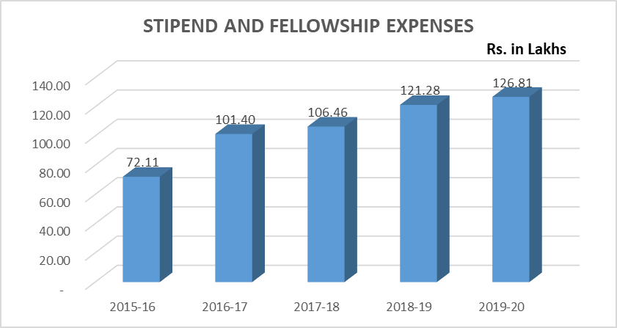

Slide 5
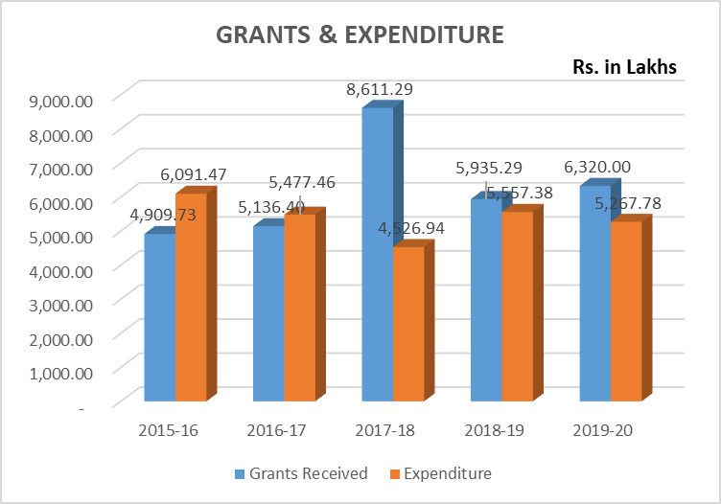

Slide 6
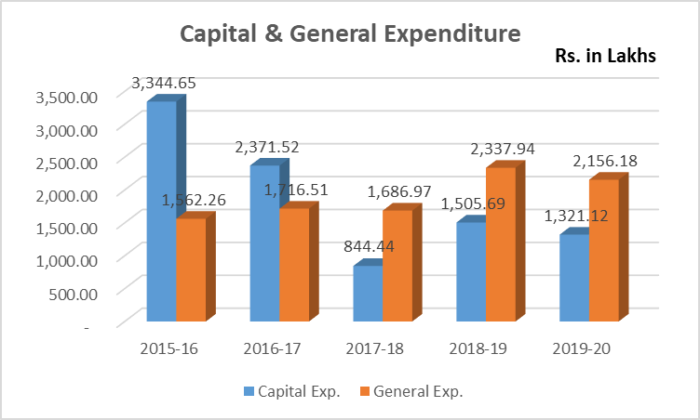

Slide 7
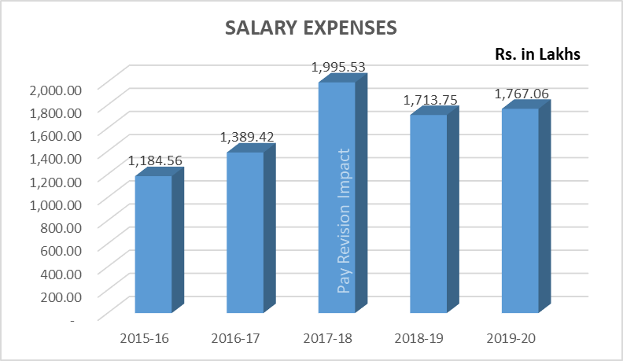

Slide 8
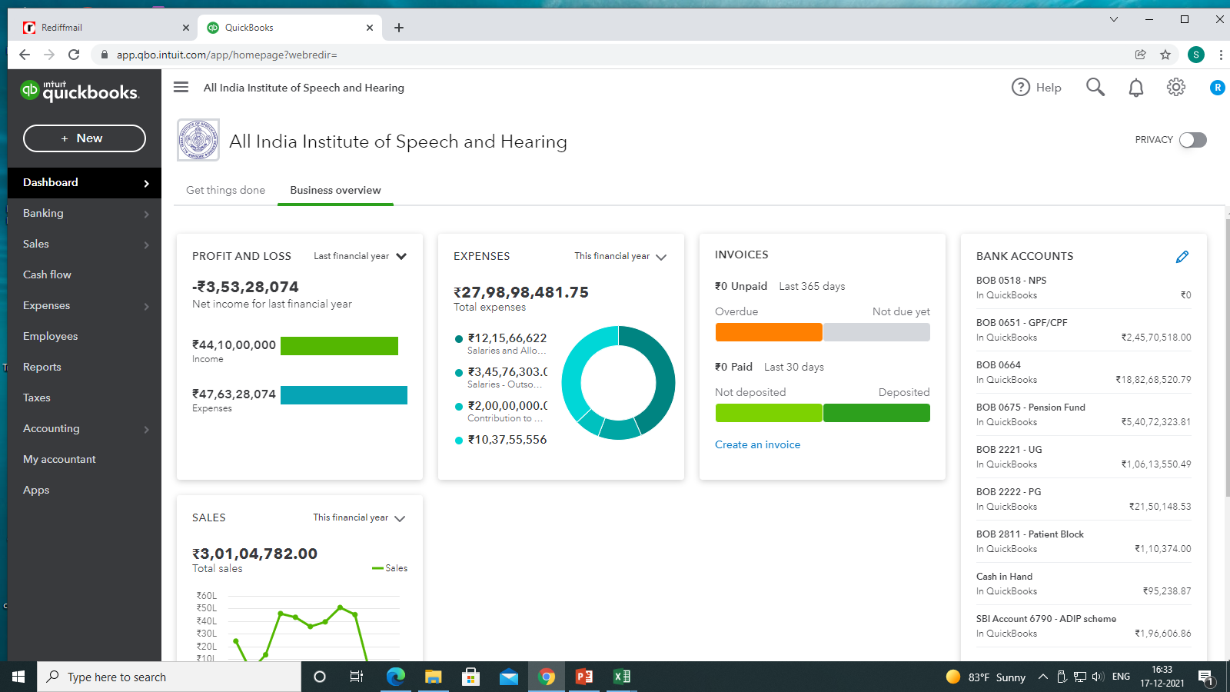
Computerization
Web based accounting software with real time accounting with backward integration of Instant Purchase Orders and forward integration with instant mail alerts on payments to suppliers

Slide 9
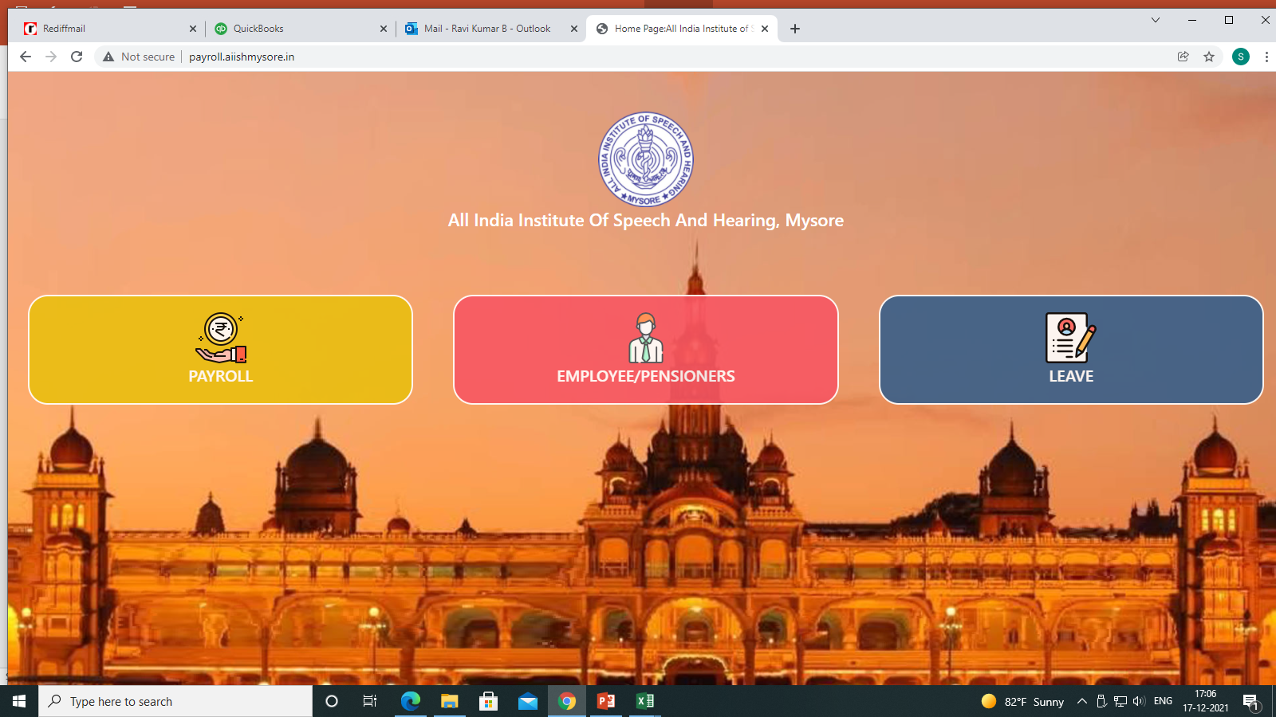
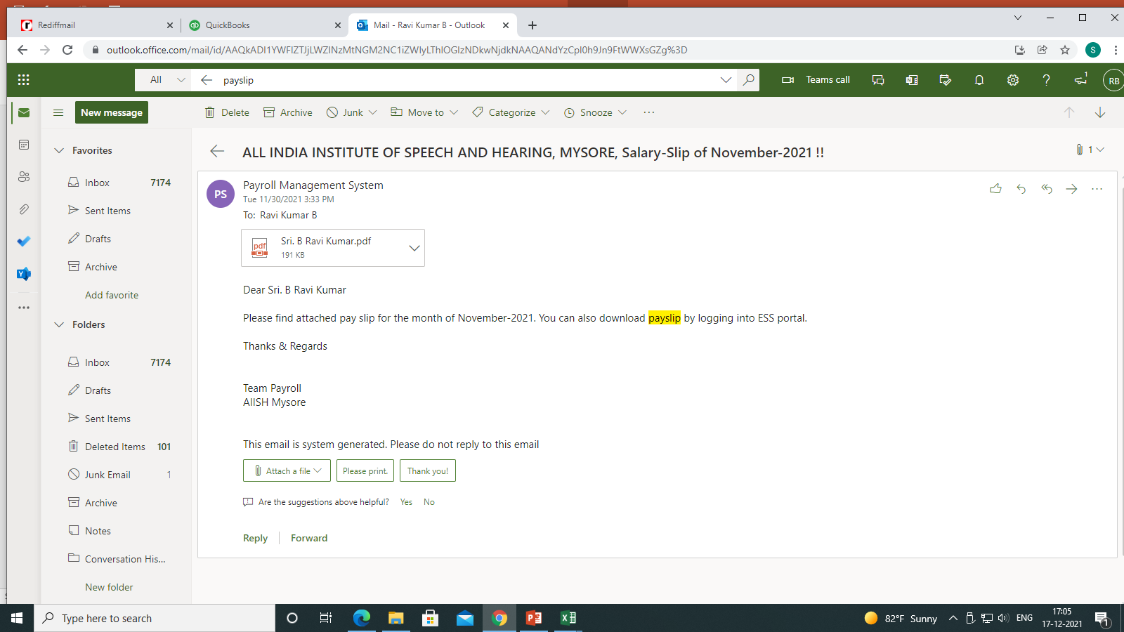
Computerization
Salary software and Leave Management module with Employee Self Service

Slide 10
OBJECTIVES
Human Resource Development
Research
Clinical Services
Public Education

Slide 11
Activities
Academic training
Professional Training Programs
JC/CC Guidance
Student Practical Training
Administrative Activities
Human Resource Development

Slide 12
Academic training details for each activity
Invited Talks
Professional Training Programs
JC/CC Guidance
Student Practical Training
Activities
Human Resource Development

Slide 13
Research
Activities
Student
research
Projects
Publications
Presentations
Reviewers& Editorial members
Research Reviewers

Slide 14
Research
Details of each activity

Slide 15
Human Resource Development
Research
AWARDS & HONORS RECEIVED

Slide 16
Activities
Clinical Services

Slide 17
Human Resource Development
Research
Details of each clinical activity
Clinical Services
Public Education
Public Education

Slide 18
Research Publications
Orientation Programs
Media programs
Public Education

Slide 19
SELF STUDY
STRENGTH
WEAKNESS
OPPORTUNITIES
THREATS

