Slide 1
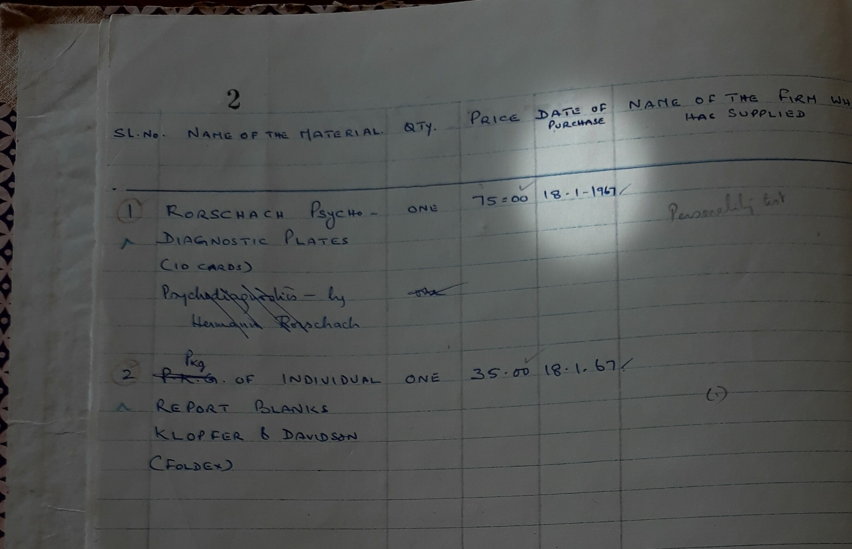
ALL INDIA INSTITUTE OF SPEECH AND HEARING MYSORE DEPARTMENT OF CLINICAL PSYCHOLOGY

Slide 2
DEPARTMENT OF CLINICAL PSYCHOLOGY
Introduction
Objectives
Rationale
Infrastructure
Human Resource Development
Research
Clinical Services
Public Education
SWOT Analysis

Slide 3
DEPARTMENT OF CLINICAL PSYCHOLOGY
Established in the year 1966-67, the department is one of the oldest departments in the institute.
OBJECTIVES
Human Resource Development
Research
Clinical Services
Public Education

Slide 4
DEPARTMENT OF CLINICAL PSYCHOLOGY
SCIENTIFIC RATIONALE
to integrate science, theory, and practice to understand, predict, and alleviate psychological factors related to speech, language and hearing impairment as well as to promote human adjustment, and personal development

Slide 5
DEPARTMENT OF CLINICAL PSYCHOLOGY
Staff
Infrastructure
Mr. Freddy Antony
Assistant Professor
Dr. Sanjeev Kumar Gupta Clinical Psychologist
Dr. Kalyan Kumar
Clinical Assistant
Mr. H.H. Raju
Clinical Assistant
Dr. P. Purusotham
Research Assistant
Dr. Yashodhara Kumar G.Y. Clinical Psychologist Grade II
Ms. Lissiue Maria
Clinical Psychologist
Ms. Simran Soni
Clinical Psychologist Grade II
6 Staff Rooms
5+2 Scientific Rooms
3 Wings (Training, Research, & Clinical Services)
10 Divisions (Academic Prog., Short Term Training, OPD, Detailed Psy. Assessment, Tele Psy. Services, Student Counselling Activities, Screening Camps etc.)
50+ Psychological Tests and Equipments

Slide 6
DEPARTMENT OF CLINICAL PSYCHOLOGY
Functional Organization
Training
Regular Academic Programmes
Short Term Training Programmes
Research
Projects (with a Specified Source of Fund)
Clinical Services
Projects (without a Specified Source of Fund)
Public Education
Clinical Care
Out Patient Division
Psychological Intervention
Detailed Psychological Assessment
Certificates & Reports
Tele Psy. Services
Student Counselling activities
Camps
Orientation Lectures/ Campaigns

Slide 7
DEPARTMENT OF CLINICAL PSYCHOLOGY
Regular Academic Programs
Short Term Training Programs
DECSE(HI)
B.ASLP I & II Sem
B.Ed.Spl.Ed.(HI) I, II & III Sem
M.Sc.(SLP/AUD)
II Sem
M.Sc.(SLP/AUD)
Dissertation
Ph.D Course Work
Internship
Workshop & Seminars

Slide 8
DEPARTMENT OF CLINICAL PSYCHOLOGY
Research Activities
Research Projects
With specified source of fund
Without specified source of fund
Research Publications
Journal Articles/ Books/Chapters in Books
Review of articles for journals/ books
Research leading to PHD*/PG Dissertation
(under the guideship of Dr. S.Venkatesan*)
Presentations in Scientific Forums
Lectures/ scientific sessions

Slide 9
DEPARTMENT OF CLINICAL PSYCHOLOGY
ARF Project
Papers Published
Prof. S. Venkatesan & Dr. G.Y. Yashodhara Kumar
Toys & Children with Developmental Disabilities
Freddy Antony & Dr. Sanjeev Kumar Gupta
Disability Evaluation in Mental Retardation: An Evaluation using WHODAS 2.0 in a Clinical Setting
Dr. Amrita Kanchan & Dr. Nawab A. Khan
Feasibility of Standardized Neuropsychological Tests in Assessment of Patients with Aphasia

Slide 10
DEPARTMENT OF CLINICAL PSYCHOLOGY
Dissertations

Slide 11
DEPARTMENT OF CLINICAL PSYCHOLOGY
Out Patient Division
Clinical History Taking
Routine Diagnostic Evaluation
Detailed Psychological Assessment
Intelligence/Developmental Psycho-educational
Neuropsychological Personality
Behavioural Forensic-psychological
Psychological Intervention
Behaviour Modification
Cognitive Behaviour Therapy
Psychological Intervention (Dissociative Disorders)
Neuropsychological Rehabilitation

Slide 12
DEPARTMENT OF CLINICAL PSYCHOLOGY
Certificates & Reports
Expert Witness under the Indian Evidence Act
Student Counseling Activities
Personal Growth & Counselling Services
Tele Psychological Services

Slide 13
DEPARTMENT OF CLINICAL PSYCHOLOGY

Slide 14
DEPARTMENT OF CLINICAL PSYCHOLOGY
Awareness Lectures/Campaigns
Audio
Video
Textual
Screening Camps

Slide 15
DEPARTMENT OF CLINICAL PSYCHOLOGY
STRENGTH
Skilled staff
State of art tests & equipments
Reputation
OPPORTUNITIES
To grow as a Centre of Excellence in Clinical Psychology in Communication Disorders
THREATS
High cost of long- term-interventions
Chronic nature of illness
WEAKNESS
A large client/staff ratio reduces the Quality of Work
Paper-pencil documentation

Slide 16
DEPARTMENT OF CLINICAL PSYCHOLOGY
Diagnosis-wise Distribution of Cases (2019-20) (According to ICD-10) |  |  | 6424
1 | F 70# | Mental retardation (Disorders of intellectual development) | 1667
2 | F 80.0 | Specific speech articulation disorder | 261
3 | F 80.1 | Expressive language disorder | 513
4 | F 80.2 | Receptive language disorder | 355
5 | F 88# | Other disorders of psychological development | 366
6 | F81# | Specific developmental disorders of scholastic skills | 923
7 | F 84# | Pervasive developmental disorders | 53
8 | F 98.5 | Stuttering [stammering] | 325
9 | F 44.4 | Dissociative motor disorders | 9
10 | F00-F99 | Other disorders included in Chapter V (F) of ICD-10 | 481
11 | R 47.0 | Dysphasia and aphasia | 39
12 | R 41.83 | Borderline Intellectual Functioning | 784
13 | Avg. Intelligence with disorders classified elsewhere in ICD |  | 648

