Slide 1
ORIENTATION PROGRAMME 7.5.2019
ENTRANCE EXAMINATION
2019-20

Slide 2
CALENDAR OF EVENTS 2019
Event |  | Dates
Downloading prospectus & Applying online |  | 1.3.2019
Last date for submission of online application |  | 29.4.2019
Last date for uploading the marks of the qualifying examination
Entrance Examination |  | 18.5.19 F/N
Admission Calendar for Academic Programmes at AIISH, Mysuru
Announcement of select list |  | 24.5.19
Interview/ counselling and admission | 1st round | 11.6.19
 | 2nd round | 18.6.19
3rd round, if required will be held on 27.6.2019
Orientation programme & Commencement of classes |  | 17.6.2019

Slide 3
Time Schedule for UG Entrance Examination: 18.05.2019
Entry to the Examination Hall | 09.00 a.m.
Instructions to candidates and issue of OMR sheet (P/C) | 09.15 a.m.
Exam Commences | 09.30 a.m.
Latest Entry in the Examination Hall | 9.30 a.m.
Exam Concludes | 12.00 p.m.

Slide 4
Time Schedule for PG Entrance Examination: 18.05.2019
 | M.Sc (Aud) | M.Sc (SLP) | M.Sc (SLP) & M.Sc (Aud) | M.Ed.Spl. Ed (HI)
ENTRY IN EXAMINATION HALL | 9.00 AM | 9.00 AM | 11.15 AM | 9.00 AM
INTRUCTIONS TO CANDIDATES AND ISSUE OF OMR SHEET | 9.15 AM | 9.15 AM | 11.20 AM | 9.15 AM
EXAM COMMENCES | 09.30 AM | 09.30 AM | 11.30 AM | 09.30 AM
LATEST ENTRY IN THE EXAMINATION HALL | 9.30 AM | 9.30 AM | NA | 9.30 AM
EXAM CONCLUDES | 11.10 AM | 11.10 AM | 01.10 PM | 10.20 AM

Slide 5
MATERIAL TO BE BROUGHT ON THE DAY OF EXAMINATION BY THE CANDIDATES
Admit card with photograph
Black/Blue ball point pen of good quality

Slide 6
DUTIES OF THE ROOM SUPERINTENDENTS
The Room Superintendent shall come to the examination centre half-an-hour before the commencement of the examination and collect the blank answer sheets and invigilator’s dairy from the deputy chief superintendent.
Only one set of question booklet and answer sheet shall be given to each candidate.
The Room Superintendent shall see that the candidates are seated in the assigned places and writes his/her correct register number and other information required on the facing sheet of the answer sheet.

Slide 7
The Room Superintendent shall read out the instructions to the candidates as given in the question booklet and the answer sheet and instruct the candidates to read and follow the instructions printed.
Before the distribution of question booklet to the candidates, the Room Superintendent shall see that the correct question booklet according to the time-table is supplied to them. If he/she finds a wrong question booklet, it shall be returned at once to the Deputy Chief Superintendent.
The candidates may be asked to check whether they have received the right question booklet.

Slide 8
Soon after the examination begins, the Room Superintendent should obtain the register number and the signature of the candidate on the invigilator’s diary.
The Room Superintendent shall check the candidate’s admission ticket in each subject.
The Room Superintendent shall then check whether the candidate’s signature on the diary agrees with his/her specimen signature on the admission ticket. Minor variation which are not uncommon, can be ignored. However, if there is glaring variation, the superintendent shall bring it to the notice of the Deputy Chief Superintendent. The Deputy Chief Superintendent shall make an enquiry after the candidate has finished writing his paper. If the Deputy Chief Superintendent is convinced that it is a clear case of impersonation, he shall not permit the candidate to take the remaining papers of the examination.

Slide 9
Additional OMR sheet shall not be given to the candidate.
The Room Superintendent has to see that all entries in the invigilator’s diary are made.
Immediately after 10 minutes of the distribution of the question booklets, the Superintendent shall return the remaining question booklets, if any to the Deputy Chief Superintendent. No question booklet is to be given to any outsider.
The Room Superintendent shall be vigilant on his duty. Most of the time he shall keep moving. Reading books, newspapers/magazines etc., is forbidden.

Slide 10
No Room Superintendent shall allow any candidate to speak to any other candidate in his/her room.
The Superintendent shall see that no candidate makes use of notes, attempts to copy from other candidates, or has in his/her possession or in his/her desk any book or papers not issued in the examination hall. He/she shall ensure that no candidate disturbs his neighbour while writing. He/she shall further ensure that no candidate detaches or tears any paper from the question booklet and that every candidate hands over his/her answer sheet before he/she is permitted to leave the examination hall.

Slide 11
No Room Superintendent is permitted to leave the examination hall during the examination. He/she may leave the examination hall after the relieving superintendent has taken charge of the supervision of the room as the case may be. Relief shall not be taken for more than 10 minutes.
In case there is a report from the candidate that in his/her question booklet the number of pages does not tally with the number of pages printed on the cover page, the Room Superintendent shall certify to that effect on the cover page. If any sheet of paper is torn, spoiled etc, he/she shall issue a new booklet / answer sheet.
The Room Superintendent has to get the question paper covers meant for the rooms ready before opening the question paper packets.

Slide 12
ARRIVAL TIME OF THE INVIGILATORS (U G and PG)
The staff members at Mysore Centre are detailed for duty on 18th May, 2019 between 7.00 a.m. to 1.30 p.m.
Report to Dr. JS Jaya Sankar Rao, Deputy Chief Superintendent, Mysore Centre at 8.00 a.m. sharp without fail, at the Academic Block.

Slide 13
RESERVE INVIGILATORS (BOTH UG AND PG EXAMINATION)
The staff members of Mysore Centre are detailed for duty on 18th May, 2019 between 7.00 a.m. to 1.30 p.m.

Slide 14
Breakfast (7.00 to 7.45 a.m.) and lunch (12.10 p.m. to 2.00 p.m.) is arranged for all the above staff at AIISH guest house on 18.05.2019.
Remuneration is paid for the examination day, no compensatory leave will be given to anybody.

Slide 15
DETAILS REGARDING THE QUESTION PAPERS AND COVERS
OMR sheets packed in yellow color covers.
Each yellow cover contains 25/50 OMR (or depending on the number of candidates) sheets or as per the number of candidates.
Seal all the un-used and damaged OMR sheets in the same cover
Two yellow covers-for filled and unfilled OMR sheets.
Question papers packed in green color covers.
Filled OMR sheets collected from candidates to be sealed in yellow color covers.

Slide 16
STATIONARIES-PACKED IN BAGS
Sl No. | Contents/Room No.
1. | OMR sheets
2. | Question Paper
4. | Attendance list
5. | Soft copy of Admission tickets of candidates (sent by Email)
6. | OMR sheet (for display)
7. | Time schedule for exam
8. | Instructions for candidates
9. | Cello tape
10. | Black/Blue pens
11. | Empty envelopes

Slide 17
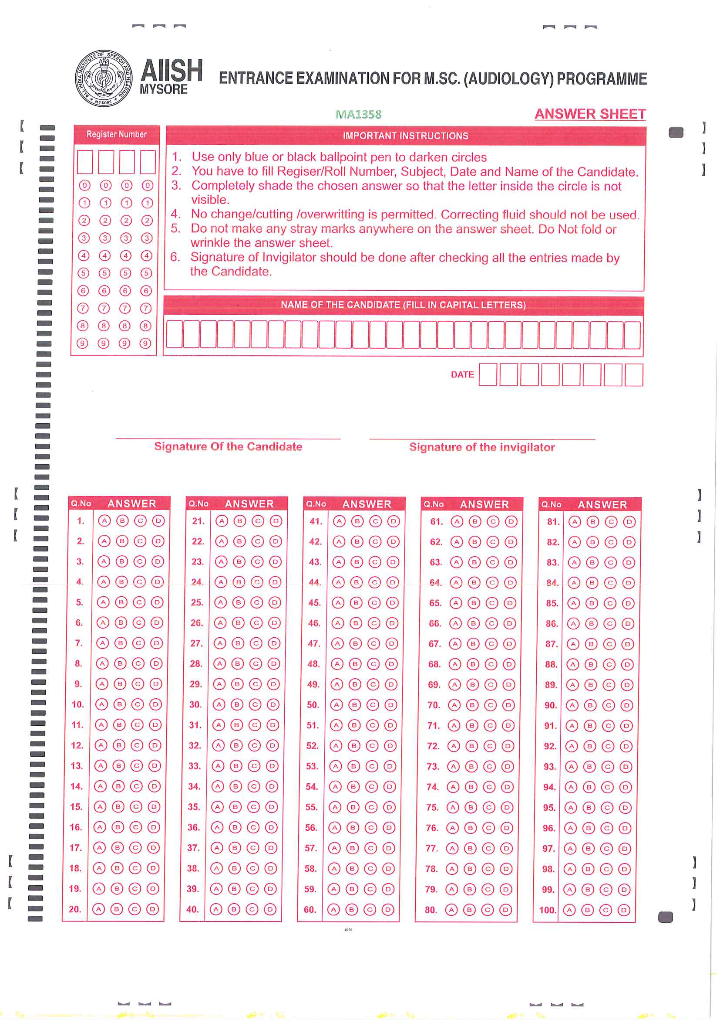

Slide 18
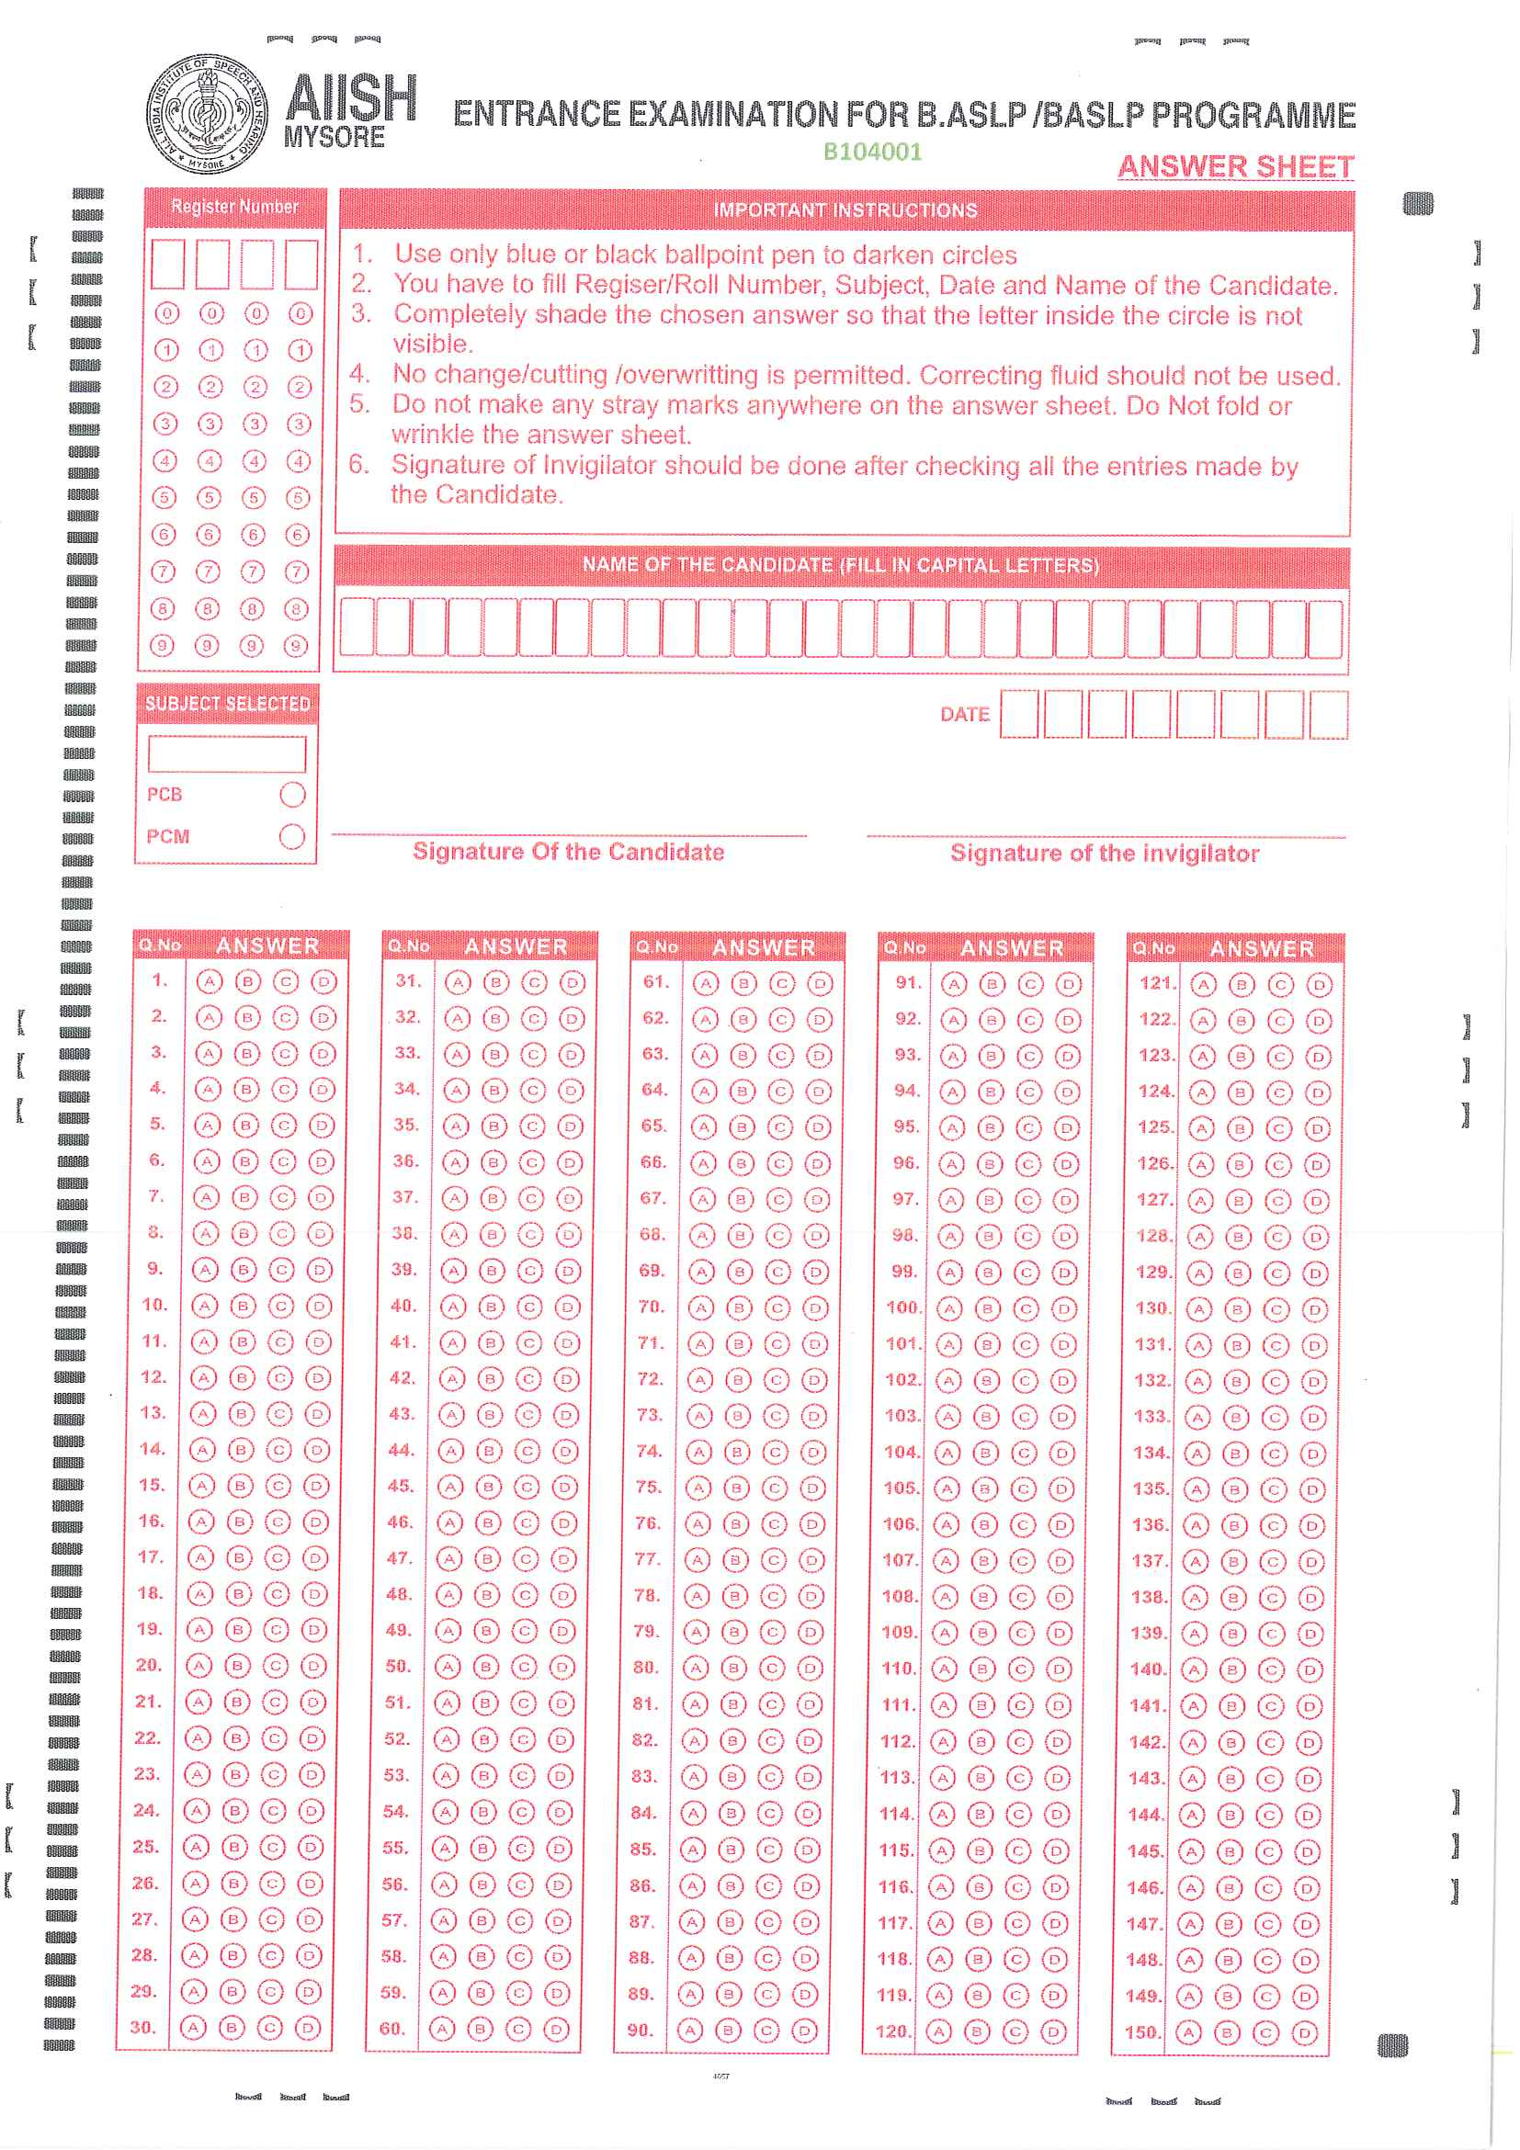

Slide 19
INSTRUCTIONS FOR CANDIDATES FOR UG
Students are not allowed to carry any mobile phone, calculator, books, bags, purse, watch, or any other electronic goods such as bluetooth.
The examination is conducted for four subjects namely Physics, Chemistry, Mathematics, and Biology. Out of which students need to opt for PCB or PCM combinations.
The three papers chosen by the candidates should be clearly indicated in the attendance sheet and sign next to their register number (BCP or MCP combination).

Slide 20
Fill up details like Register number, name, subject, date, and affix your signature in the space provided in the OMR sheet.
The duration of the examination is 9.00 a.m. to 12.00 noon for B.ASLP; 9.00 a.m. to 11.10 for M.Sc (SLP/Audiology); 11.30 a.m. to 1.10 for combined M.Sc (SLP/Audiology) and M.Ed. Spl. (HI) is 9.30 a.m. to 10.20 a.m.
Students have to answer 50 questions of multiple choice types, each carrying one mark. There is no negative marking for wrong answer B.ASLP and M.Ed. Spl. (HI)

Slide 21
Mark the correct answer using BLACK/BLUE BALL POINT PEN only.
Carefully shade the chosen answer in the appropriate circle. Once done it cannot be corrected. If more than one shading is there per question, then that answer will be invalid.
Do not make any stray marking on the OMR sheet.
Fill the circle
Do not do rough work on OMR sheet

Slide 22
For rough work use the additional work sheets given in the end of question booklet.
Return the answer sheet to the invigilator before leaving the examination hall.
Students can leave the hall only after half an hour of commencement of examianation. However, if they decide to leave the hall, they have to handover the question paper and OMR sheet to the Invigilator.

Slide 23
There is negative marking for wrong answers for M.Sc program.
Carefully mark the answers in the appropriate circle. Once done it cannot be corrected. If more than one marking is there per question, then that answer will be invalid.
Fill the circle
Do not do rough work on OMR sheet

Slide 24
For rough work to be done only on the additional work sheets provided in question paper
The candidates have to bring their admit card on the day of the entrance examination, without which they will not be permitted to take up the entrance examination.
If more than one answer is indicated against a question, no marks will be awarded for the same.

Slide 25
Any form of overwriting and erasing on the answer sheets will be processed by the computer as an incorrect answer.
Students are not allowed to carry any mobile phone, calculator, books, bags, purse, watch, or any other electronic goods such as bluetooth.
Return the answer sheet to the invigilator before leaving the examination hall.
Students can’t leave the hall before the scheduled time.

Slide 26
ANNOUNCEMENT OF RESULTS- KEEP VISITING AIISH WEBSITE: aiishmysore.in
 |  | B.ASLP/ BASLP | M.Sc. (Aud/ SLP) | M.Ed. Sp. Ed. (HI)
Announcement of select list |  | 30.05.19 | 30.05.19 | 30.05.19
Interview/ counselling and admission | 1st round | 11.06.19 | 25.06.19
 | 2nd round | 18.06.19 | 02.07.19
 | 3rd round | Will be intimated , if required Keep visiting AIISH website: aiishmysore.in

Slide 27
DO’S AND DONT’S
Do not correct any questions.
Get back to Chairperson/Core committee UG/PG EE.
Be on time.
Maintain strong confidentiality during examination.
For any queries do not hesitate to get in touch chairperson/Core committee UG/PG EE.

Slide 28
Declaration form to be signed
Payment to be made at the respective centers to the staffs involved in duty at all centers except AIISH Mysore.

Slide 29
Instructions for outside DCS
OMR sheets collected after each exam need to be sealed immediately
Services of clerical and MTS staff in the respective centers to be availed

Slide 30
TEXT AS SOON AS YOU
Reach at your center
Exam commences
Exam concludes
Board the flight
Reach Mysore
Any other issues

Slide 31
Tentative Details of BASLP
S.No | Centre | PCB | PCM | Total | OMR Sheets | Empty envelops PCB | Empty envelops PCM
1 | Calicut | 570 | 11 | 581 | 30 X 24 | 30 | 2
2 | Chennai | 285 | 18 | 303 | 30 X 12 | 15 | 2
3 | Guwahati | 74 | 1 | 75 | 50 X 1 30 X 1 | 3 | 1
4 | Jabalpur | 174 | 24 | 198 | 50 X 2 60 X 2 | 8 | 2
5 | Kolkata | 347 | 27 | 374 | 30 X 14 | 20 | 2
6 | Mumbai | 92 | 3 | 95 | 60 X 2 | 5 | 1
7 | Mysuru | 1615 | 135 | 1750
8 | Noida | 193 | 15 | 208 | 30 X 8 | 12 | 2
9 | Secunderabad | 43 | 9 | 52 | 60 X 1 | 2 | 1
10 | Thrissur | 799 | 24 | 823 | 30 X 33 | 40 | 2
Total |  | 4193 | 268 | 4461

Slide 32
Tentative Details of M.Sc
S.No | Centre | Audiology | SLP | Audio/SLP | Total | OMR Sheets SLP | OMR Sheets Audio | Empty envelops Audiology | Empty envelops SLP
1 | Calicut | 7 | 10 | 2 | 19 | 15 | 12 | 1 | 1
2 | Chennai | 28 | 36 | 22 | 86 | 25+25+15 | 30+30 | 2 | 2
3 | Guwahati | 1 | 1 | 5 | 7 | 10 | 10 | 1 | 1
4 | Jabalpur | 25 | 7 | 6 | 38 | 20 | 35 | 1 | 1
5 | Kolkata | 30 | 12 | 8 | 50 | 25 | 25+20 | 1 | 1
6 | Mumbai | 36 | 20 | 11 | 67 | 35 | 25+25 | 1 | 1
7 | Mysuru | 94 | 71 | 67 | 232
8 | Noida | 25 | 14 | 12 | 51 | 30 | 20+20 | 1 | 1
9 | Secunderabad | 19 | 7 | 8 | 34 | 30 | 30 | 1 | 1
10 | Thrissur | 47 | 37 | 21 | 105 | 25+25+15 | 25+25+25 | 3 | 3
Total |  | 312 | 215 | 162 | 689

Slide 33
THANK YOU

