Slide 1
ORIENTATION PROGRAMME
22nd May 2018
ENTRANCE EXAMINATION
26th May 2018

Slide 2
CALENDAR OF EVENTS 2018
Event |  | Dates
Downloading prospectus & Applying online |  | 1.3.2018
Last date for submission of online application |  | 2.5.2018
Last date for uploading the marks of the qualifying examination
Entrance Examination |  | 26.5.18 F/N
Admission Calendar for Academic Programmes at AIISH, Mysuru
Announcement of select list |  | 1.6.18
Interview/ counselling and admission | 1st round | 11.6.18
 | 2nd round | 18.6.18
3rd round, if required will be held on 27.6.2018
Orientation programme & Commencement of classes |  | **

Slide 3
Time Schedule for UG Entrance Examination: 26.05.2018
a) | Entry to the Examination Hall | 9:30 a.m.
b) | Instructions to candidates | 9:45 a.m.
c) | Commencement of Examination
 | Physics | 10:00 a.m.to 10:50 a.m.
 | Chemistry | 11:05 a.m. to 11:55 a.m.
 | Mathematics / Biology | 12:10 p.m. to 1:00 p.m.
d) | Latest Entry to the Examination Hall | 10:00 a.m.

Slide 4
Time Schedule for PG Entrance Examination: 26.05.2018
a) | Entry to the Examination Hall | 9.30 a.m
b) | Instructions to candidates | 9.45 a.m
c) | Commencement of Examination
 | M.Sc.(Aud / SLP) | 10.00 a.m to 11.30 a.m
For candidates writing both M.Sc.(Aud & SLP):
 | M.Sc.(Aud / SLP) | 10.00 a.m to 11.30 a.m
 | M.Sc.(SLP / Aud) | 11.40 a.m to 01.10 p.m
d) | Latest Entry to the Examination Hall | 10.00 a.m

Slide 5
MATERIAL TO BE BROUGHT ON THE DAY OF EXAMINATION BY THE CANDIDATES
Admit card with photograph,
Black ball point pen of good quality

Slide 6
DUTIES OF THE
ROOM INVIGILATORS
The Room Invigilator/s shall come to the examination centre an-hour before (at 09:00 a.m.) the commencement of the examination and collect the blank answer sheets and invigilator’s dairy from the deputy chief superintendent.
Only one set of question booklet and answer sheet shall be given to each candidate.
The Room Invigilator/s shall see that the candidates are seated in the assigned places and writes his/her correct register number and other information required on the facing sheet of the answer sheet (OMR sheet).

Slide 7
The Room Invigilator/s shall read out the instructions to the candidates as given in the question booklet and the answer sheet and instruct the candidates to read and follow the instructions printed.
Before the distribution of question booklet to the candidates, the Room Invigilator/s shall see that the correct question booklet according to the time-table is supplied to them. If he/she finds a wrong question booklet, it shall be returned at once to the Deputy Chief Superintendent and replaced with correct question booklet.
The candidates may be asked to check whether they have received the right question booklet.

Slide 8
Soon after the examination begins, the Room Invigilator/s should obtain the Register Number and the signature of the candidates on the Invigilator’s Diary.
The Room Invigilator/s shall check the candidate’s admission ticket in each subject.
The Room Invigilator/s shall then check whether the candidate’s signature on the diary agrees with his/her specimen signature on the admission ticket. Minor variations can be ignored. However, if there is glaring variation, the Room Invigilator/s shall bring it to the notice of the Deputy Chief Superintendent. The Deputy Chief Superintendent shall make an enquiry after the candidate has finished writing his paper. If the Deputy Chief Superintendent is convinced that it is a clear case of impersonation, he shall not permit the candidate to take the remaining papers of the examination.

Slide 9
Additional OMR sheet shall not be given to the candidate.
The Room Invigilator/s has to see that all entries in the Invigilator’s Diary are made.
Immediately after 10 minutes of the distribution of the question booklets, the Room Invigilator/s shall return the remaining question booklets if any, to the Deputy Chief Superintendent. No question booklet is to be given to any outsider.
The Room Invigilator/s shall be vigilant on his duty. Most of the time he/she shall keep moving. Reading books, newspapers/magazines, use of mobile phones etc., is forbidden.

Slide 10
No Room Invigilator/s shall allow any candidate to speak to any other candidate in his/her room.
The Room Invigilator/s shall see that no candidate makes use of notes, attempts to copy from other candidates, or has in his/her possession or in his/her desk any book or papers not issued in the examination hall. He/she shall ensure that no candidate disturbs his neighbour while writing. He/she shall further ensure that no candidate detaches or tears any paper from the question booklet and that every candidate hands over his/her answer sheet before he/she is permitted to leave the examination hall.

Slide 11
No Room Invigilator/s is permitted to leave the examination hall during the examination. He/she may leave the examination hall after the relieving Invigilator has taken charge of the supervision of the room as the case may be. Relief shall not be taken for more than 10 minutes.
In case there is a report from the candidate that in his/her question booklet the number of pages does not tally with the number of pages printed on the cover page, the Room Invigilator/s shall certify to that effect on the cover page. If any sheet of paper is torn, spoiled etc, he/she shall issue a new booklet / answer sheet.
The Room Invigilator/s has to get the question paper covers meant for the rooms ready before opening the question paper packets.

Slide 12
ARRIVAL TIME OF THE INVIGILATORS (U G and PG)
The staff members are detailed for duty on 26th May 2018 between 8.15 a.m. to 1.30 p.m.
Report to Dr. P. Manjula, Deputy Chief Superintendent, Mysore Centre at 8.15a.m. sharp without fail at the Academic Block.

Slide 13
SUPPORTIVE STAFF (BOTH UG AND PG EXAMINATION)
The staff members are detailed for duty on 26th May 2018 between 8.15 a.m. to 1.30 p.m

Slide 14
Breakfast (7.30 to 8.15 a.m.) and lunch (01.15 p.m. onwards) is arranged for all the above staff at AIISH guest house on 26.05.2018
Remuneration is paid for the examination day, no compensatory leave will be given to anybody.

Slide 15
DETAILS REGARDING THE QUESTION PAPERS AND COVERS
OMR sheets packed in brown color covers.
Each brown cover contains 30/10 OMR (or depending on the number of candidates) sheets or as per the number of candidates.
Seal all the un-used and damaged OMR sheets in the same cover
Question papers packed 30/10 in green cloth line color covers.
Filled OMR sheets collected from candidates to be sealed in yellow color covers(max. of 50 Nos.).

Slide 16
STATIONARIES-PACKED IN BAGS
Sl No. | Contents/Room No.
1. | OMR sheets
2. | Question Paper
3. | Work sheet
4. | Attendance list
5. | Admission tickets of candidates
6. | OMR sheet (for display)
7. | Time schedule for exam
8. | Instructions for candidates
9. | Cello tape
10. | Black pens
11. | Empty envelopes

Slide 17
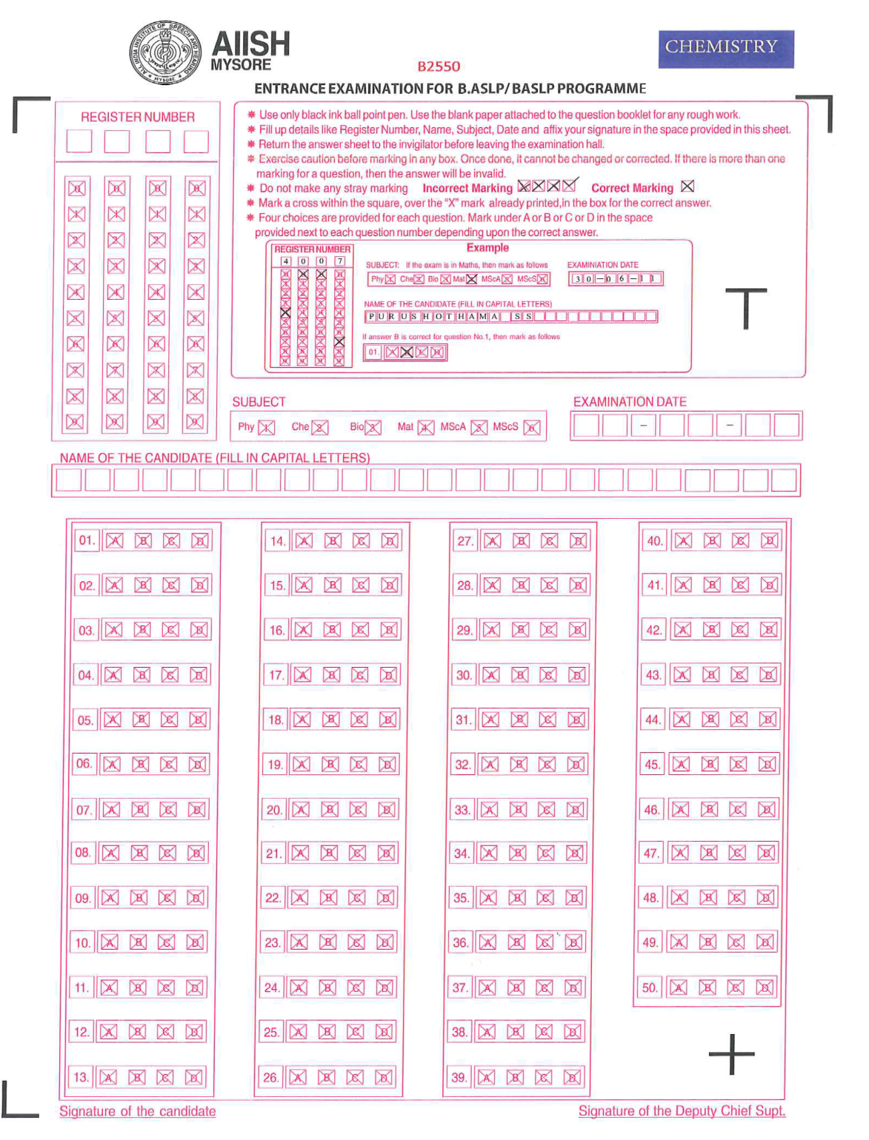

Slide 18
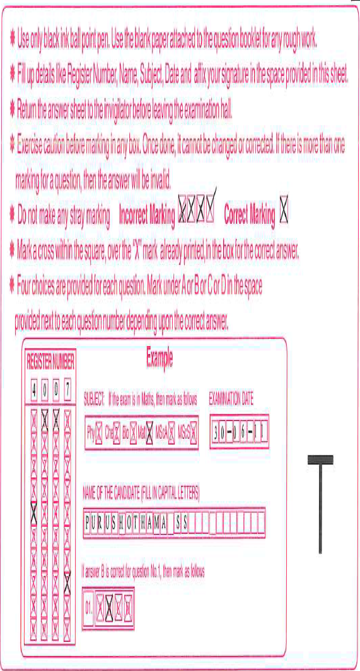

Slide 19
INSTRUCTIONS FOR CANDIDATES FOR UG
Students are not allowed to carry any mobile phone, calculator, books, bags, purse, watch, or any other electronic goods such as bluetooth.
The examination is conducted for four subjects namely Physics, Chemistry, Mathematics, and Biology. Out of which students need to opt for any three subjects in the combination of PCB or PCM only.
The three papers chosen by the candidates should be clearly indicated in the attendance sheet and sign next to their register number

Slide 20
Fill up details like register number, name, subject, date, and affix your signature in the space provided in the OMR sheet.
The duration of each subject shall be 50 minutes with additional 15 minutes for reading the instructions and filling-up personal details in the OMR sheet. The total duration is for 3 hours.
Students have to answer 50 questions of multiple choice types, each carrying one mark. There is no negative marking for wrong answer.

Slide 21
Mark the correct answer using BLACK BALL POINT PEN only.
Carefully mark the answers in the appropriate box. Once done it cannot be corrected. If more than one marking is there per question, then that answer will be invalid.
Do not make any stray marking on the OMR sheet.
Mark cross [X] within the square.
Do not do rough work on OMR sheet

Slide 22
For rough work use the additional work sheets given in the end of question booklet.
Return the answer sheet to the invigilator before leaving the examination hall.
Students can’t leave the hall before the scheduled time.

Slide 23
Instructions for Entrance Examination M.Sc program
The examination is conducted in English
Fill up details like register number, name, subject, date, and your signature in the space provided in the OMR sheet
The duration of each paper shall be 90 minutes with an additional 10 minutes for reading instructions and filling-up of personal details in the OMR sheet.
Students have to answer 100 questions of multiple choice types, each carrying one mark, on a specially designed OMR sheet which will be scanned and processed on a computer. Answers are to be marked using BLACK BALL POINT PEN only.

Slide 24
There is negative marking for wrong answers for M.Sc program.
Carefully mark the answers in the appropriate box. Once done it cannot be corrected. If more than one marking is there per question, then that answer will be invalid
Mark cross [X] within the square
Do not do rough work on OMR sheet

Slide 25
For rough work to be done only on the additional work sheets provided in question paper
The candidates have to bring their admit card on the day of the entrance examination, without which they will not be permitted to take up the entrance examination.
If more than one answer is indicated against a question, no marks will be awarded for the same.

Slide 26
Any form of overwriting and erasing on the answer sheets will be processed by the computer as an incorrect answer.
Students are not allowed to carry any mobile phone, calculator, books, bags, purse, watch, or any other electronic goods such as bluetooth.
Return the answer sheet to the invigilator before leaving the examination hall
Students can’t leave the hall before the scheduled time

Slide 27
ANNOUNCEMENT OF RESULTS- KEEP VISITING AIISH WEBSITE: aiishmysore.in
 |  | B.ASLP/ BASLP | M.Sc. (Aud/ SLP) | M.Ed. Sp. Ed. (HI)
Announcement of select list |  | 01.06.18 | 01.06.18 | 01.06.18
Interview/ counselling and admission | 1st round | 11.06.18 | 12.06.18
 | 2nd round | 18.06.18 | 19.06.18
 | 3rd round | Will be intimated , if required Keep visiting AIISH website: aiishmysore.in

Slide 28
DO’S AND DONT’S
Do not correct any questions
Get back to chairperson/Core committee UG/PG EE
Be on time
Maintain strong confidentiality during examination
For any queries do not hesitate to get in touch chairperson/Core committee UG/PG EE

Slide 29
Declaration form to be signed
Payment to be made at the respective centers to the staffs involved in duty at all centers except AIISH Mysore.

Slide 30
Instructions for outside DCS
OMR sheets collected after each exam need to be sealed immediately
Services of clerical and MTS staff in the respective centers to be availed

Slide 31
TEXT AS SOON AS YOU
Reach at your center
Exam commences
Exam concludes
Board the flight
Reach Mysore
Any other issues

Slide 32
CONTACT DETAILS OF MEMBERS OF
EE COMMITTEE - 2018
Sl.No. | Name | Contact No.
1. | Dr. S.P. Goswami | 9480169216
2. | Dr. P. Manjula | 9731251948
3. | Dr. Animesh Barman | 9481150246
4. | Dr. Ajith Kumar U. | 9901993555
5. | Dr. Vasantha Lakshmi M.S. | 9886252546
6. | Mr. Sreeraj K. | 9738786283
7. | Dr. Hema N. | 9343120039
8. | Ms. N. Parimala | 9481815902

Slide 33
THANK YOU

