Slide 1
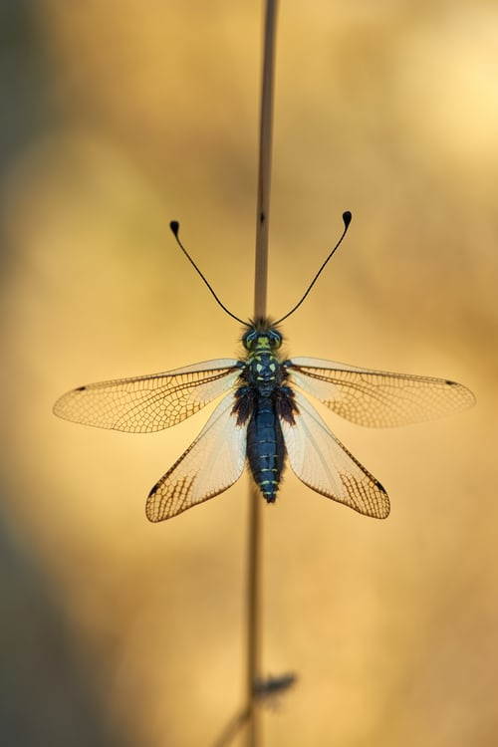
DHAE-EaMo
P04-T02
Ear Moulds

