Slide 1
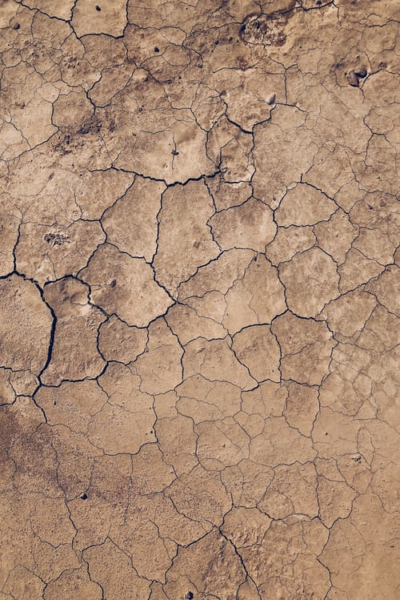
B.Ed. Special Education BSEd3-ViAr
24632
Visual Arts in Education

