Slide 1
M.Sc. Audiology - PGA1-A-TeSp
31902
Auditory Perception

Slide 2
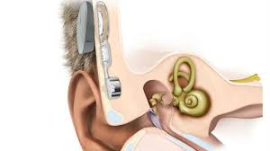
M.Sc. Audiology - PGA3-A-ImDe
31921
Implantable Devices for Individuals with Hearing Impairment

Slide 3
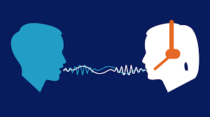
M.Sc. Audiology PGA3-A-SpPe
31922
Speech Perception

Slide 4
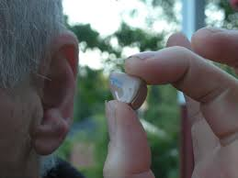
M.Sc. Audiology PGA3-A-SeAs
31923
Seminars In Assessment of Hearing Impairment

Slide 5
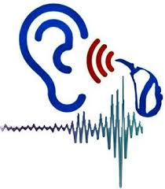
M.Sc. Audiology PGA3-A-SeRe
31924
Seminars In Rehabilitative Audiology

Slide 6
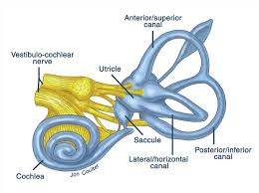
M.Sc. Audiology PGA3-A-VeSy
31925
Vestibular System : Assessment & Management

Slide 7
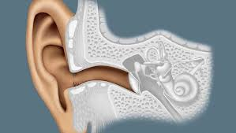
M.Sc. Audiology PGA3-A-AuPh
31926
Auditory Physiology

Slide 8
M.Sc. Audiology PGA3-A-TeSp
31927
Technology for Speech Language & Hearing

Slide 9
M.Sc. Speech-Language Pathology PGS3-A-ApSa
31971
Aphasia

Slide 10
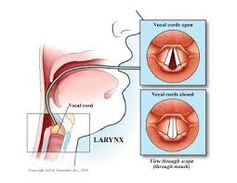
M.Sc. Speech-Language Pathology PGS3-A-VoIt
31972
Voice & Its Disorders

Slide 11
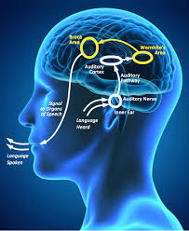
M.Sc. Speech-Language Pathology PGS3-A-SpLa
31973
Speech & Language Processing

Slide 12
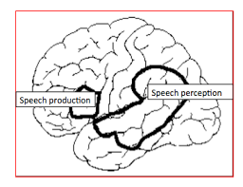
M.Sc. Speech-Language Pathology PGS3-A-SpLa
31974
Speech Language Perception

Slide 13
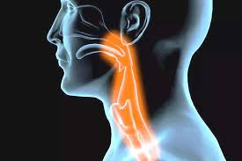
M.Sc. Speech-Language Pathology PGS3-A-DyPh
31975 Dysphagia

Slide 14
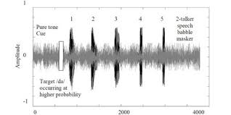
M.Sc. Speech-Language Pathology PGS3-A-BeAs
31976
Behavioural Assessment & Management of Capd

Slide 15
M.Sc. Speech-Language Pathology PGS3-A-EvRe
31977
Event Related Potentials In Speech & Language

Slide 16
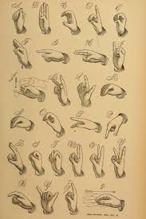
M.Sc. Speech-Language Pathology PGS3-A-SiLa
31978
Sign Languages

Slide 17
M.Sc. Speech-Language Pathology PGS3-A-ClLi
31979
Clinical Linguistics Multilingual Issues Communication

Slide 18
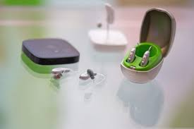
M.Sc. Speech-Language Pathology PGS3-A-TeSp
31980
Technology for Speech Language & Hearing

Slide 19
Bachelor of Audiology & Speech-Language Pathology UG3-A-VoIt
73931
Voice & ITS Disorders

Slide 20
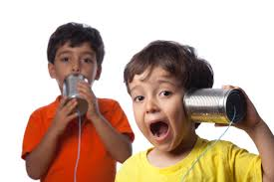
Bachelor of Audiology & Speech-Language Pathology UG3-A-SpSo
73932
Speech Sound Disorders

Slide 21
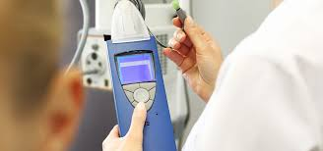
Bachelor of Audiology & Speech-Language Pathology UG3-A-DiAu
73933
Diagnostic Audiology: Behavioral Tests

Slide 22
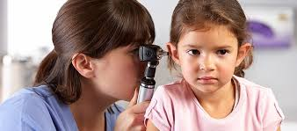
Bachelor of Audiology & Speech-Language Pathology UG3-A-EdAu
73934
Educational Audiology

Slide 23
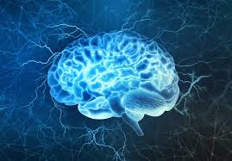
Bachelor of Audiology & Speech-Language Pathology UG3-A-NeRg
73935
Neurology

