Slide 1
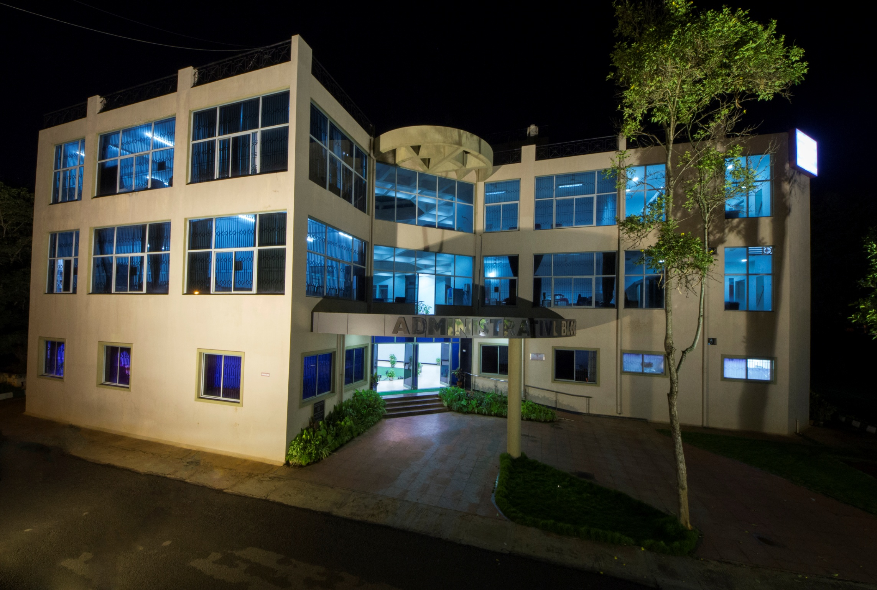
All India Institute of Speech and Hearing

Slide 2
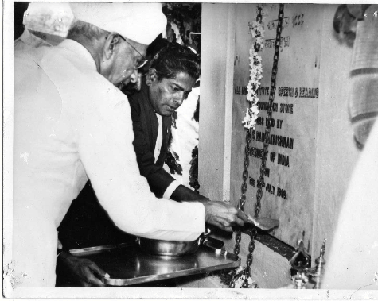
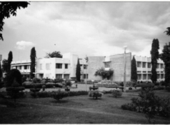
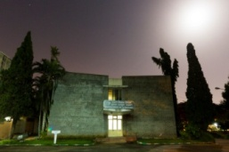
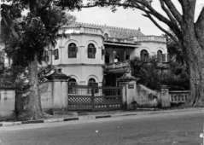
Introduction
A 54 Year old autonomous organization in the field of communication disorders
Fully funded by the Ministry of Health & Family Welfare, Govt. of India.
A unique organization pertaining to the field in the Asian sub-continent.
All India Institute of Speech and Hearing

Slide 3
Credentials
College with Potential for Excellence - UGC
A Grade Accreditation - NAAC
9001-2008 Quality Certification - ISO
Centre of Excellence in the area of Deafness - WHO
Centre of Excellence in the area of Communication Disorders - Ministry of Health & Family Welfare, Govt. of India
Centre for Advanced Research in Speech and Hearing - UGC
Nodal Centre for the Implementation of the National Programme on Prevention and Control of Deafness - Ministry of Health & Family Welfare, Govt. of India
Collaborative Organization for the Rashtriya Bal Swasthya Karyakram (RBSK), under the Ministry of Health & Family Welfare.
Introduction
All India Institute of Speech and Hearing

Slide 4
Major Events
Swachh Bharath Fortnight from 1st to 15th April 2018.
Launching of Illumina Miseq Equipment on 9th April 2018.
Preschool Graduation Day on 27th April 2018.
Summer camp for pre-school children from 1st to 31st May 2018.
53rd Annual Day celebration on 9th August 2018.
Opening of Eye-tracking Lab on 9th August 2018.
Inauguration of Equipment for Vestibular System Evaluation on 9th August 2018.
Inauguration of new New-born Screening Centres on 9th August 2018.
Opening of upgraded Central Computer Centre on 9th August 2018.

Slide 5
International Workshop on Speech Processing for Voice, Speech and Hearing Disorders on 8 & 9th September 2018.
Swachhta Drive – Swachhta Hi Sewa on 15th September to 2nd October 2018.
World Cerebral Palsy day on 5th October 2018.
Appointment of Dr. M. Pushpavathi, Professor, Speech Language Pathology as new director on 17th October 2018.
Sensitization Programme on Occupational Noise induced Hearing Loss and its Prevention on 19th October 2018.
Free hearing aid repair camp from 26th to 30th November 2018.

Slide 6
The Institute Graduation Day on 15th December 2018.
The International Day of Persons with Disabilities on 20th December 2018.
Opening of the 6th Outreach service centre of the institute on 3rd February 2019.
All India Annual NBS Coordinators Meet on 28th February 2019.
World Hearing Day from 4th to 6th March 2019.
AIISH AAWAAZ, the annual inter-collegiate cultural from 16th & 17th March 2019.

Slide 7
Learning & Teaching
Academic Programs Offered
Diploma in Hearing Aid & Earmould Technology
Diploma in Early Childhood Special Education (Hearing Impairment)
Diploma in Hearing, Language and Speech
Bachelor of Audiology and Speech Language Pathology
Bachelor of Education Special Education (Hearing Impairment)
PG Diploma in Clinical Linguistics for SLP
PG Diploma in Forensic Speech Sciences & Technology
PG Diploma in Neuro-Audiology
PG Diploma in Augmentative and Alternative Communication
M.Sc (Audiology)
M.Sc (Speech - Language Pathology)
Master of Education -Special Education (Hearing Impairment)
Ph. D (Audiology)
Ph. D (Speech-Language Pathology)
Ph. D (Speech & Hearing)
Post Doctoral Fellowship
All India Institute of Speech and Hearing

Slide 8
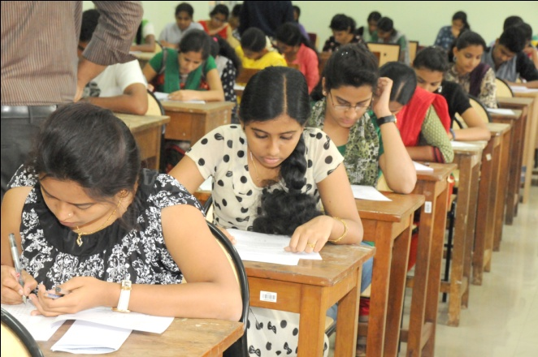
Learning & Teaching
Admission and Enrolment
National Level Entrance Examinations to
B.ASLP. M.Sc. Programmes
Students Admitted: 242
Admission based on
All India Institute of Speech and Hearing

Slide 9
Learning & Teaching
Academic Performance
Programmee | Pass Percentage
B.Sc. (Sp. & Hg.) | 98
B.S.Ed.(HI) | 85
M.Sc. (Audiology) | 100
M.Sc. (SLP) | 100
All India Institute of Speech and Hearing

Slide 10
Educational Stipend
Learning & Teaching
Total amount spent : Rs. 121.27 lakhs
All India Institute of Speech and Hearing

Slide 11
Learning & Teaching
Journal club meetings - 20
Clinical conferences - 18
Student Enrichment and Expansion of Knowledge (SEEK Gyan Programme ) – 5
All India Institute of Speech and Hearing

Slide 12
Guest Lectures/Training/ Conferences
Learning & Teaching
07 Guest Lectures
69 In-house Training Programmes
29 Workshops / Conferences
All India Institute of Speech and Hearing

Slide 13
Learning & Teaching
296
Short-term training /Orientation
All India Institute of Speech and Hearing

Slide 14
Learning & Teaching
203
Invited talks by faculty/staff
All India Institute of Speech and Hearing

Slide 15
Research
Funded Research Projects
Completed : 13 no. Rs. 114.29 lakhs
Ongoing : 30 no. Rs. 573.36 lakhs
New : 26 no. Rs. 229.78 lakhs
Funding Agencies: ICMR, DST , UGC & AIISH
All India Institute of Speech and Hearing

Slide 16
Research
Doctoral Research
Awarded
Ms. Amulya P. Rao
Mr. Jithin Raj B.
Ms. Kumari Apeksha
Mr. Nike Gnanateja G.
Ms. Nisha K.V.
Mr. Pebbili Gopi Kishore
Mr. Reuben Jebaraj M.P.
Mr. Sreeraj K.
Under Evaluation
Mr. Mahesh B.V.M
Ms. Megha
Ms. Shylaja K.
Ms. Yashaswini R.
Ms. Yashomathi
Ongoing Research 58
All India Institute of Speech and Hearing

Slide 17
Postgraduate Research
Research
69
72
Ongoing
Completed
All India Institute of Speech and Hearing

Slide 18
Publications & Presentations
Research
National / International Journals: 91
In-house Journal: 43
Books/ Book chapters: 19
National / International Conferences: 139
All India Institute of Speech and Hearing

Slide 19
Clinical Care
Patient Registration
New 22037
Review 51872
Karnataka - 20668
Kerala - 730
T. Nadu- 221
Overseas Clients : UK, Maldives & Nepal
All India Institute of Speech and Hearing

Slide 20
Speech & Language Assessment / Rehabilitation
Clinical Care
Total Clients 6914
New 5123
Review 1791
Clients underwent Therapy 5062
Therapy Sessions 25731
All India Institute of Speech and Hearing

Slide 21
Audiological Assessment & Rehabilitation
Clinical Care
Total clients 15738
Hearing Evaluation 13525
Hearing aid trial 6668
Ear moulds made 5475
All India Institute of Speech and Hearing

Slide 22
Psychological Assessment & Rehabilitation
Clinical Care
Total Clients Assessed 6768
Rehabilitation:
Behavior therapy
Home based training
Remedial training
Parent counselling
Neuropsychological rehabilitation
All India Institute of Speech and Hearing

Slide 23
Otorhino-laryngological Assessment and Rehabilitation
Clinical Care
Clients Evaluated
AIISH 39665
K.R Hospital 22166
Major Surgery 109
Minor Surgery 600
All India Institute of Speech and Hearing

Slide 24
Specialized Clinical Services
Clinical Care
Augmentative & Alternative Communication
Autism Spectrum Disorders
Adult and Elderly Persons with Language Disorders
Dysphasia
Fluency
Implantable Hearing Devices
Learning Disabilities
Listening Training
Motor-Speech Disorders
Neuropsychology
Professional Voice Care
Structural Orofacial Anomalies
Vertigo
Voice
All India Institute of Speech and Hearing

Slide 25
Medical Specialty and Allied Health Services
Clinical Care
Medical Specialty Services
Neurology
Pediatrics
Phono surgery
Plastic surgery
Prosthodontics
Orthodontics
Allied Health Services
Physiotherapy
Occupational Therapy
All India Institute of Speech and Hearing

Slide 26
Special Education Services
Clinical Care
Preschool training
Parent-infant training
Preschool parent empowerment
Preschool bridge course
Curricular support
Educational counselling & guidance
Co-curricular service
Computer literacy training for care givers
All India Institute of Speech and Hearing

Slide 27
Clinical Support Services
Clinical Care
Distribution of Hearing Aids
ADIP Scheme 584
AIISH HADS 2324
Repairing of Hearing Aids 584
Distribution of Toy Kits 31
Certificates Financial aid,
Income Tax Exemption,
Educational Scholarship,
School Admission
Financial Assistance Rs. 14,46,354/-
All India Institute of Speech and Hearing

Slide 28
Outreach Services
Communication Disorder Screening Programs
Newborn Screening
Industrial Screening
School Screening
Elderly Screening
Camp based Screening
Clinical Services at
Outreach Service Centres
Total Clients Evaluated 2136
All India Institute of Speech and Hearing

Slide 29
Other Outreach Services
Tele-intervention & Assessment
Tele-Educational Guidance and Counselling
Itinerant Service
All India Institute of Speech and Hearing

Slide 30
Public Education
Monthly Public Lectures
Preparation and Dissemination of Information Resources
Public Awareness Programmes
Street Plays
Observation of Commemorative days
Orientation lectures & sensitization programmes
Resource Exchange and Education
through Care and Hope (REECH)
Mass Media based Education
All India Institute of Speech and Hearing

Slide 31
Extracurricular Events
AIISH Gymkhana
53rd Annual day Celebrations
Independence Day
Christmas
Republic Day Celebrations
Talents Day
Ayurveda Awareness
Movie Night
Farewell Party
National Science Day
Live Band and Auto Expo
Zumba
AIISH Aawaaz
All India Institute of Speech and Hearing

Slide 32
Extracurricular Events
National Service Scheme Unit
Orientation Programme
Shramadan
Kodagu and Kerala Flood Relief
Games and Sports
Art and Craft Making
Trekking
Run for Unity
Pre-school Screening
Blood Donation
NSS Special Camp
Orphanage Visit
Kannada Classes
All India Institute of Speech and Hearing

Slide 33
Official Language Implementation
Training in Prabodh for the Institute staff
Material Translation and Development
Conducting of workshops & seminars
Hindi week celebration
Word-a-day in Hindi and
Award for best execution of official language
All India Institute of Speech and Hearing

Slide 34
Awards & Laurels
Awards/Laurels by other Organizations...
KARYALAYA JYOTHISMRITHI Puraskar Best Execution of Official Language
Dr. M Pushpavathi, Director: Rais Ahmed Memorial Lecture Award & Braithwaite's Oration award
Dr. Animesh Barman: Padmashree Prof. S. Rameswaran Endowment Oration Award
Dr. S. Venkatesan & Dr. Alok Upadhaya- Felicitation for professional contribution
All India Institute of Speech and Hearing

Slide 35
.....Awards & Laurels
.......Awards/Laurels by other organizations
Ms. Rakshith S - Arati Venkataraman Memorial Gold Medal
Ms. Priyadarshini V - Dr P.D. Manohar Gold Medal
Best Scientific Paper Presentation Awards: 60
All India Institute of Speech and Hearing

Slide 36
.....Awards & Laurels
Awards hosted by the Institute…
Dr. Sreedevi N., Dr. Ajith Kumar U, Dr. P. Purusothama, Ms. Megha, Ms. Geetha M.P., Mr. B. Suresh and Mr. K. Sreenivasa received the BEST AIISHIAN of the Year
Mr. Rakshith S: Dr. Vijayalakshmi Basavaraj Gold Medal
Ms. Priyadharshini V : Dr. R. Sundar Gold Medal, Smt. Jayalakshamma Gold Medal, Friends United Organisation Endowment cash prize and, Smt. T. V. Alamelu Gold Medal
Ms. Eliza Baby: Smt. T. V. Alamelu Gold Medal
All India Institute of Speech and Hearing

Slide 37
.....Awards & Laurels
…Awards hosted by the Institute
Ms. Priyanka, Ms. Shezeen Abdul Gafoor and Ms. Varsha M: Best Student Clinician Award
Ms. Hima Nair, Ms. Pooja C, Ms. Thanuja D, and Ms. Vijaya Varsha: Best Journal Club Presentation Award
Ms. Gouri Girish, Mr. Ankit Lohani and Mr. Jeevan RS: Best Clinical Conference Presentation Award
All India Institute of Speech and Hearing

Slide 38
Other Activities and Events
Infrastructure Development & Maintenance
Material Development
Personnel Management
Technological Consultancy Services
Implementation of Right to Information Act
Reservation Policy Implementation
Library and Information Services
All India Institute of Speech and Hearing

Slide 39
Financial Statement
Grants received
Rs. 5935. 29 lakhs
Expenditure
Rs. 5557.38 lakhs
Income Generated = Rs. 866.61 lakhs
All India Institute of Speech and Hearing

Slide 40
Thank You

