Slide 1
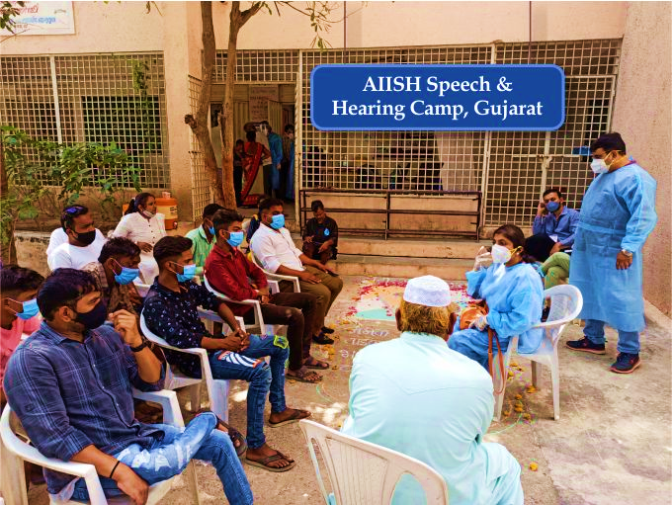
Outreach Services
Clinical cases at OSCs 2633
Tele-Assessment 99
Screening Programmes
Newborn Screening 34051
Industrial Screening 490
Student Screening 2642
Elderly Screening 64
Camp-based Screening 70/ 5936
General Public Screening 2648
New Centres
Bhubaneswar
Bidar
Belagavi
Hubbali
Kolar
Madikeri
Patna

Slide 2
Other Services & Activities
Special education services
Technological consultancy
Infrastructure development
Official language implementation
Swach Bharath abhiyan
Material development

