Slide 1
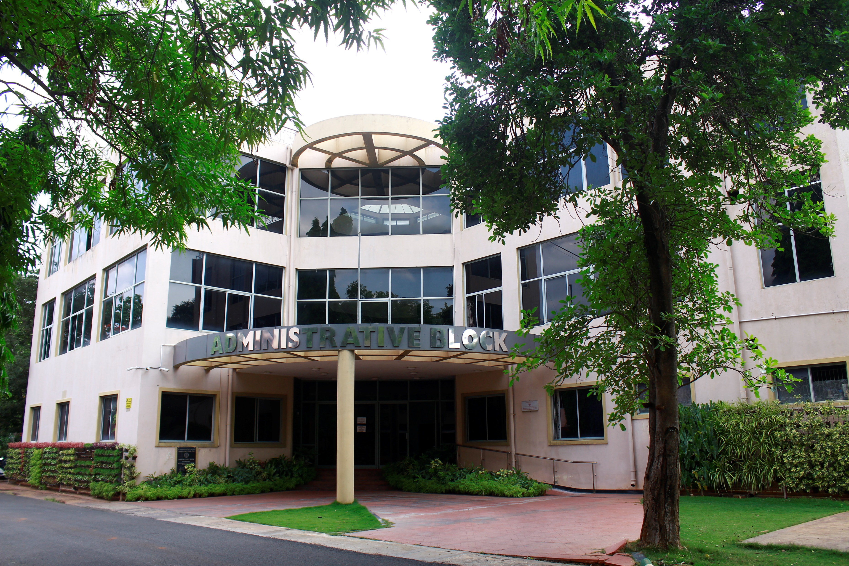
ANNUAL REPORT
2020-21
AIISH
All India Institute of Speech & Hearing, Mysuru

Slide 2
Academic Affairs
Academic Programmes Offered
Total Students
17
583
New JRFs
Students Admitted
257
35
University Entrance
Examination
AIISH Online Entrance Examinations/Direct Admission

Slide 3
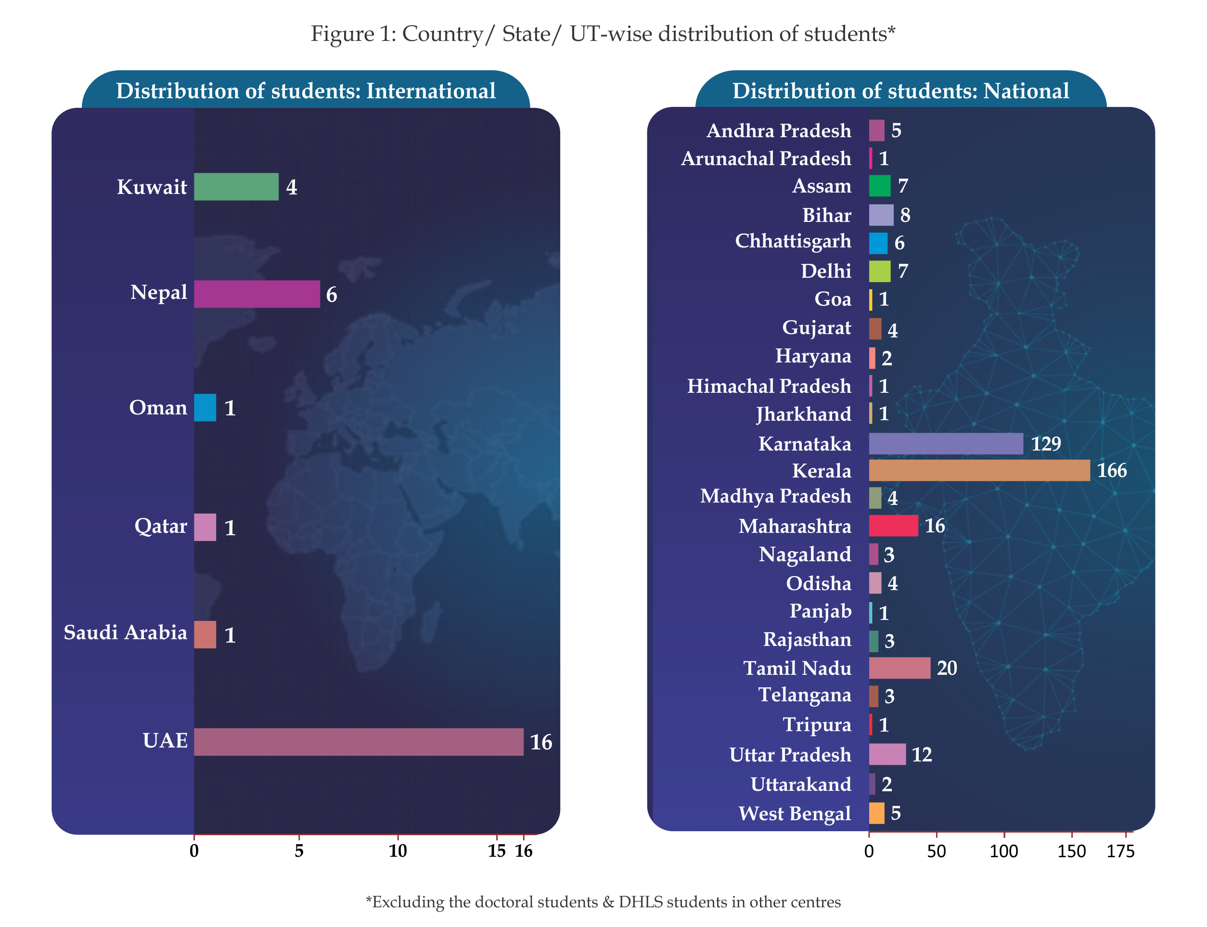
Geographical distribution of students

Slide 4
Funded Projects
AIISH, DST, SERB, UKRI
58
Ongoing
54
Completed
Doctoral Research
Completed
Ongoing
Postgraduate Research
Completed
Ongoing
Research
4
95
77
81

Slide 5
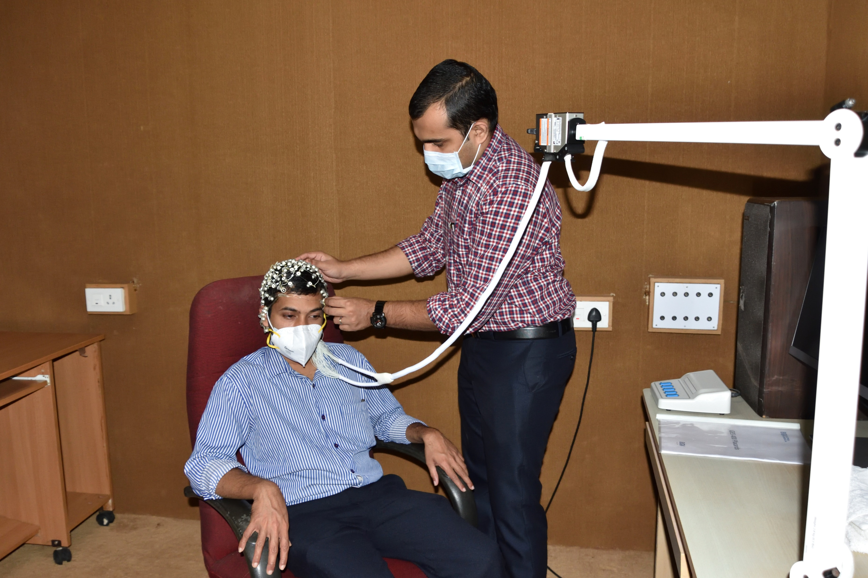
Scientific Publications & Presentations
Journal Articles
National/International 97
In-house 86
Books/ Book Chapters 16
Conference presentations 19
Invited talks delivered 329

Slide 6
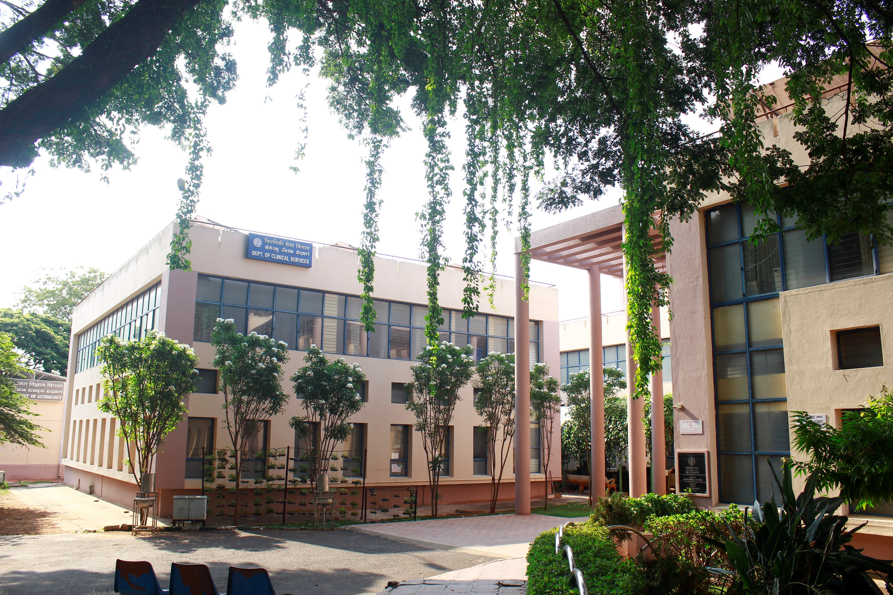
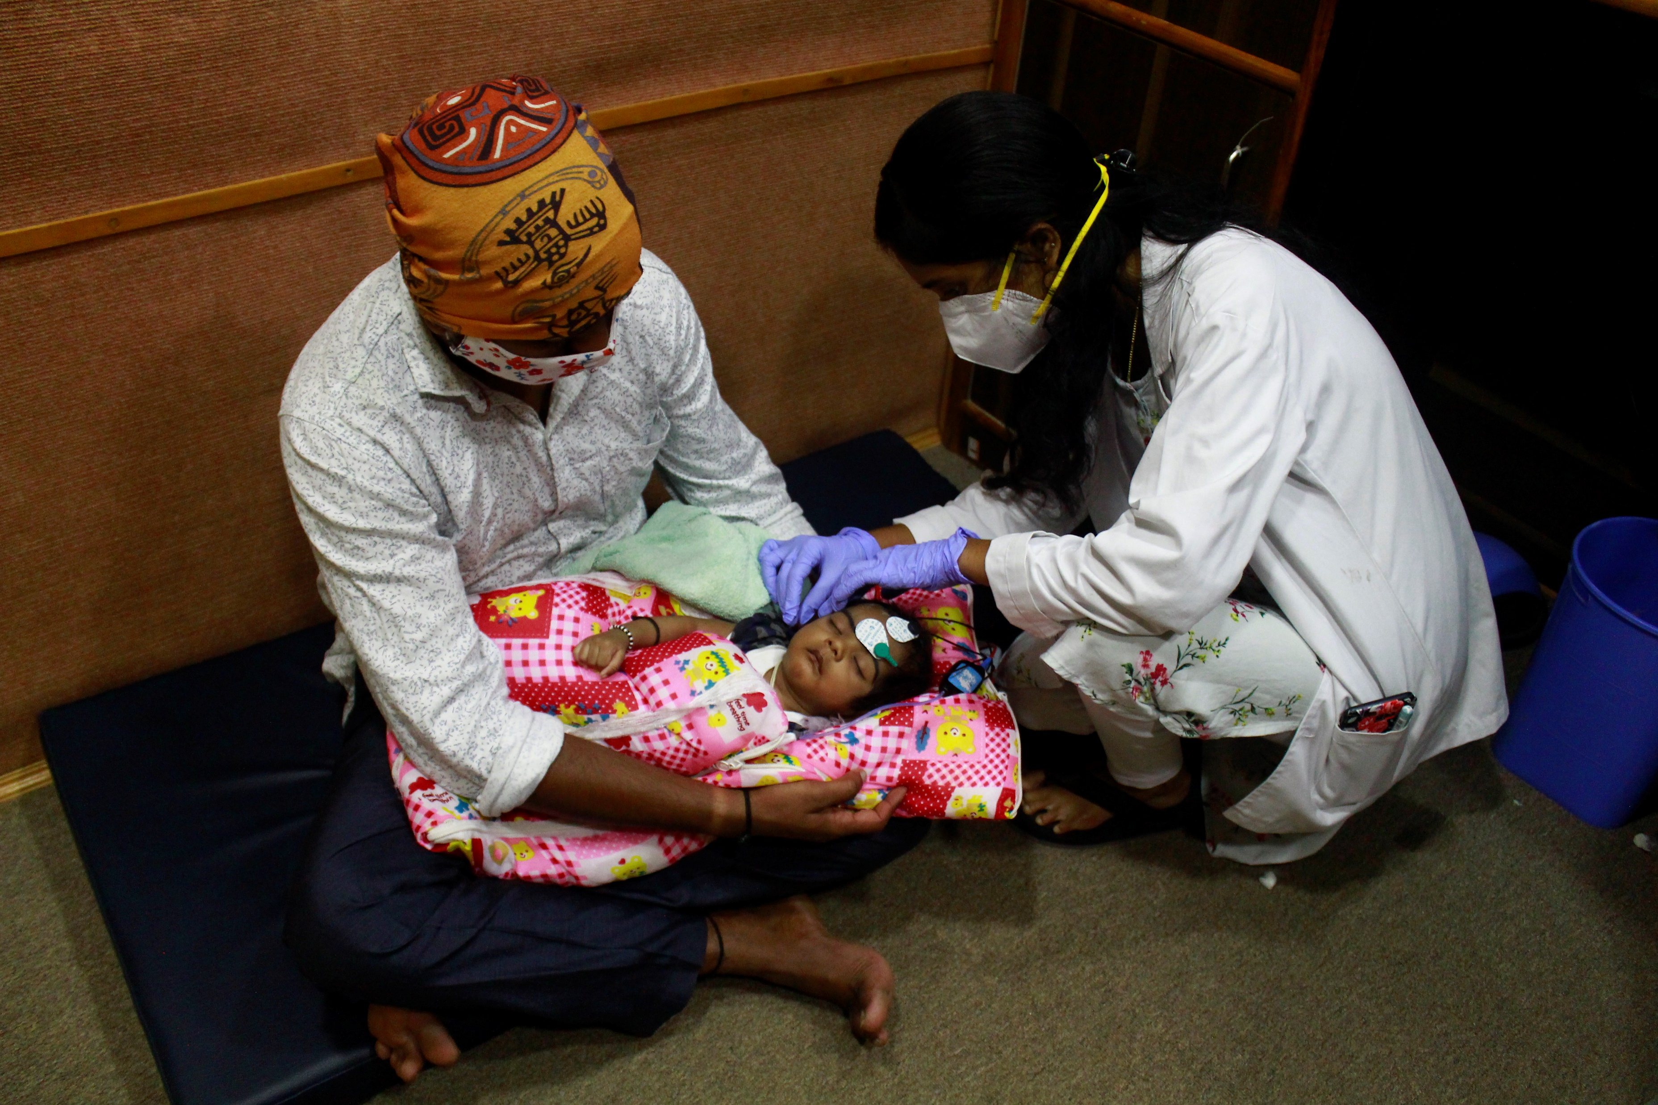
Clinical Care
New Patient Registration
13,432
Repeat Case Files
29,965
Audiology OPD
10,618
Speech OPD
2,814

Slide 7
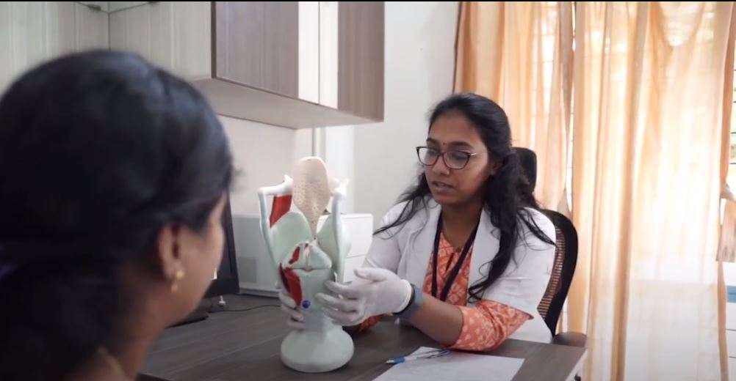
Total
3953
New
2824
Review
1129
Speech-Language Assessment

Slide 8
Total cases
Physical
Sessions
Virtual
Sessions
Speech-language Therapy
2796
791
1995
7379
9080

Slide 9
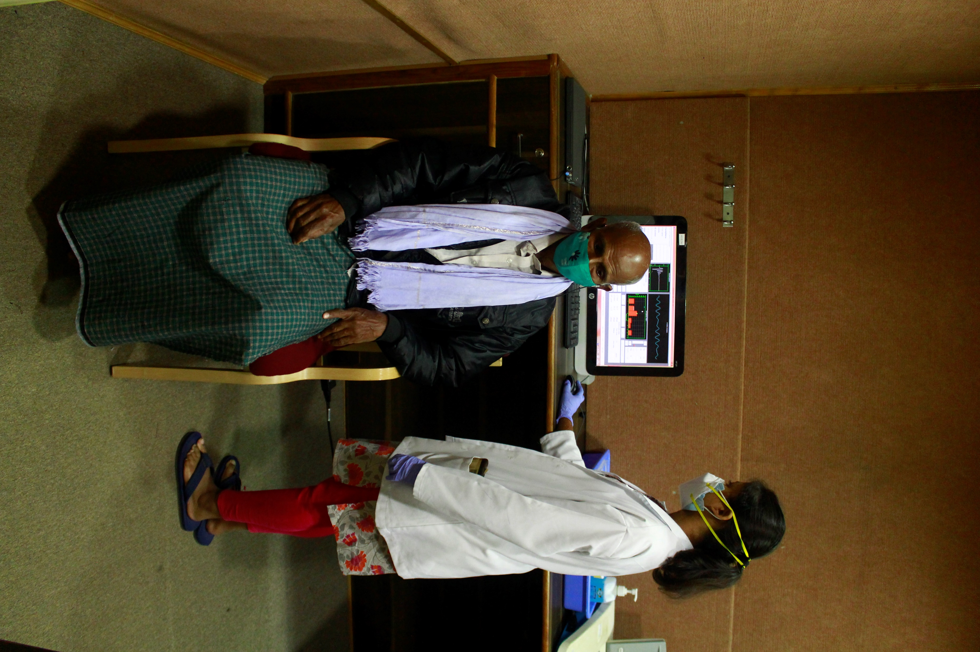
Audiological Services
6686
3321
4124
Hearing Evaluation
Hearing Aid Trial
Earmold Impressions
2045
Hearing Aid Distribution

Slide 10
Referred Evaluations
Psychological Evaluation
Total 3105
New 2435
Review 670
ENT Evaluation
AIISH
23843
K.R. Hospital
9960
Surgery
Major-87
Major-280

Slide 11
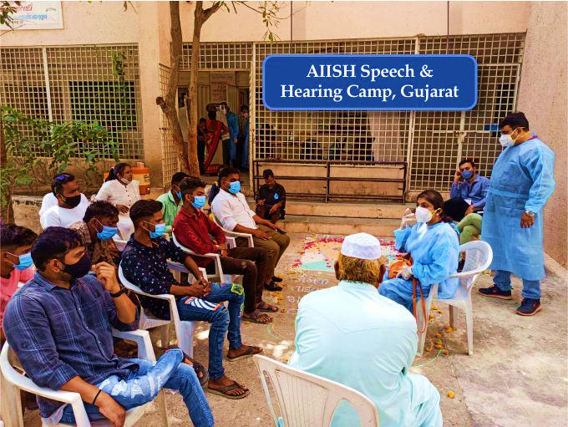
Outreach Services
Clinical cases at OSCs 2633
Tele-Assessment 99
Screening Programmes
Newborn Screening 34051
Industrial Screening 490
Student Screening 2642
Elderly Screening 64
Camp-based Screening 70/ 5936
General Public Screening 2648
New Centres
Bhubaneswar
Bidar
Belagavi
Hubbali
Kolar
Madikeri
Patna

Slide 12
Social Media Activities
Live videos
Animated videos
Live phone-in programs
Public Education
Monthly Public Lectures
Street plays & Cyclothon
REECH Programmes
Observation of Commemorative Days
Radio Programmes
Magazine & Newspaper Articles
Public Orientation & Sensitization
Television Programmes

Slide 13
Other Services and Activities
Special education services
Technological consultancy
Infrastructure development
Official language implementation
Swach Bharath abhiyan
Material development

Slide 14
Other Services & Activities
Special education services
Technological consultancy
Infrastructure development
Official language implementation
Swach Bharath abhiyan
Material development

Slide 15
World Hearing Forum Membership: AIISH
Prof. Rais Ahmed Memorial Lecture Award: Prof. Ajish K. Abraham
Woman Achiever Award: Prof. Rajeswari
Best Teacher Award: Dr. P. Manjula, Dr. Jayashri Shanbal & Dr. N. Swapna
Best Paper Award: Mr. Rakesh, Dr. Santhosh, Dr. Swapna & Ms. Shrushti
University Examination Toppers: Ms. Hina Fathima & Ms. Nivedha Rao
Awards & Honours

Slide 16
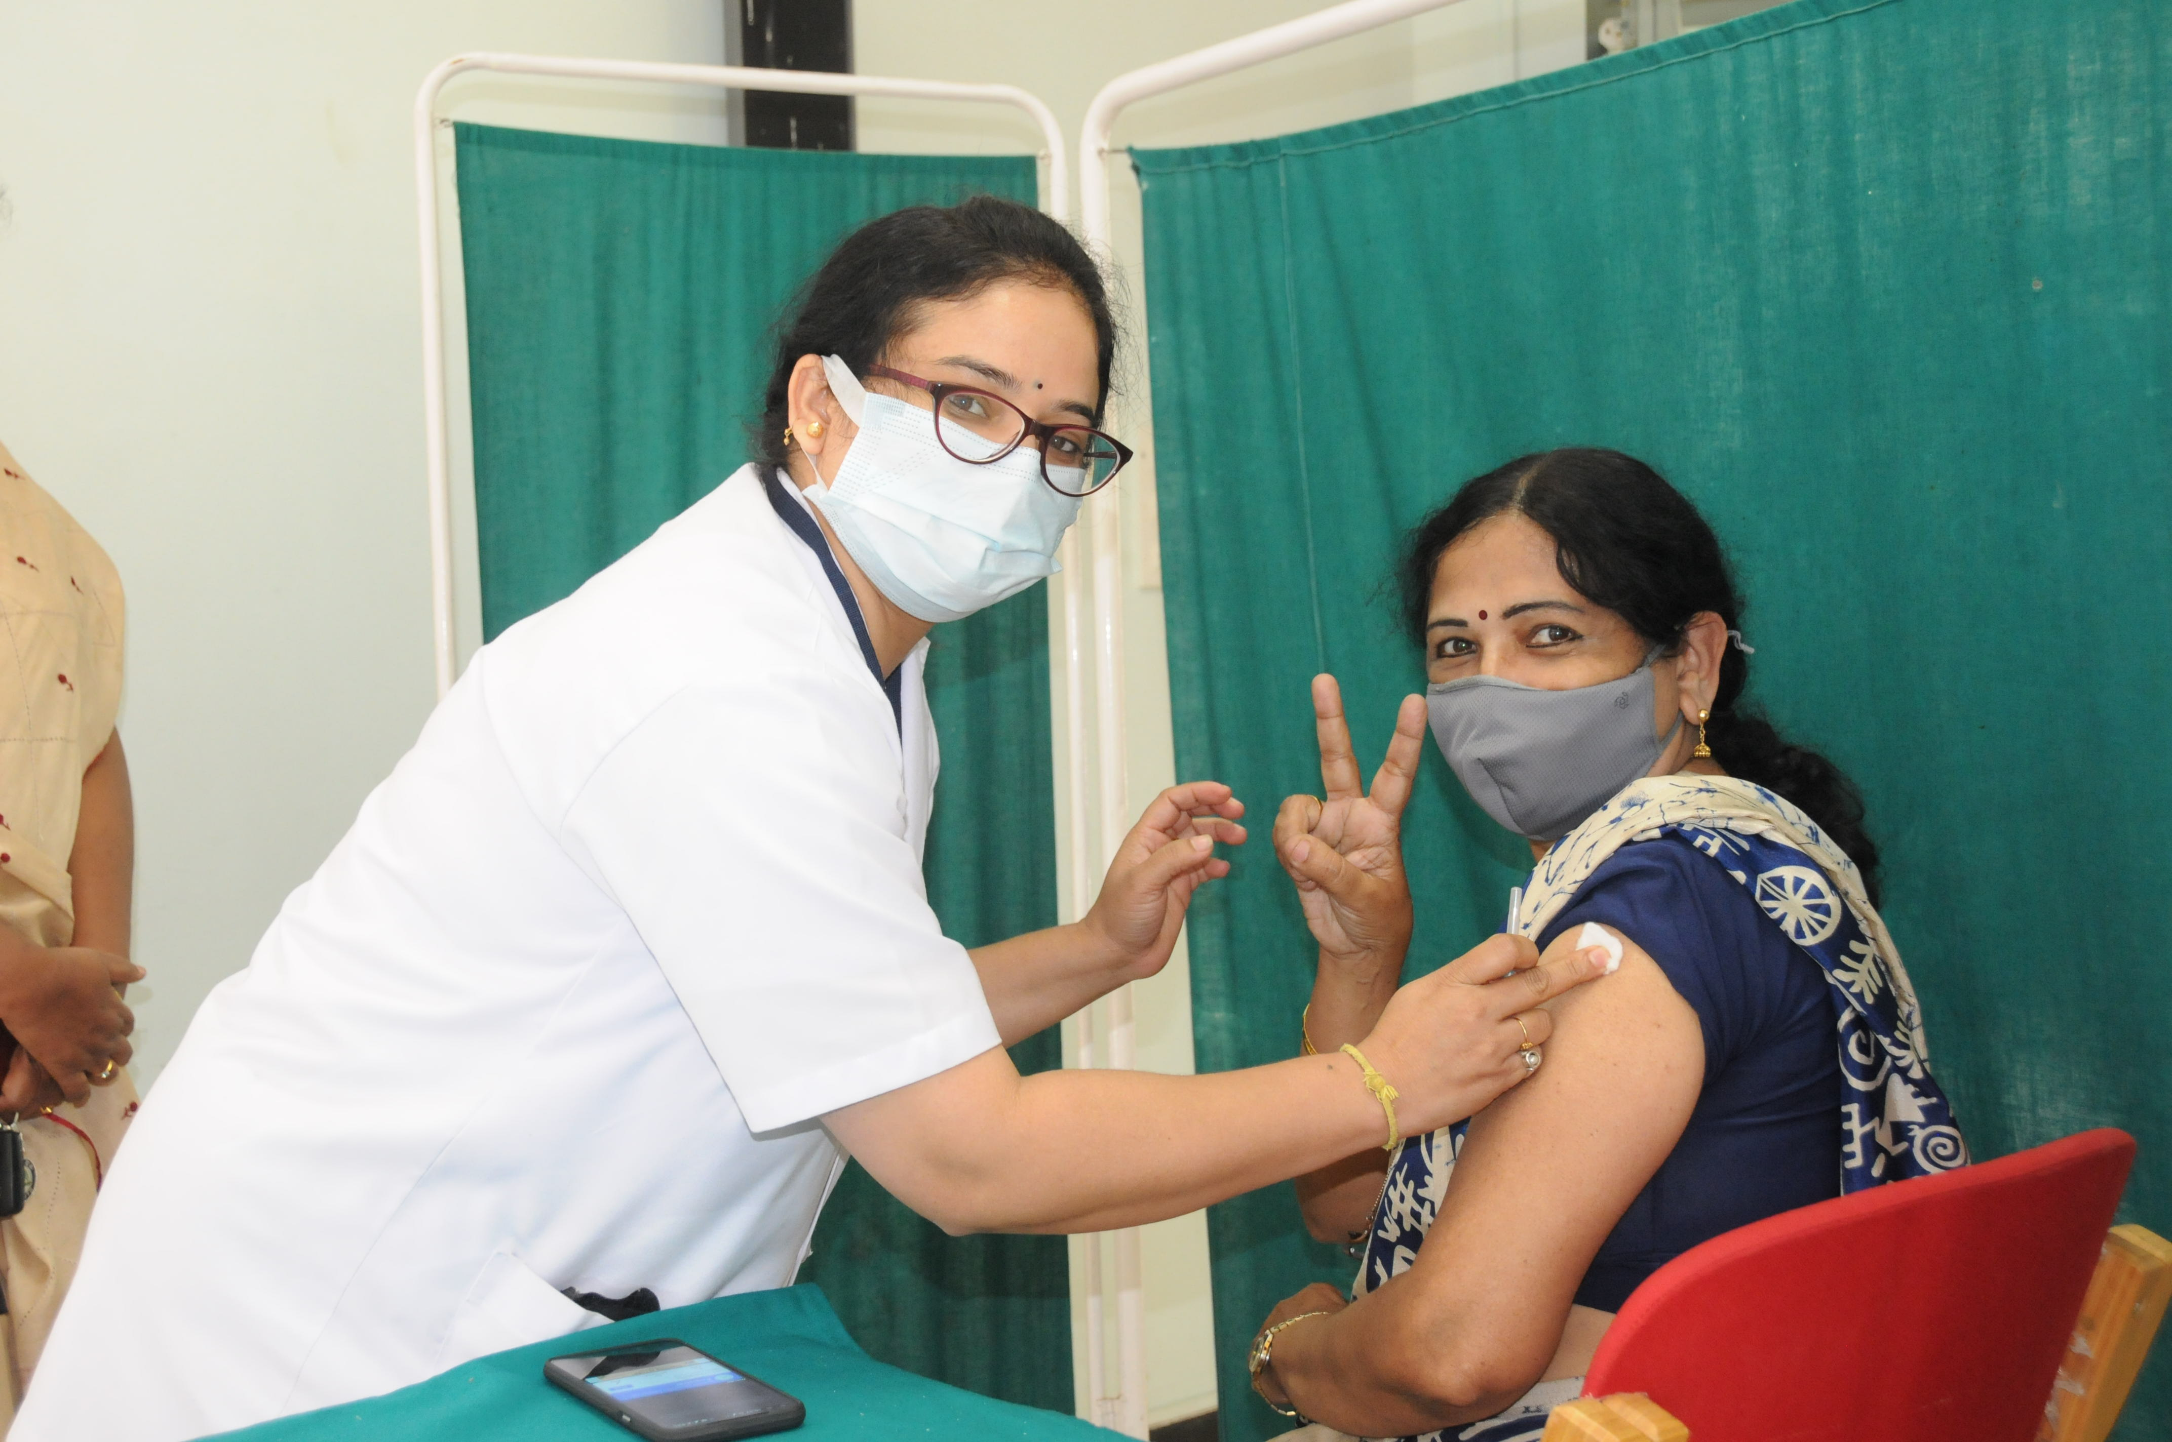
Response to Covid-19
Online Classes
Tele-assessment & Rehabilitation
Student Counselling
Standard Operating Procedure
Isolation Centre
Vaccination drive
Our Response to Covid-19

