Slide 1
NON CONVENTIONAL ENERGY SOURCES AND ITS APPLICATIONS
Presented by
Prof.Mir Sadat ali
Mr.Arun Manohar Gurram
Mr.Raghuveer dontikurti

Slide 2
Outline of the presentation
Brief note of different non conventional energy resources
Projects undertaken
Bio diesel-analysis
Power generation by bio-gas
Power generation by bio-waste
Solar energy utilisation
Solar tracking system
Campus rider
Wheel chair
Three-wheeler

Slide 3
Non-Conventional Energy sources
Non-Conventional sources of energy
Biomass.
Wind Energy.
Geothermal Energy.
Hydel Energy.
Fuel cells.
Solar Energy.

Slide 4
BIO DIESEL-ANALYSIS

Slide 5
What is BIODIESEL?
Natural organic oil that is taken out of several non edible oil bearing plants by organic and chemical processes.

Slide 6
The tests were done for the oils from the plants of
1:Mohua
2:karanj
3:castor
The biodiesel was B40.
Different tests were done for checking power output for the engine for different oils used.

Slide 7
DENSITY COMPARISON
Density of karanj>mohua>castor
Density of mohua and castor are approximately close to density of diesel

Slide 8
CALORIFIC VALUE
Castor has the highest calorific value
It is greater than diesel
Calorific value of karanj was greater than mohua oil

Slide 9
TOTAL FUEL CONSUMPTION
The total fuel consumption of karanj was less than castor and mohua
Karanj has high viscosity

Slide 10
LOAD AND BRAKE THERMAL EFFICIENCY
It is seen that the brake thermal efficiency increases with the increase in load, upto a maximum value the starts reducing.

Slide 11
LOAD AND MECHANICAL EFFICIENCY
Similar to the Brake thermal efficiency, the mechanical efficiency increases with an increase in load upto a maximum value, then starts decreasing

Slide 12
“POWER GENERATION BY NON-CONVENTIONAL FUEL - BIO GAS”

Slide 13
The concept
Central to the generation of biogas is the concept of anaerobic digestion, also called biological gasification. It is a naturally occurring, microbial process that converts organic matter to methane and carbon dioxide. The chemical reaction takes place in the presence of methanogenic bacteria with water an essential medium. The anaerobic digestion process, as the name states, is one that functions without molecular oxygen.

Slide 14
BIOGAS IN INTERNAL COMBUSTION ENGINE
S. I. Engines
The only adoption for a spark ignition engine is a gas (not gasoline!) carburettor to work at the supply pressure (just like an LPG conversion, but an evaporator would not be needed as the storage pressure is low). It is also a good idea to scrub the H2S (as it causes corrosion) and to derate the engine (unless you want to replace it each year if operating continuously).

Slide 15
Modification of S.I. Engine
S.I. engines can run completely on biogas, however, the engines are required to be started on petrol at the beginning, conversion of S.I. engine for the entry of biogas, throttling of intake air & advancing the ignition timing. Biogas can be admitted to S.I. engine through the intake manifold & air flow control valve can be provided on the air cleaner pipe connecting air cleaner & carburetor for throttling the intake air

Slide 16
Solar Energy
Solar energy is the most readily available source of energy.
It is free.
It is also the most important of the non-conventional sources of energy because it is non-polluting.

Slide 17
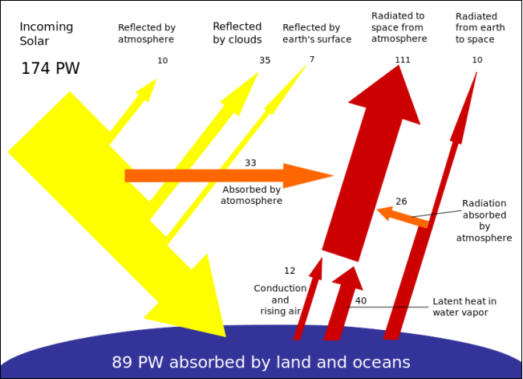

Slide 18
Sun tracking
The most attainable method of improving the performance of solar power collection is to increase the mean intensity of radiation received from the source.

Slide 19
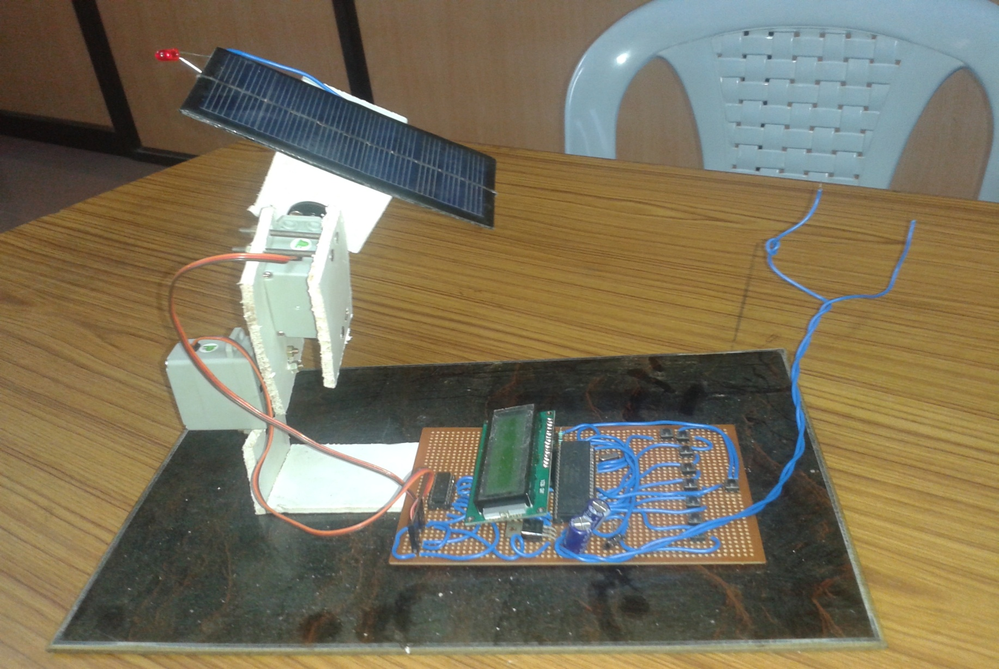
CONTINUOUS SOLAR TRACKING SYSTEM

Slide 20
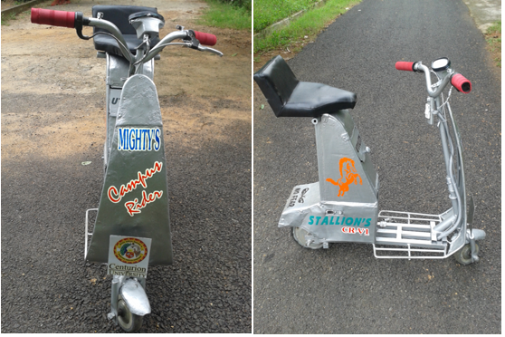
Campus rider

Slide 21
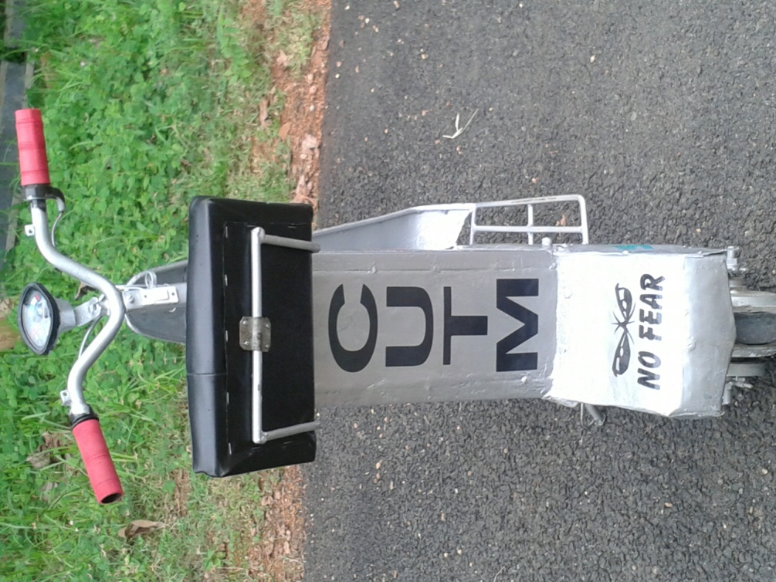
Technical Specifications
Battery : 48 V
Motor : 240W
Transmission : Automatic
Brake : Drum Brake
Max.Speed : 25KMPH
Mileage : 7 to 10 KM
Charging : 3Hours
Seat : Single
Weight : 40Kg (Approx)
Driver Wheels : Rear
Front : Caster Wheel
Body : Sheet Metal
LXBXH : 105X36X80 CM

Slide 22
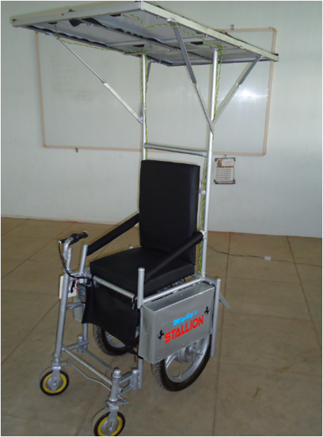
Wheel chair

Slide 23
Thank you...

