Slide 1
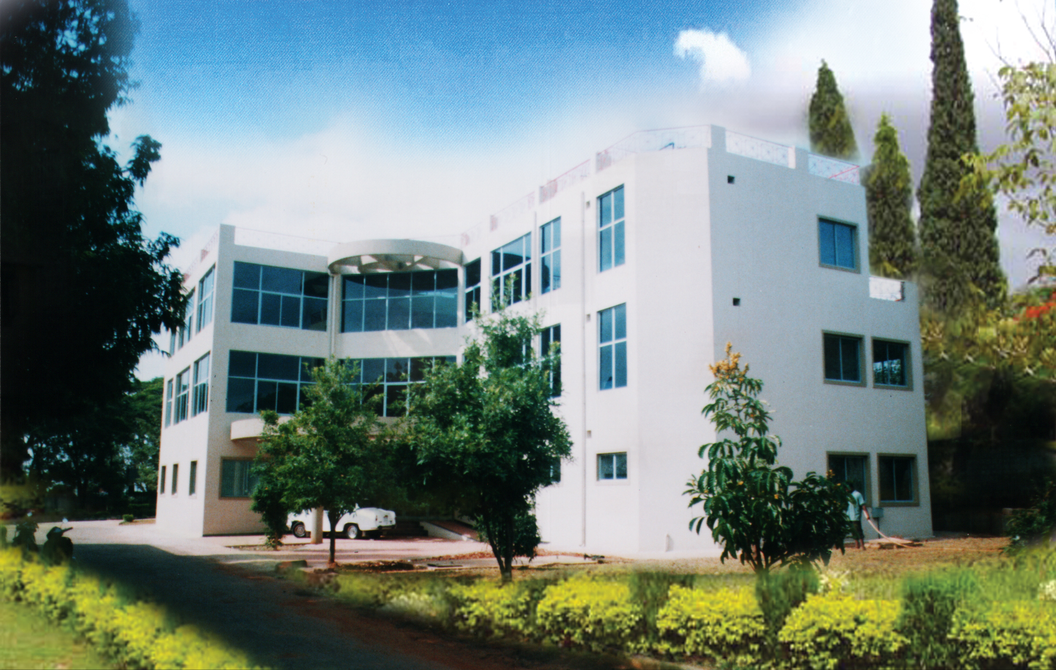
All India Institute of Speech and Hearing
An autonomous body
Under administrative
control of the Ministry of Health and Family Welfare,
Government of India
----------------
Founded in 1965
As Institute of Logopedics
----------------
Foundation stone laid on 25.07.1966
by Dr.S.Radhakrishnan
President of India
----------------
A registered Society under
Indian Societies Registration Act of XXI of 1860
(Punjab Amendment, 1957) 10th October 1966
A pioneer autonomous institute addressing issues related to communication and its disorders

Slide 2
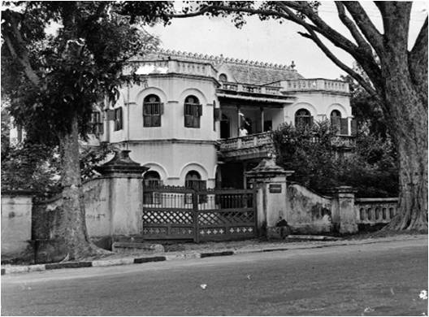
Ramamandira

Slide 3
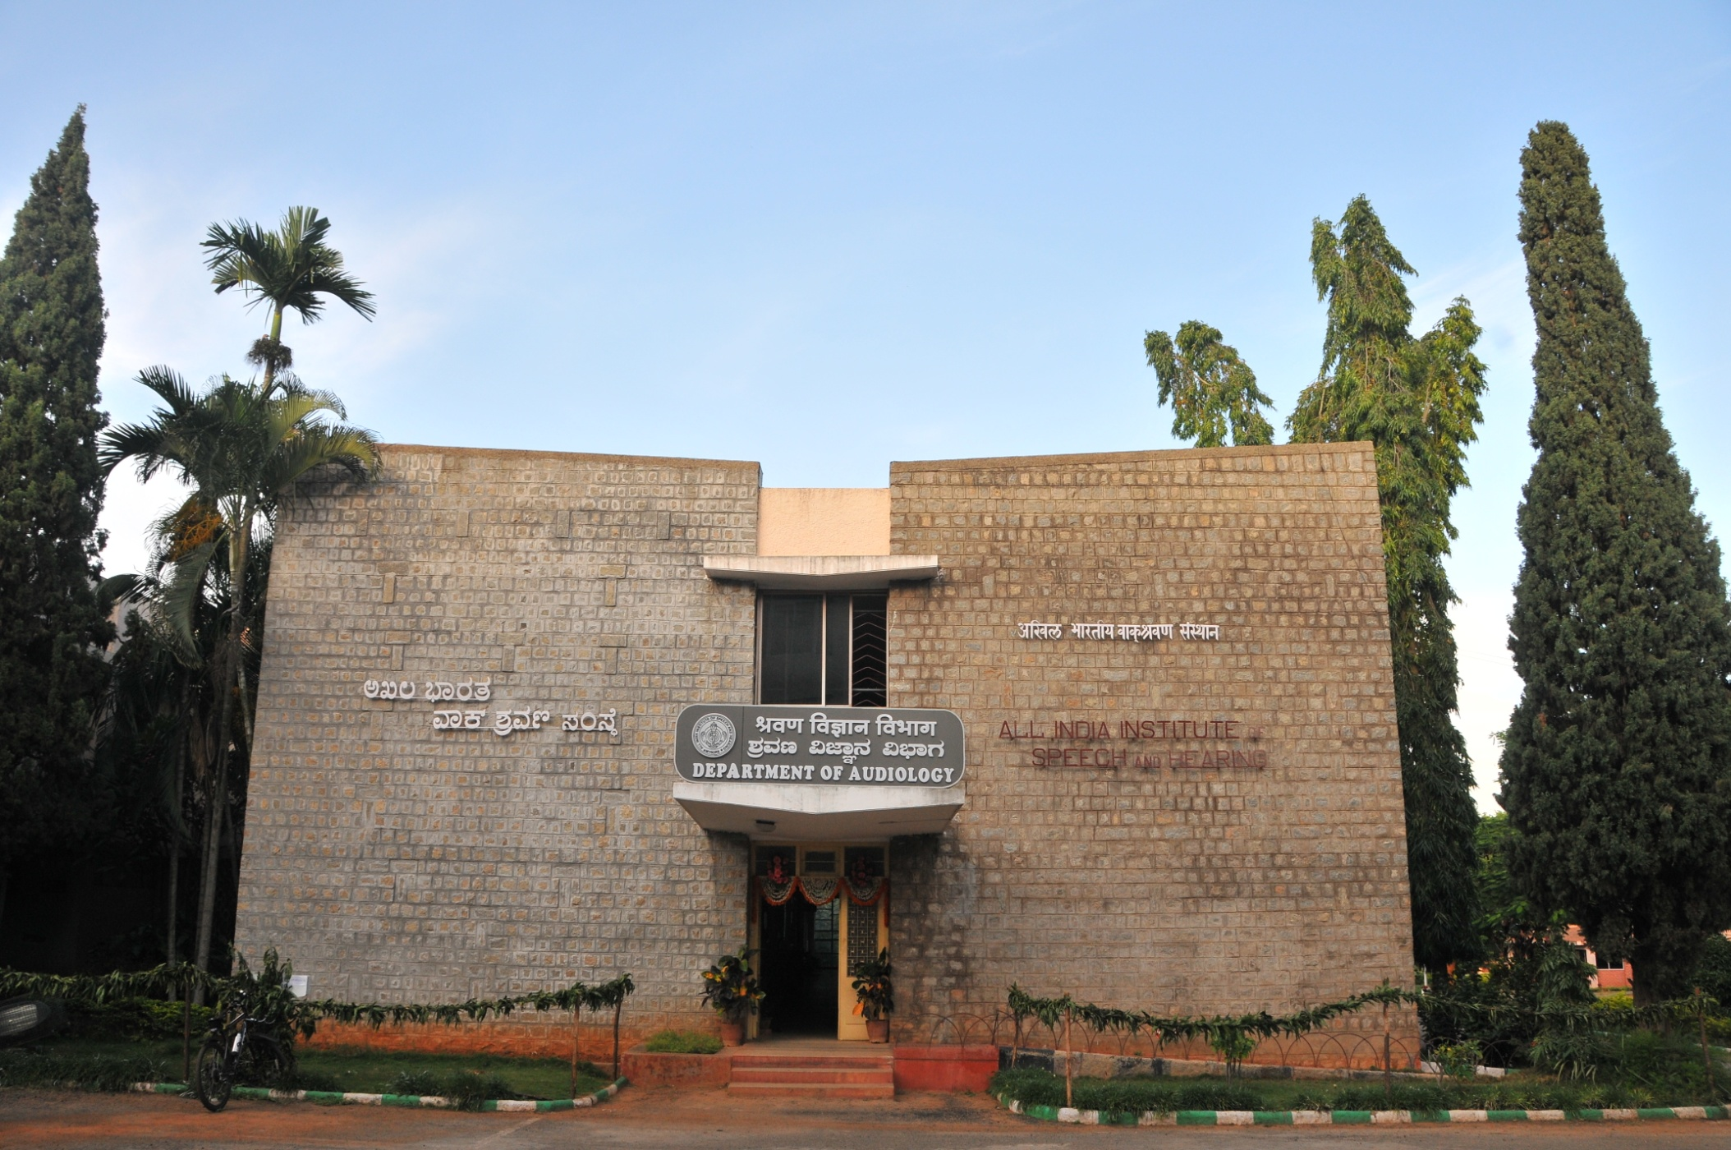
Core Departments
Notes:
Core

Slide 4
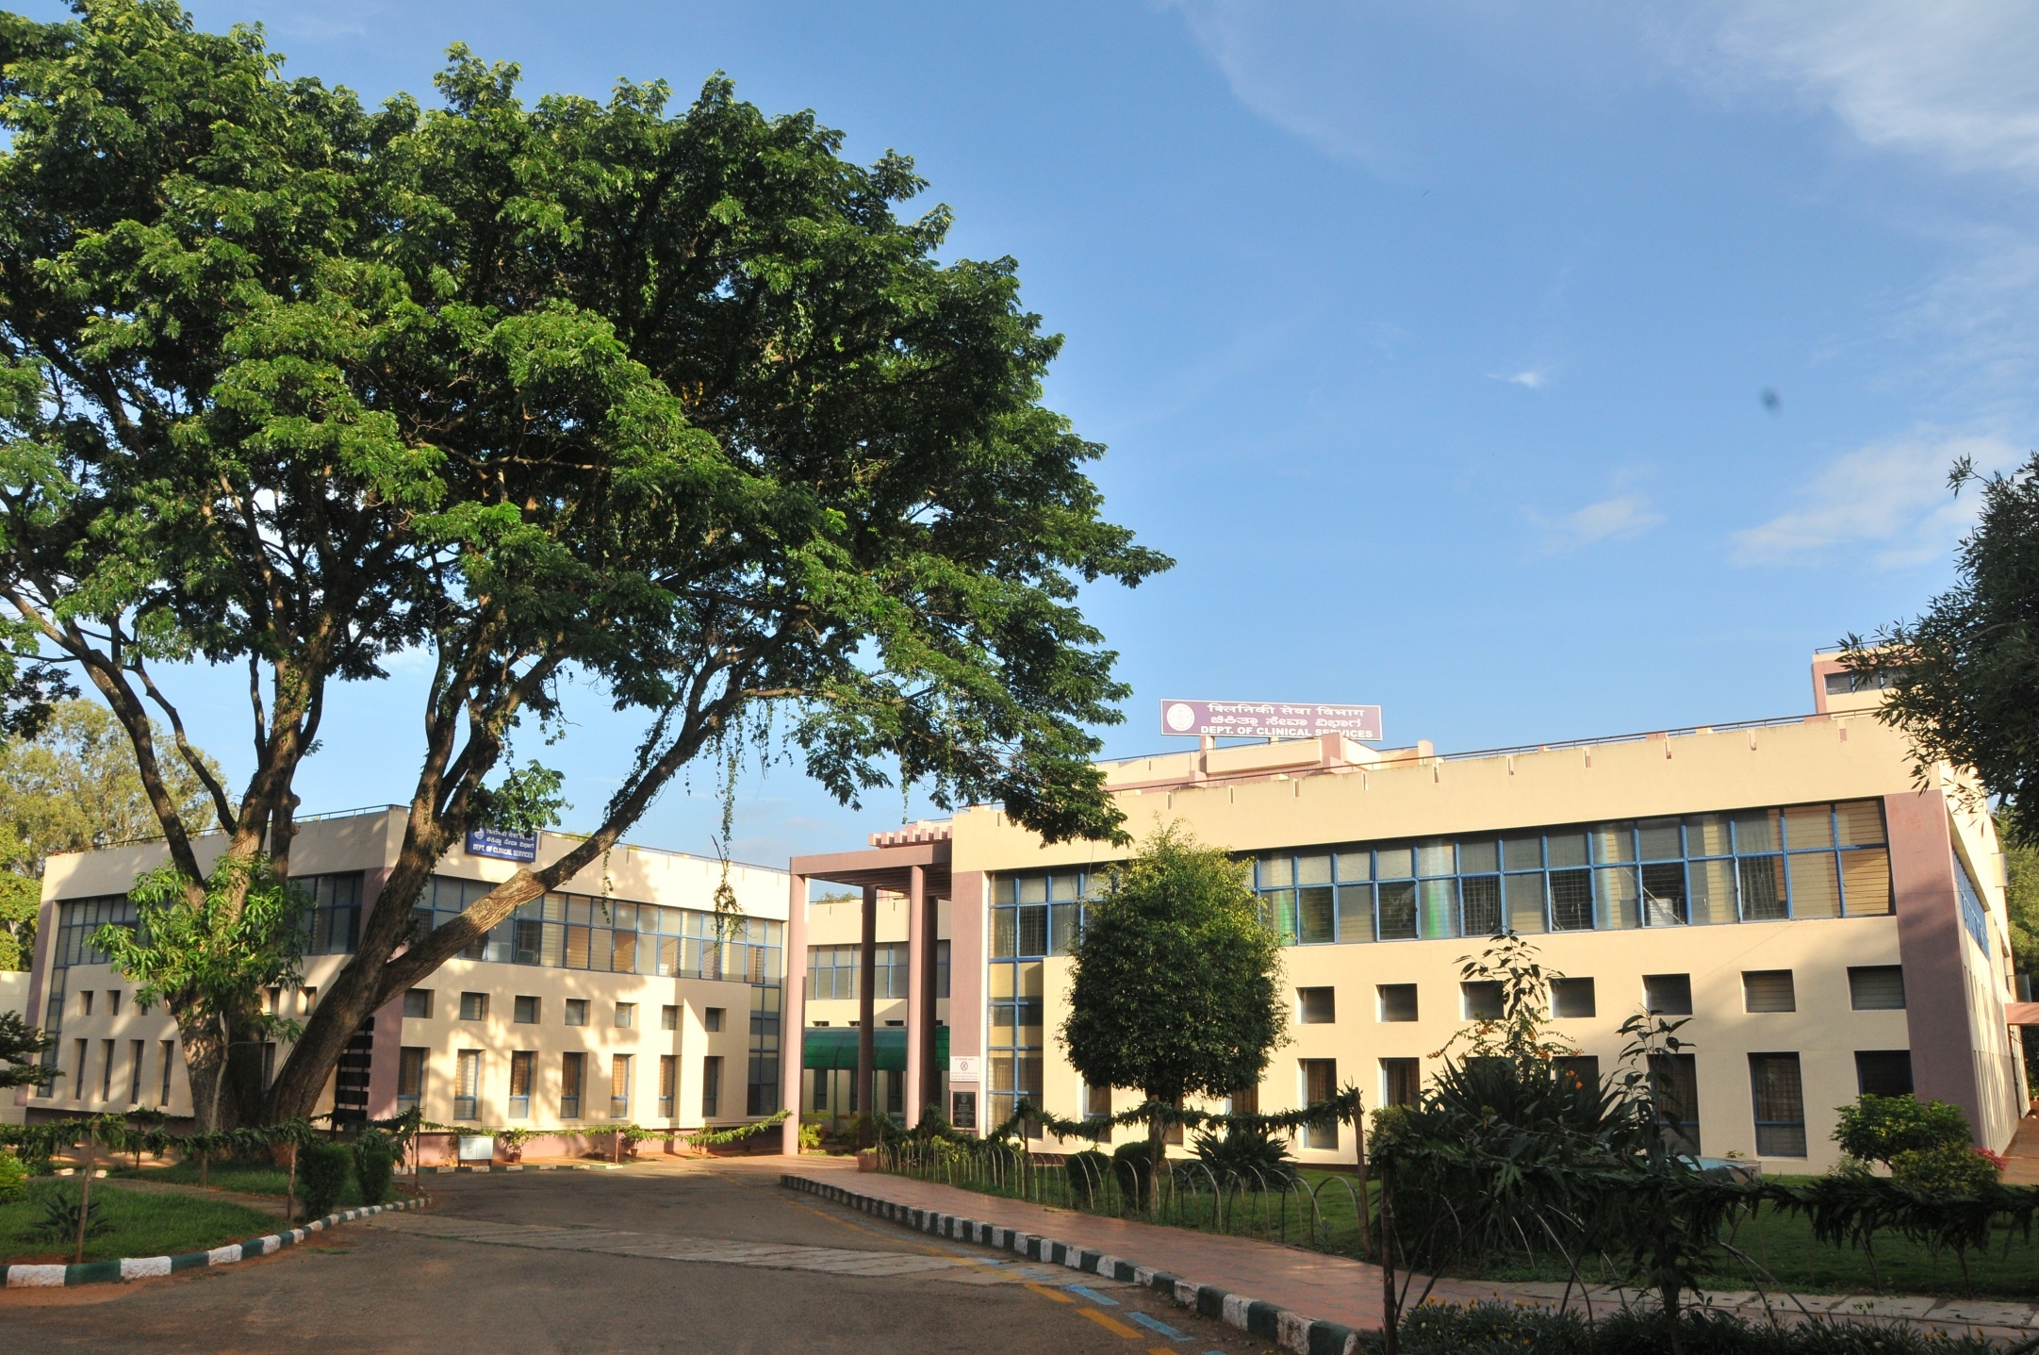
Department of Clinical Services

Slide 5
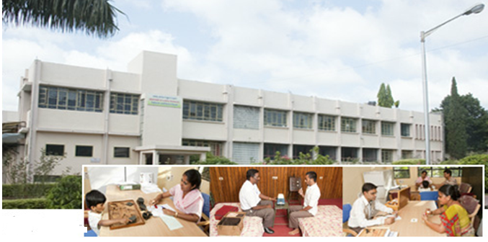
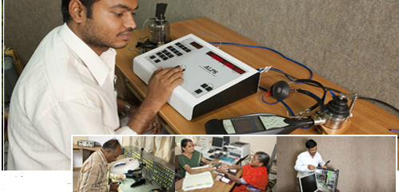
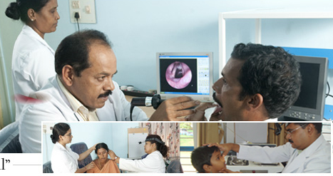
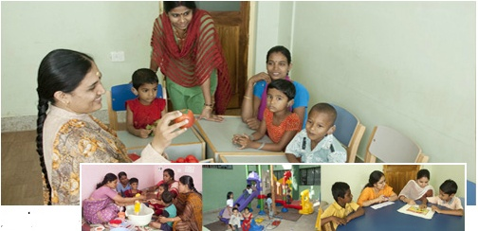
Allied Departments

Slide 6
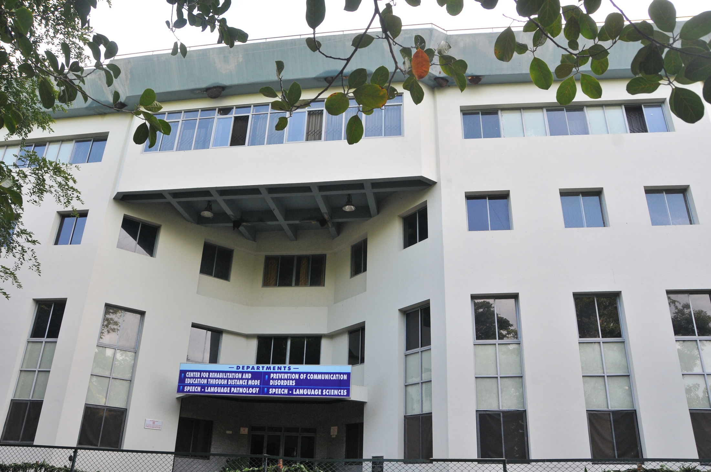
Outreach Departments

Slide 7
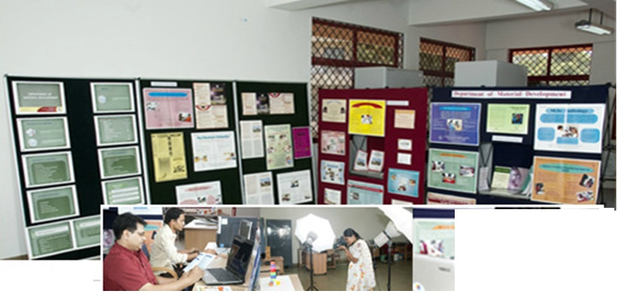
Service Department

Slide 8
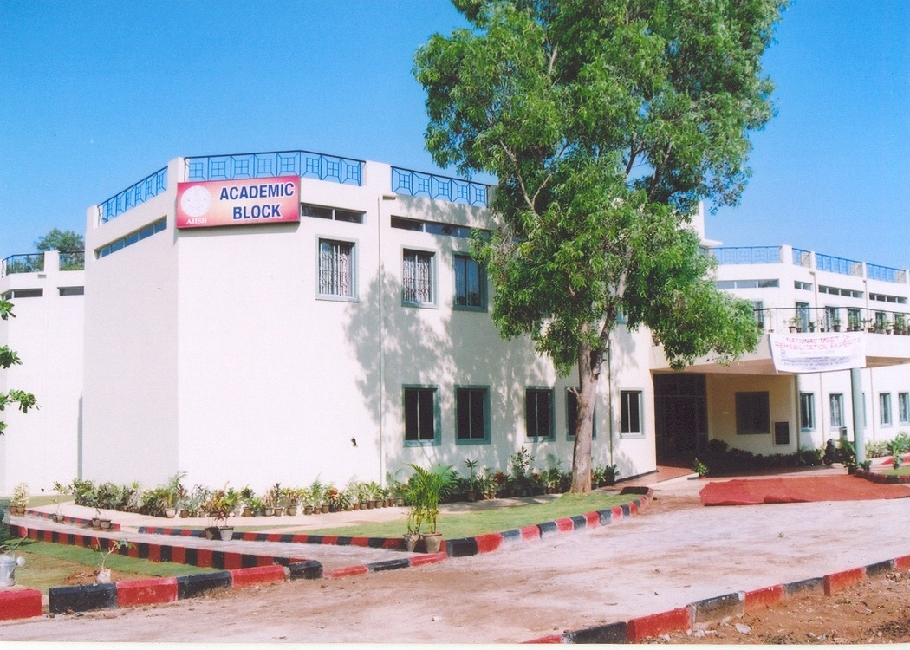
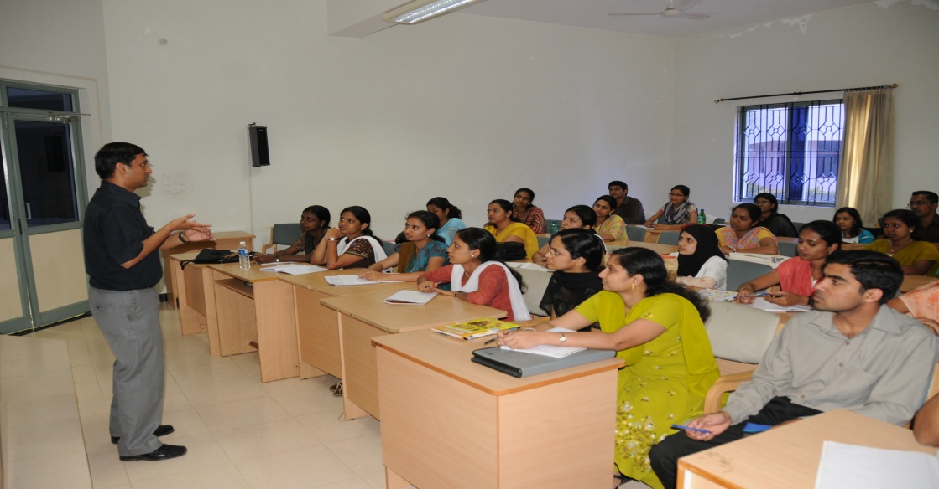
Academic Block

Slide 9
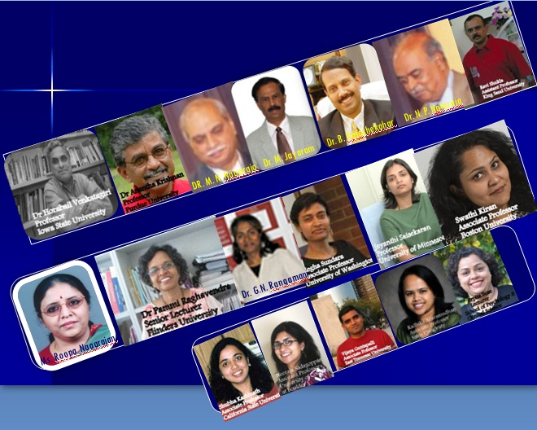
Alumni holding Prominent position across Globe

Slide 10
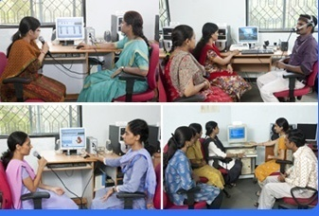
20 Laboratories
Launched in 2013
Electrophysiology
Neuropsychology
Human Genetic

Slide 11
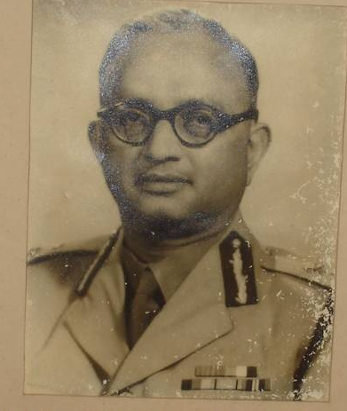
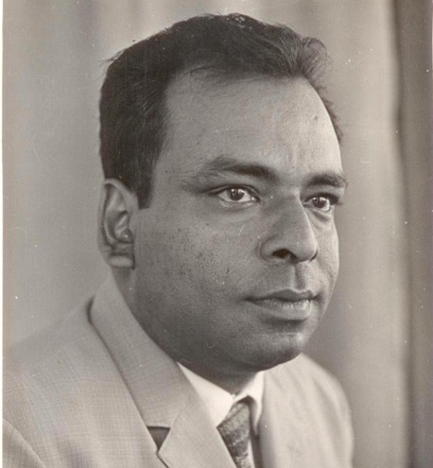
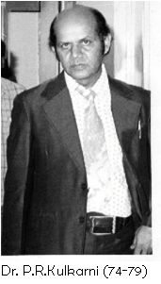
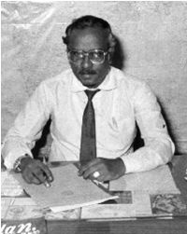
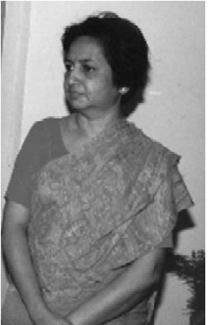
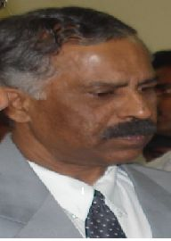
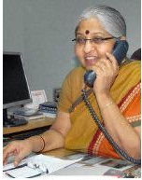
Former Directors
Lt. Gen B. M. Rao Dr. J. J. Dharmaraj Dr. N. Ratna Dr. P. R. Kulkarni
Dr. M. Nityasheelan Dr. S. Nikam Dr. M. Jayaram Dr. Vijayalakshmi
Basavaraj
Notes:
Dr.

Slide 12
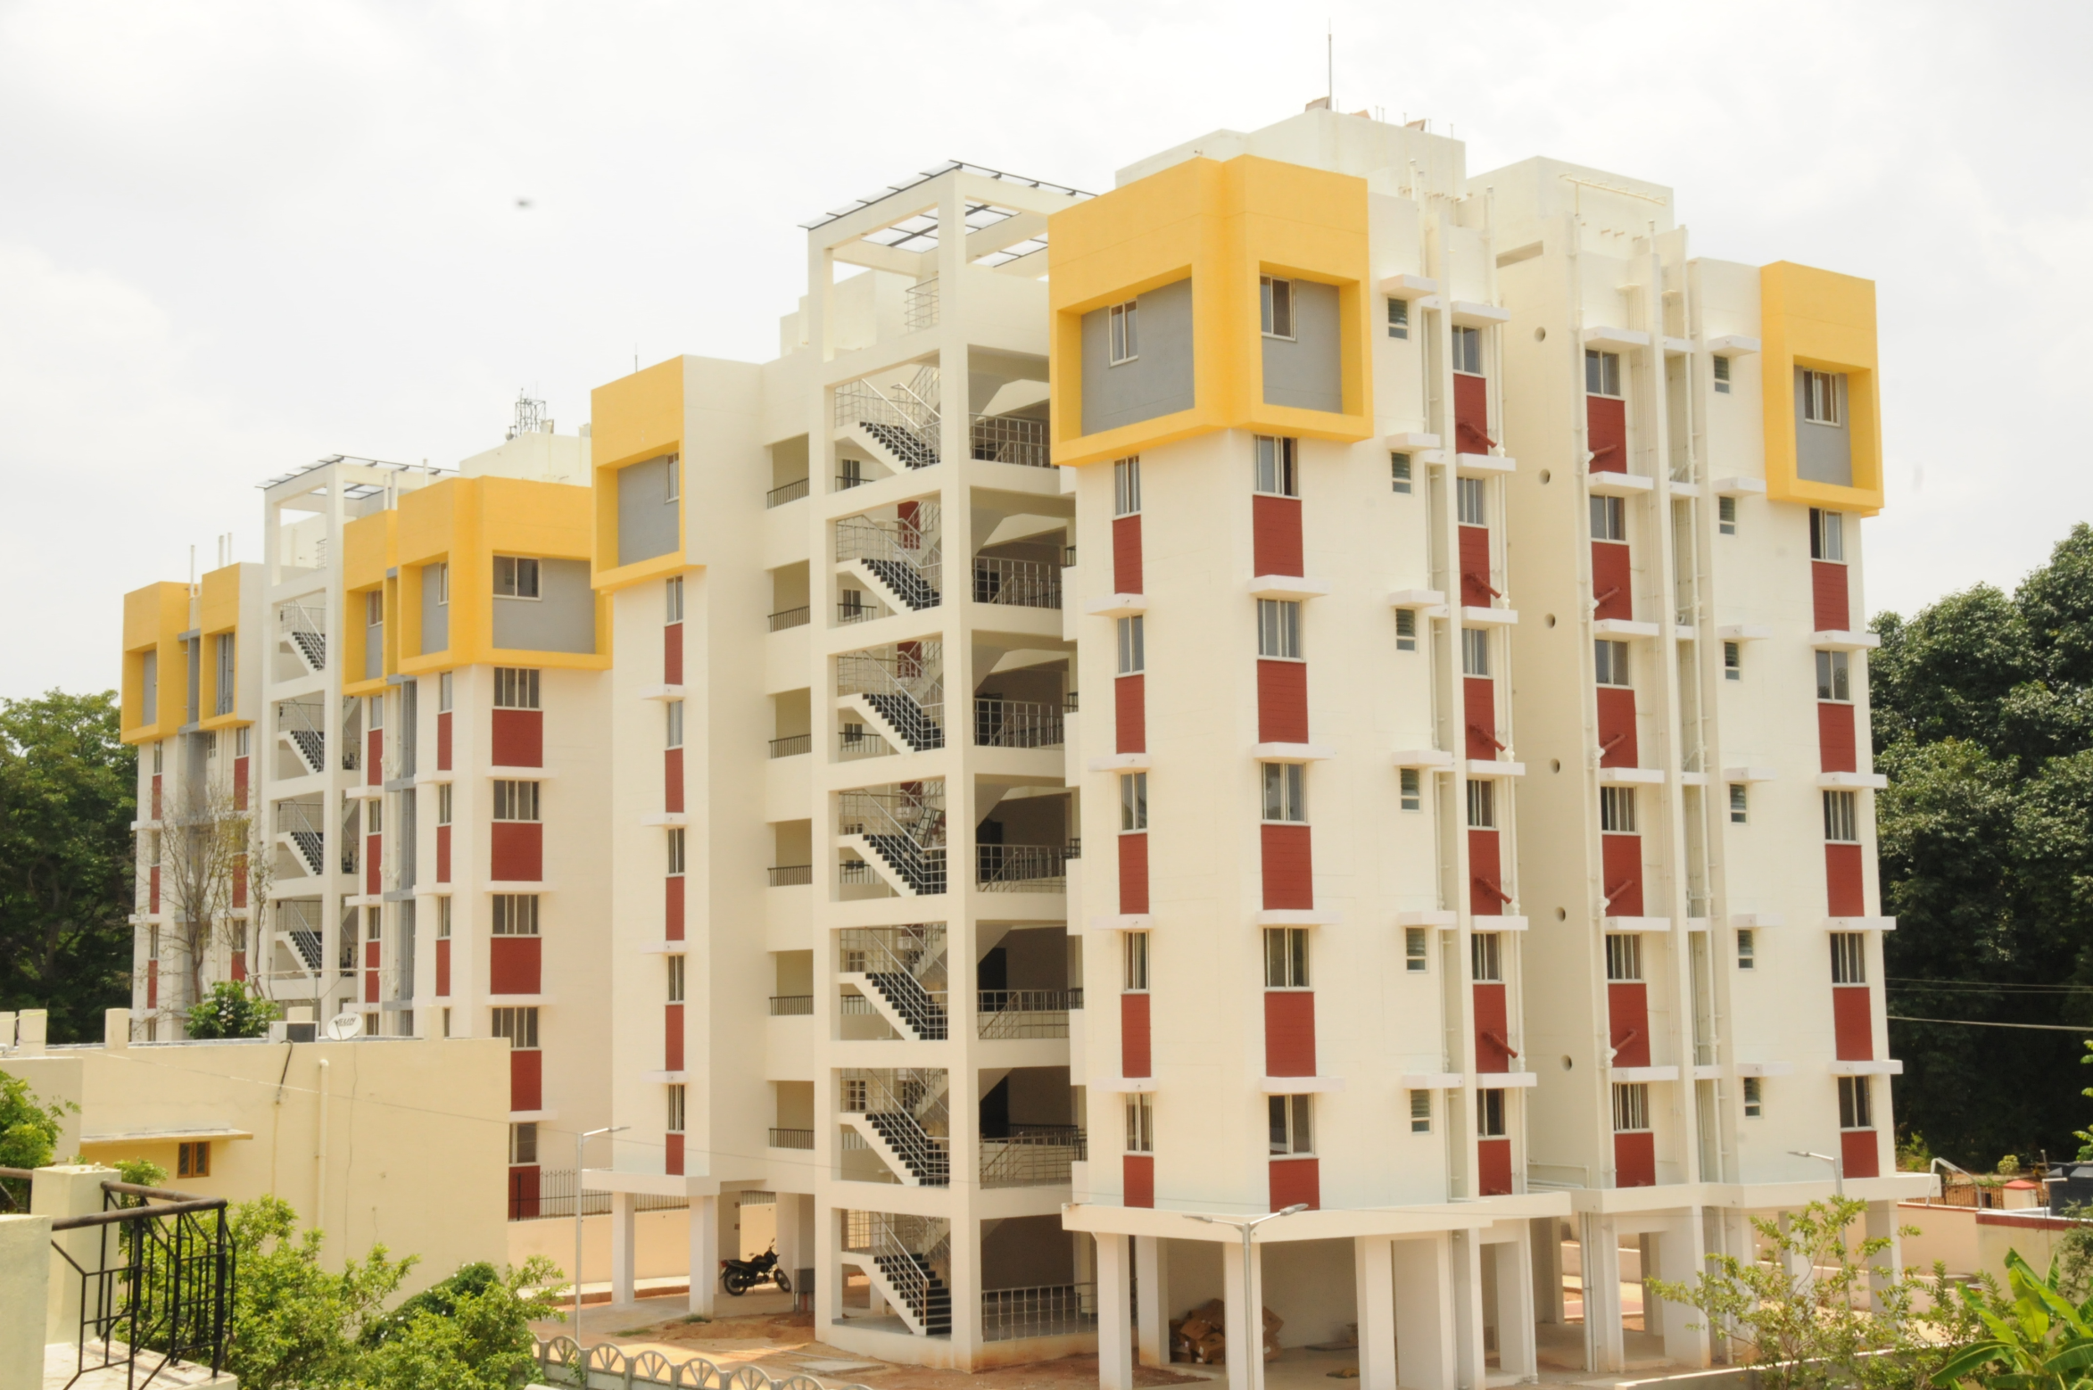
Staff Quarters

Slide 13
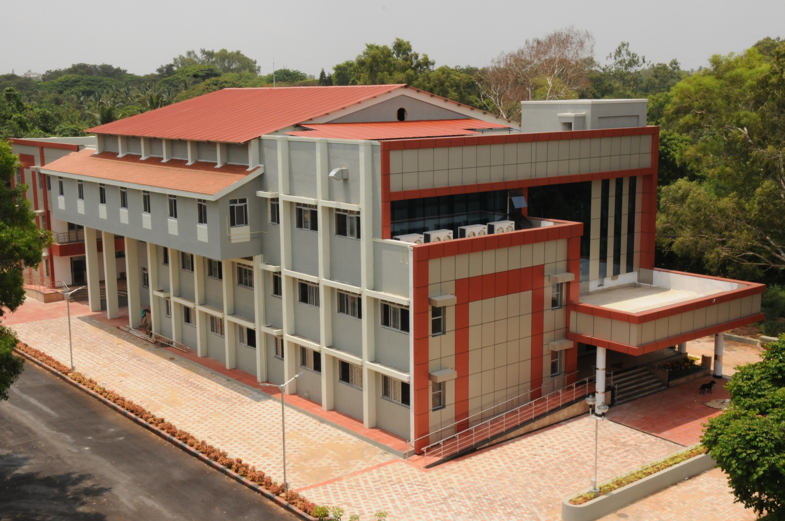

Slide 14
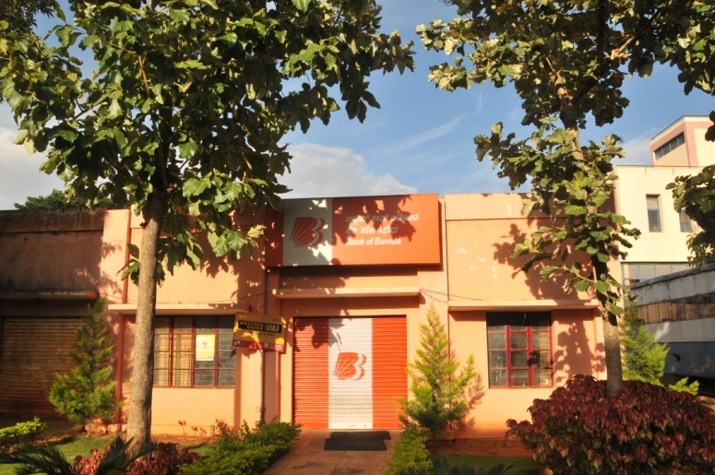
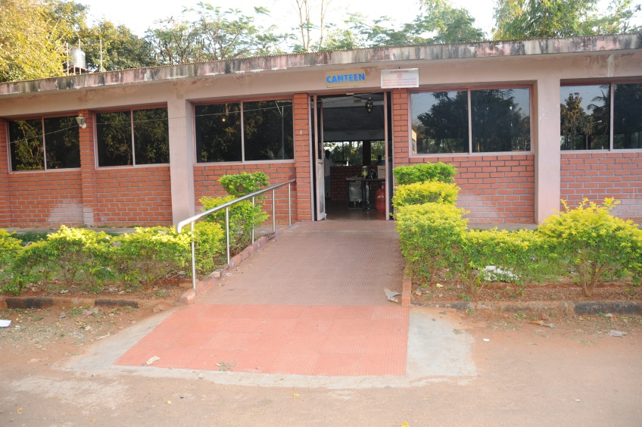
OTHERS
Anti-ragging committee
Anti Ragging Squad
Student grievances redressal cell
Committee for redressal of
complaints of sexual harassment
Student Satisfaction Index
Bank
Canteen
Round the clock security

Slide 15
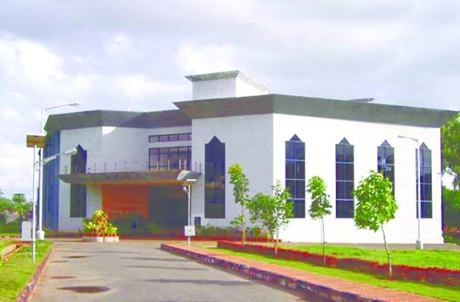
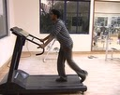
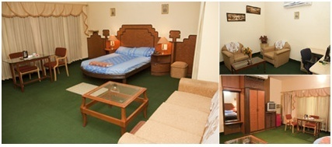
Gymkhana
Staff and Student Welfare Fund
Awards , Prizes
State of the art sports devices are available in the Gymnasium
Science day, Talents day, Intercollegiate Cultural
Cuhoo-Cuhoo
Guest House

Slide 16
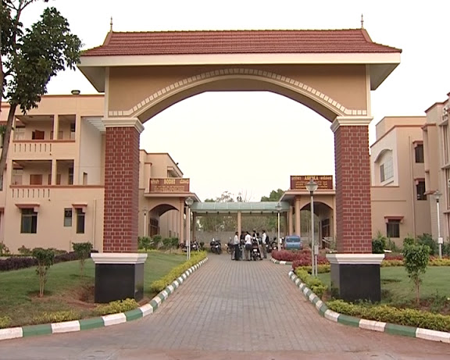
Men‘s Hostel and International Guest house

Slide 17
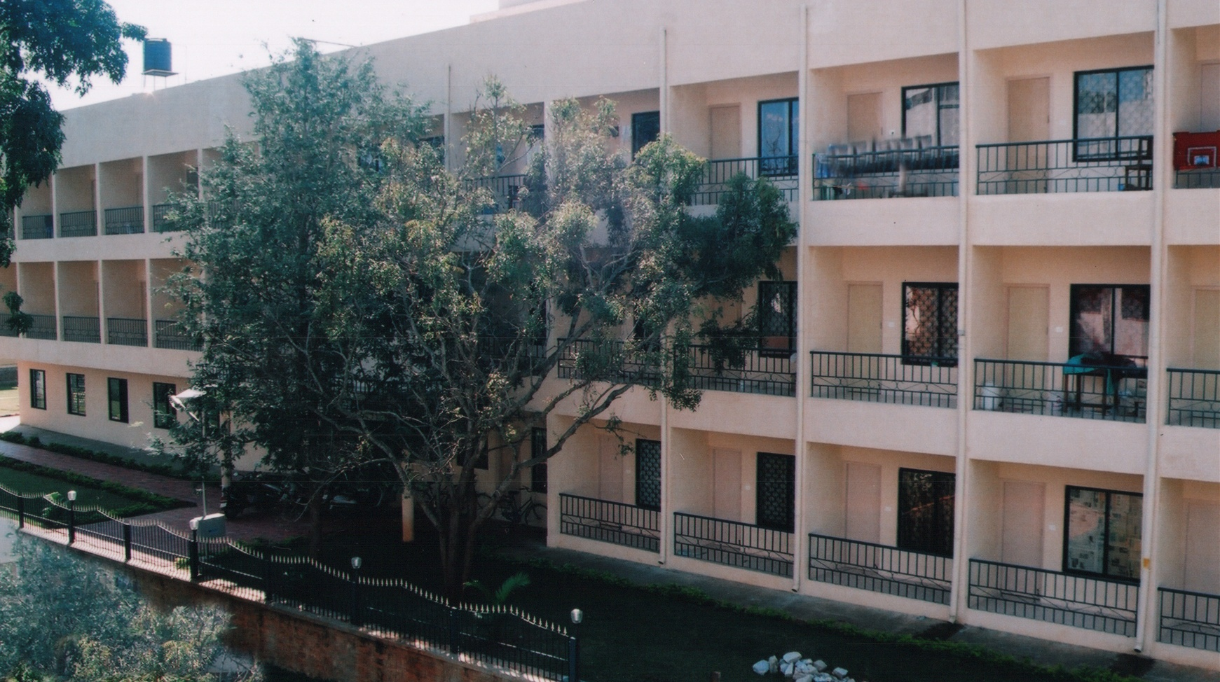
Ladies hostel – 3-storied - 140 rooms

Slide 18
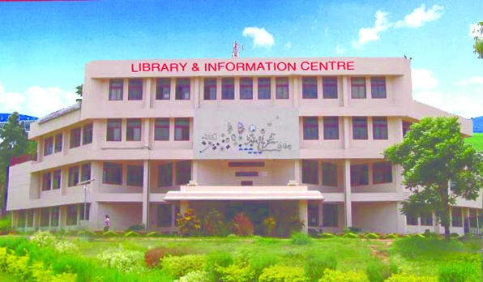

Slide 19
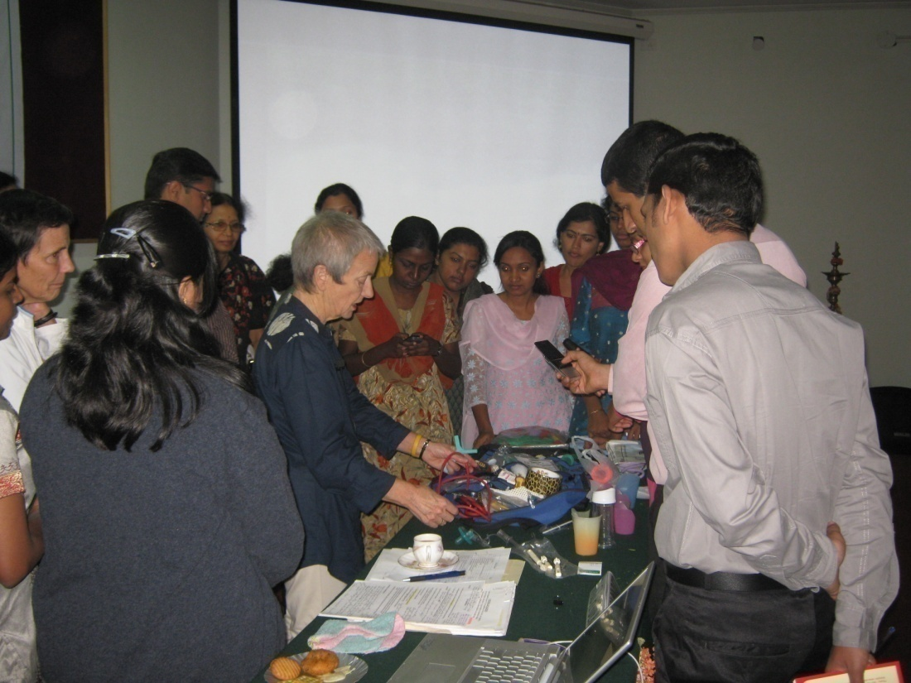
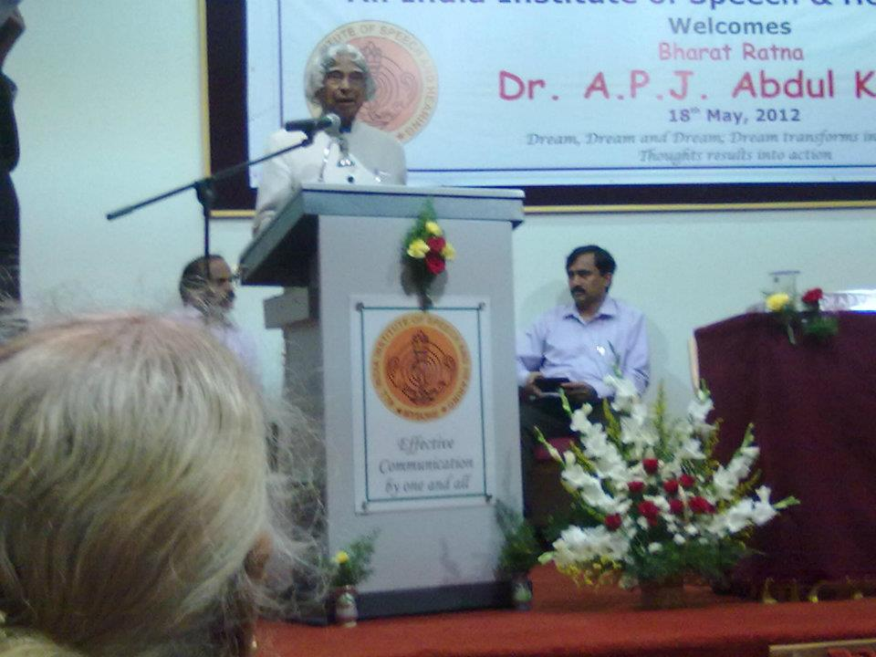
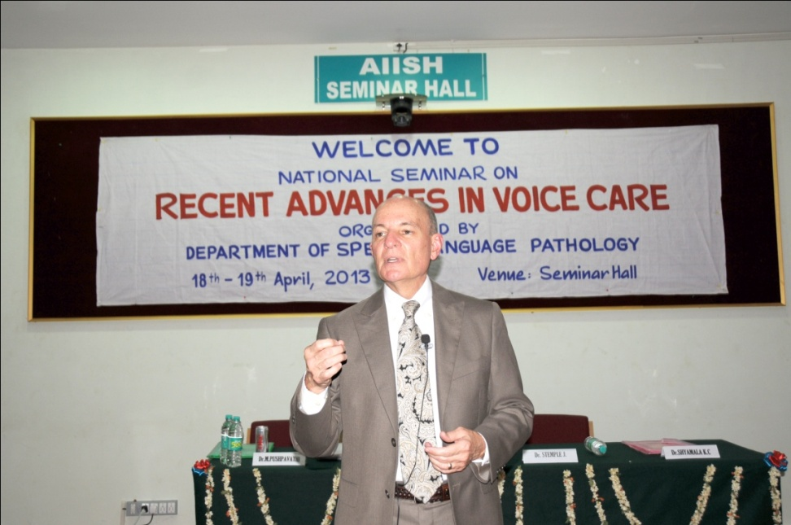
Dr. G. L. Pinder sharing her experience on feeding skills
Dr. A. P. J. Abdul Kalam, Former President of India
Dr. Stemple

Slide 20
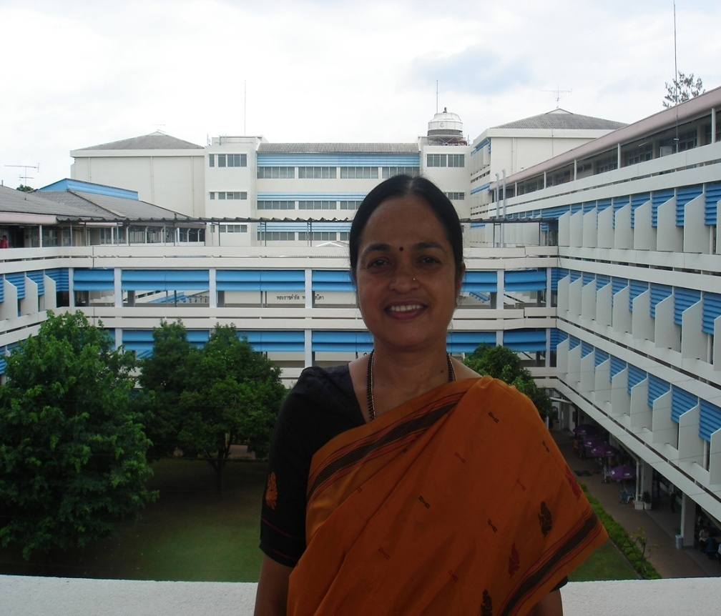
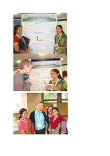
Dr. K. S. Prema
Host Department: Department of Community Medicine, Khon Kaen University , Thailand
Dr. Y. V. Geetha and Ms. Sangeetha
Presentation – International fluency Conference – London, UK

Slide 21
Fulbright Fellow at AIISH
Dr. G. N. Rangamani, Ph.D., CCC-SLP, BC-ANCDS Fulbright Nehru Senior Researcher, Associate Professor, Dept. of Communication Sciences and Disorders, St. Cloud State University, St. Cloud, MN, U.S.A. September 2010 –May 2011

Slide 22
Fulbright Fellow

Slide 23
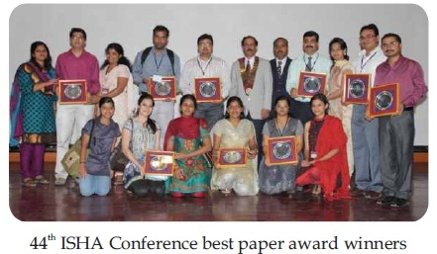
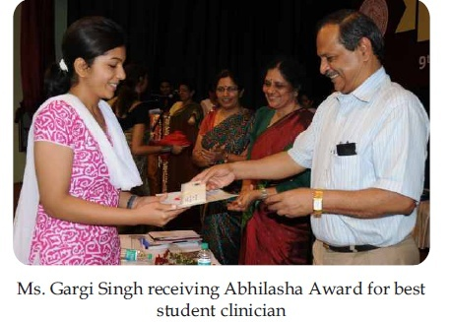
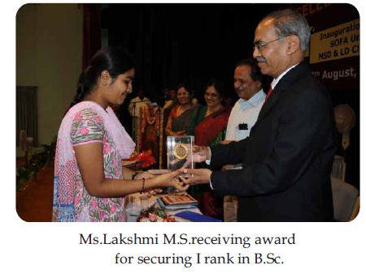
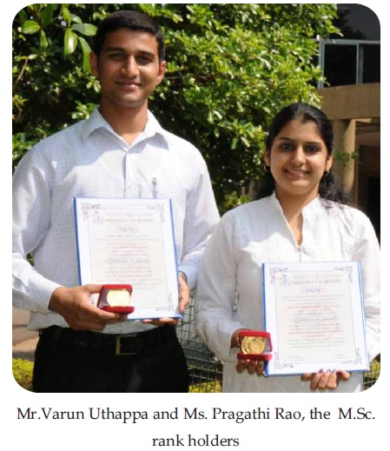

Slide 24
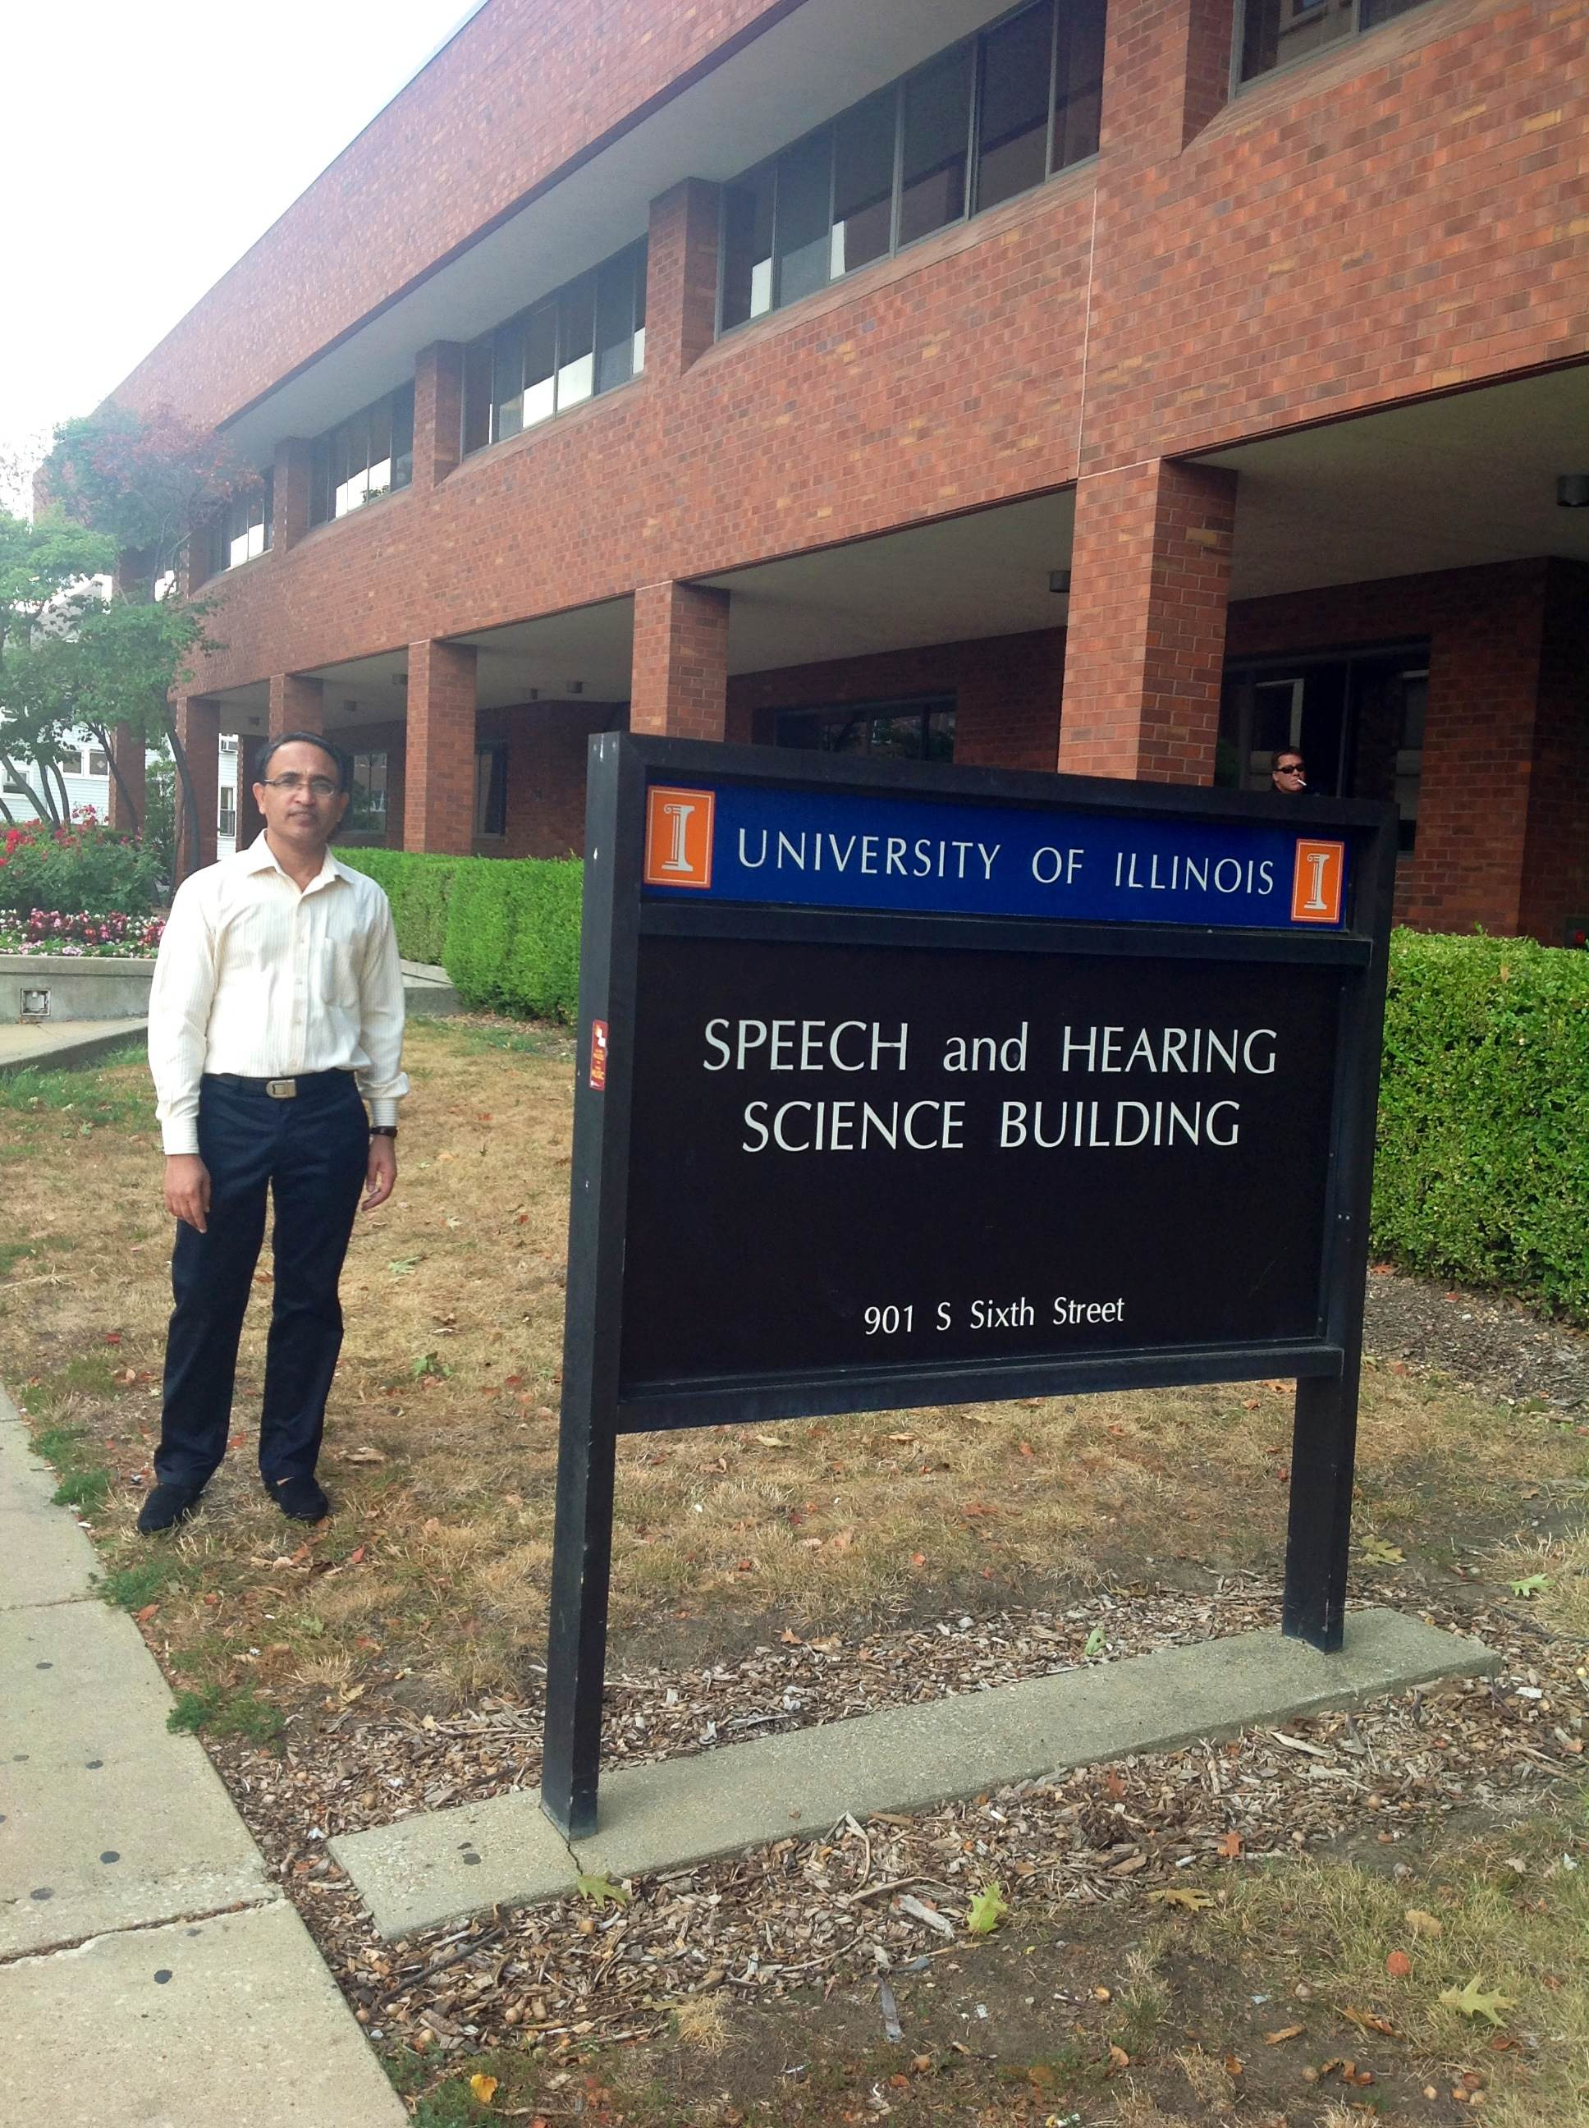
UGC C. V. Raman Post-Doctoral Fellow

