Slide 1
All India Institute of Speech and Hearing (An Autonomous Institute under the Ministry of Health & Family Welfare, Govt. of India
Annual Report
2012-13

Slide 2
1
Administration

Slide 3
Administrative Activities
Submission of self study report to NAAC for accreditation
Application for Deemed to be University status to UGC
Comments on National Comm. for Human Resources for Health Bill
Initiation of ISO 9001-2008 certification process

Slide 4
1
Administration

Slide 5
Administrative Decisions
Launching of PG Diploma in AAC with five seats for students from SAARC countries
Institution of Dr. Vijayalakshmi Basavaraj Gold Medal
Re-constitution of Ethics Committee

Slide 6
2 Major Events

Slide 7
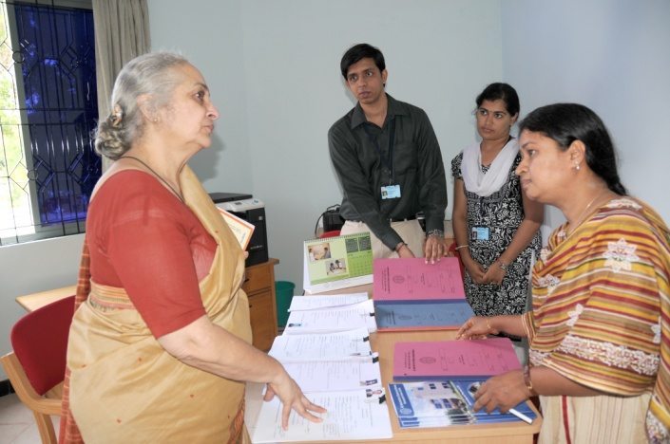
Academic Events
Establishment of Placement Cell
Launching of Online Application System
Initiation of National Lib. & Info. Services Infrastructure for Scholarly Content

Slide 8
2 Major Events

Slide 9
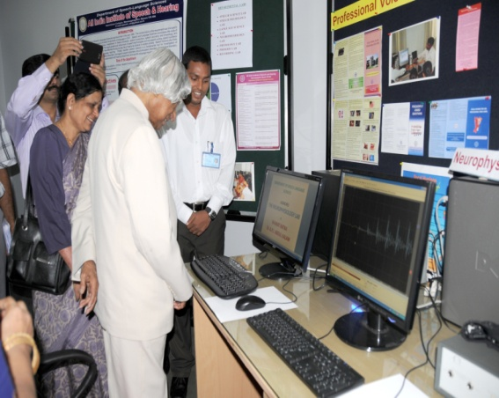
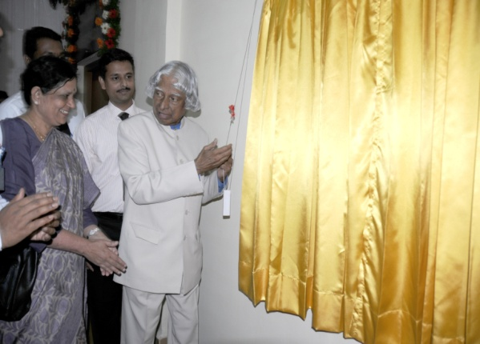
Research Events
Launching of Neurophysiology Lab
Launching of Psychoacoustics Lab
Initiation of Plagiarism Detection Service

Slide 10
2 Major Events

Slide 11
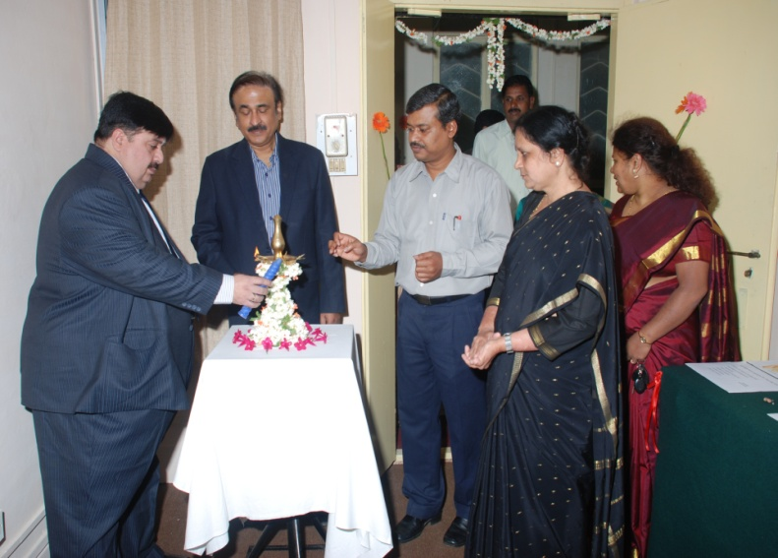
Clinical Events
Opening of Clinic for Adult & Elderly Persons with Language Disorders
Opening of Implantable Hearing Devices Unit

Slide 12
2 Major Events

Slide 13
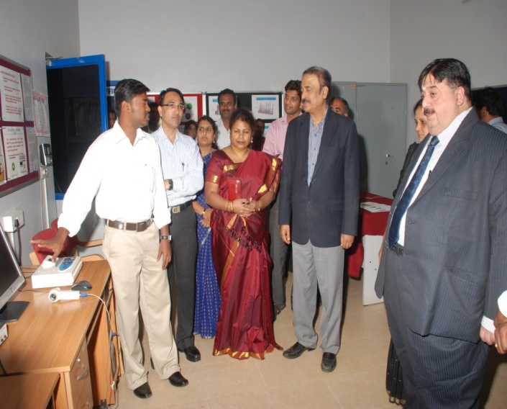
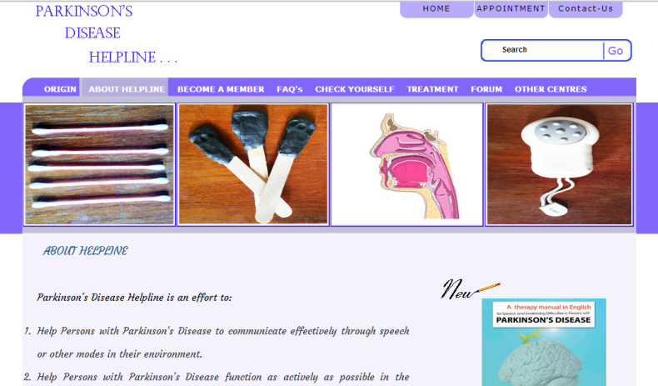
Clinical Events-II
Opening of Voice Clinic
Launching of Online
Helpline for Parkinson’s
Disease

Slide 14
2 Major Events

Slide 15
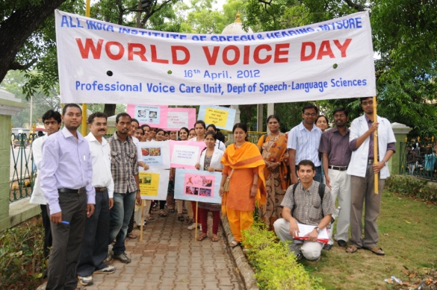
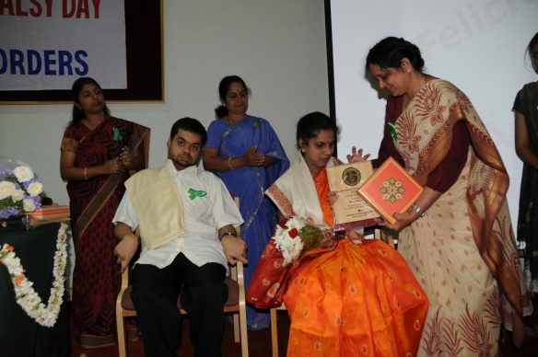
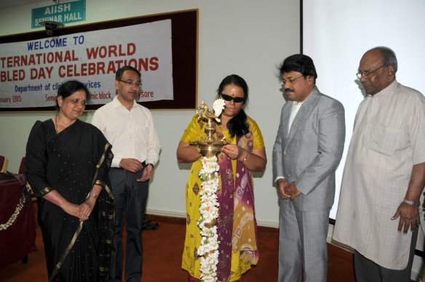
Clinical Events- III
World Voice Day on 21st April, 2012
National Cerebral Palsy Day on 3rd October, 2012
Internat. Day of Persons with Disabilities on 16th January, 2013

Slide 16
3
Learning and Teaching

Slide 17
Academic Programs Offered
14 Academic programs ranging from certificate to post doctorate
Diploma in Hearing, Language and Speech at 12 centers across the country

Slide 18
3
Learning and Teaching

Slide 19
Admission and Enrolment
National level entrance examinations were conducted to admit students to B.Sc. & M.Sc. courses
Totally 339 students admitted, and 203 among them were girls
There were students from all over the country
The total student strength was 631

Slide 20
3
Learning and Teaching

Slide 21
Academic Performance
100 percentage pass in B.S.Ed. and P.G.D.C.L. examinations
More than 94 percentage pass in B.Sc. (Sp.& Hg.), M.Sc. (Audiology) and M.Sc. (SLP) examinations

Slide 22
3
Learning and Teaching

Slide 23
Educational Stipend
Distributed stipend to all the eligible students
The total amount spent was ` 74.5 lakhs

Slide 24
3
Learning and Teaching

Slide 25
Invited Talks & Guest Lectures
Faculty and staff delivered 142 invited talks both inside and outside the institute
Organized 10 guest lectures by eminent personalities in the area of communication disorders

Slide 26
3
Learning and Teaching

Slide 27
Training/ Workshops/Conferences
120 short-term training/orientation programs were organized and totally 3300 persons were trained
24 professional workshops/conferences were organized with an attendance of 1500 professionals and students

Slide 28
4
Research

Slide 29
Funded Research Projects
The projects were funded by the Institute and external agencies such as ICMR and DST
Completed: 38 projects worth ` 147 lakhs
Ongoing: 43 projects worth ` 321 lakhs
Initiated: 24 projects worth ` 154 lakhs

Slide 30
4
Research

Slide 31
Doctoral Research
Doctoral degree was awarded to three candidates namely, Mr. Jayakumar, T., Ms. Yeshoda K. and Ms. Deepa M. S.
5 candidates submitted theses
42 candidates were pursuing research

Slide 32
4
Research

Slide 33
Postgraduate Research
71 Research projects completed
61 Research projects ongoing

Slide 34
4
Research

Slide 35
Paper Presentations & Publications
International Conferences: 15
National Conferences: 44
International Journals: 15
National Journals: 40
Book/ Book Chapters: 17

Slide 36
4
Research

Slide 37
Institute Serial Publications
Journal of All India Institute of Speech and Hearing, V.31
Student Research at AIISH, V. 9
Part A : Audiology
Part B : Speech Language Pathology
Part C : Special Education

Slide 38
5
Clinical Care

Slide 39
Clinical Registration
Total Clients = 50906
New = 21006
Review = 29900
Geographical Distribution
Karnataka = 19713
Kerala = 719
T.Nadu = 230

Slide 40
5
Clinical Care

Slide 42
5
Clinical Care

Slide 43
General Clinical Services
Speech and Language
Audiology
Psychology
Otorhinolaryngology

Slide 44
5
Clinical Care

Slide 45
Speech & Language Assessment and Rehabilitation
Total Clients = 8161
Clients diagnosed with disorders = 7664
Clients underwent therapy = 5945
Therapy Sessions = 74,151

Slide 46
5
Clinical Care

Slide 47
Audiological Assessment and Rehabilitation
Total Clients = 13572
Clients evaluated for hearing devices = 10594
Hearing aids prescribed = 5867

Slide 48
5
Clinical Care

Slide 49
Psychological Assessment & Rehabilitation
Total Clients Assessed = 6876
Rehabilitation Provided:
Behavior therapy
Home based training
Remedial training
Parent counseling
Neuropsychological rehabilitation

Slide 50
5
Clinical Care

Slide 51
Otorhinolaryngological Assessment and Rehabilitation
Total Clients Evaluated = 36910
Major Surgery = 285
Minor Surgery = 147

Slide 52
5
Clinical Care

Slide 53
Specialized Clinical Services
Augmentative & Alternative Communication
Autism Spectrum Disorders
Fluency Disorders
Implantable Hearing Devices
Lang. Disorders of Adult & Elderly Persons
Learning Disabilities
Listening Training
Motor-Speech Disorders
Professional Voice Care
Structural Orofacial Anomalies
Vertigo
Voice

Slide 54
5
Clinical Care

Slide 55
Medical Specialty and Allied Health Services
Medical Specialty Services
Neurology
Pediatrics
Phono surgery
Plastic surgery
Prosthodontics
Orthodontics
Allied Health Services
Physiotherapy
Occupational Therapy

Slide 56
5
Clinical Care

Slide 57
Special Education Services
Preschool training
Parent-infant training
Preschool parent empowerment
Curricular support / Individualised edu. service
Educational counseling & guidance
Co-curricular service
Computer & literacy training for care givers

Slide 58
5
Clinical Care

Slide 59
Clinical Electronic Services
Electro-acoustic evaluation of hearing aids
Management and issue of hearing aids
Total hearing aids distributed = 4397
ADIP Scheme = 2686
AIISH HADS = 1711
Hearing aids repaired = 858

Slide 60
5
Clinical Care

Slide 61
Clinical Support Services
Counseling and guidance
Issue of certificates for financial aid, income tax exemption, educational scholarship, and school admission
Financial assistance

Slide 62
6
Outreach Services

Slide 63
Communication Disorder Screening Programs
Infant Screening
12 hospitals/immunization centres in Mysore
3 Outreach Centres and nearby hospitals
3 DHLS Centres in Cuttack, Imphal and Ajmer
Industrial Screening
Rane Madras Pvt Ltd., Mysore
School Screening
12 schools in Mysore city
3 schools nearby the Hullahalli OSC
Camp based Screening
19 camps in Karnataka & Lakshadweep Islands

Slide 64
6
Outreach Services

Slide 65
Clinical Services at Outreach Centres
Speech and Hearing Evaluation of 4078 clients ranging from infants to adults
2299 clients diagnosed with various communication disorders were provided rehabilitation

Slide 66
6
Outreach Services

Slide 67
Other Outreach Services
Tele-intervention & assessment of persons with communication disorders at 10 DHLS centers
Web-based information support
Educational guidance and counseling through distance mode

Slide 68
7
Public Education

Slide 69
Public Education
12 Monthly Public Lectures
40 Public Education Materials
Awareness Programs
Screening Camps
Open Day

Slide 70
8
Supporting Services

Slide 71
Supporting Services
Library and Information Services
Material Development Activities
Public Information Activities

Slide 72
9
Extracurricular Events

Slide 73
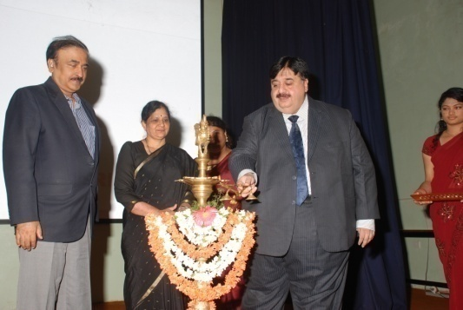
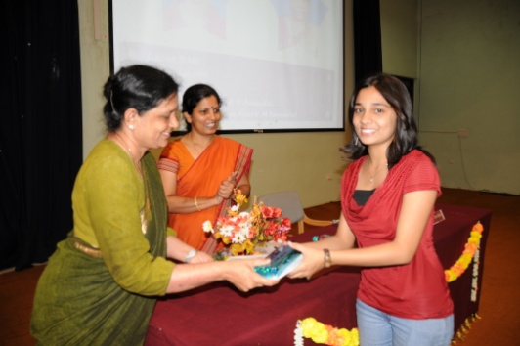
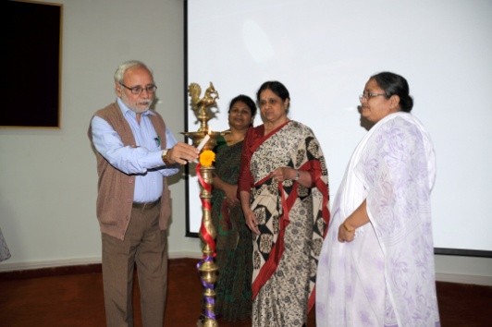
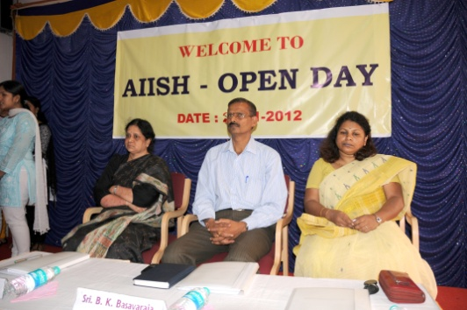
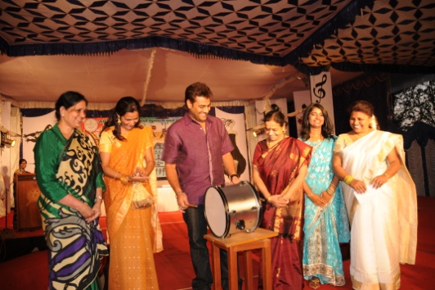
AIISH Gymkhana
47th Annual day celebrations on 9 August, 2012
Prathibha Puraskar on 17th July, 2012
Kannada Rajyotsava Day on 8th November, 2012
Open Day on 23rd November, 2012
AIISH Aawaaz on 1st March, 2013

Slide 74
9
Extracurricular Events

Slide 75
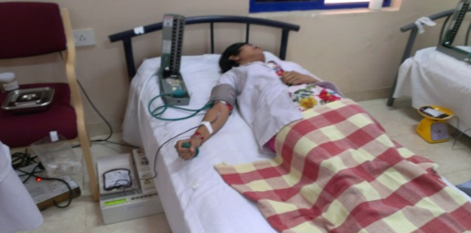
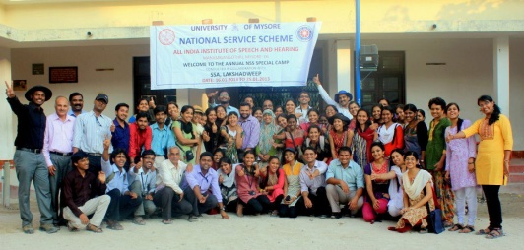
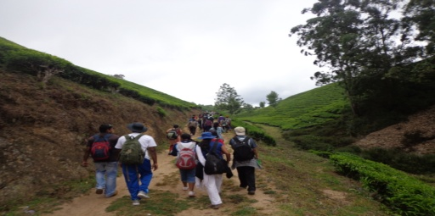
National Service Scheme Unit
Blood donation camp
Special camp Trekking
Kannada classes
Literary activities
Orientation classes
Orphanage visit
Shramadan

Slide 76
10
Official Language Implementation

Slide 77
Activities Carried Out
Training for Prabodh & Praveen courses
Development of various materials in Hindi
Displaying of frequently used words
Celebration of Hindi week
Organization of Hindi workshops

Slide 78
Awards Received
The Hindi version of the institute Annual Report 2009-10 received Karyalaya Darpan Smuti Chinh Puraskar by Rajbhasha Sansthan, New Delhi
Dr. H. P. Uma Saraswathi, Hindi Translator was honoured by the Ministry of H&FW, Govt. of India, New Delhi for best performance in Official Language Implementation

Slide 79
11
Reservation Policy Implementation

Slide 80
Reservation Policy Implementation
Appointed a Liaison Officer to look into the matters of reservation policy and address grievances of employees
Ensured reservation in institute service and reservation of seats in various academic courses

Slide 81
12
Other Activities and Events

Slide 82
Personnel Management
Recruited of 9 regular staff
6 promoted under Assessment Promotion Scheme, and one under regular promotion
10 staff completed 25 years in service
4 staff retired/ resigned

Slide 83
Financial Matters
Grant-in-aid
Non-Plan = ` 10,14,12,383.00
Plan = ` 25,41,48026.00
------------------------
Total = ` 35,55,60,409

Slide 84
12
Other Activities and Events

Slide 85
Infrastructure Development & Maintenance
Spent ` 80 lakhs for electronic and I.T. Infrastructure
Completed 22 maintenance and civil construction works of ` 36.78 lakhs & construction works of ` 2601.87 lakhs nearing completion
Maintained an aesthetically pleasing natural environment and garden and won many prizes during the Dasara Horticultural Show, 2012
Purchased 101 equipments by spending ` 3,31 72000

Slide 86
12
Other Activities and Events

Slide 87
Awards and Laurels
Dr. S. R. Savithri, Director received the prestigious Visvesvaraya Vijnana Puraskara at the 8th Kannada Vijnana Sammelana organized by Swadeshi Vijnana Andolana, Karnataka at the University of Agricultural Sciences, Dharwad
Dr. R. Manjula, Professor and Head, CREDM received Dr.N. Rathna Oration Award hosted by the Indian Speech and Hearing Association for her incredible contribution to the field of speech and hearing

Slide 88
12
Other Activities and Events

Slide 89
Awards and Laurels-II
Dr.Asha Yathiraj & Mr. Akshay Raj M won Dr. N.R.Chaudhary Memorial award for best paper in Audiology and Dr. Santhosh M. won Manohar award for Best Poster in Speech and Language Pathology during ISHACON 2013.
First ranks in University exams were secured by Ms. Priyanka J in B.Sc. (Sp.& Hg.), Ms. Sara Paul in M.Sc. (SLP) & Ms. Seby Maria Manuel in M.Sc. (Audiology)
Mr. Reuben T.V. and Mr. Saravanan P jointly received Abhilasha Award for best student clinician

Slide 90
12
Other Activities and Events

Slide 91
Distinguished Visitors
Many eminent personalities visited the institute including Dr. A.P.J. Abdul Kalam, former President of India and Shri Sudhip Bandyopadhyay, Hon’ble Minister of State for Health & Family Welfare, Govt. of India.

Slide 92
12
Other Activities and Events

Slide 93
Visits Abroad
Dr. Y.V. Geetha and Ms. Pravesh A. - France
Dr. Rajalalakshmi, K. - U.K
Dr. P. Manjula - Sri Lanka
Ms. Mamatha, N.M., Mr. Arunraj K, & Mr. Akshay M. - Italy
Mr. Reuben, T. V. - U.S.A.
Ms. Navya, A. - Republic of Seychelles
Mr. Sunil Kumar Ravi - Hong Kong

Slide 94
Thank You

