Slide 1
LIBRARY & INFORMATION CENTRE
All India Institute of Speech & Hearing
WELCOMES

Slide 2
Information Resources
Books
Print Journals
Print Journal Archives
E-Books
E-Journals
E-Journal Archives
Standards
Online Databases
AIISH Publications
CD-ROMs
Rare Books

Slide 3
Information Services
Book Circulation
Plagiarism Detection
Reference Management
Remote Login
ISBN Service
E-JAIISH
ERMED
NLIST

Slide 4
Major Infrastructure & Facilities
Automatic Gate Register
Computer Centre
Electromagnetic Security System
Exclusive Website
Institutional Repository
Language Lab
Spacious Reading Halls
Web OPAC

Slide 5
WORKSHOPS & TRAINING
Workshops on Electronic Information Resources & Services
Workshops on Plagiarism and Academic Integrity
Workshop on Academic Writing
Training on Reference Management Software
Training on online databases
Training on writing support tool
Orientation Programmes
OPEN ELECTIVE COURSE

Slide 6
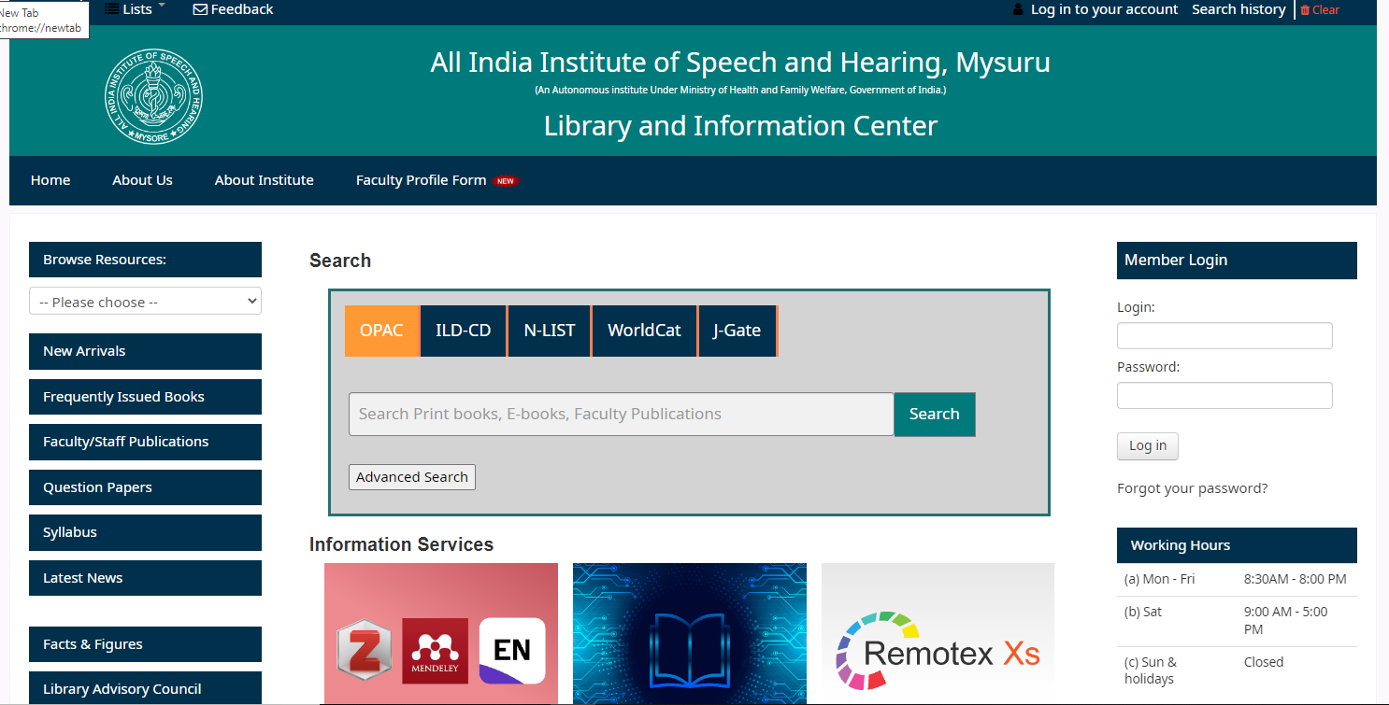
Research Projects
Library Webportal

Slide 7
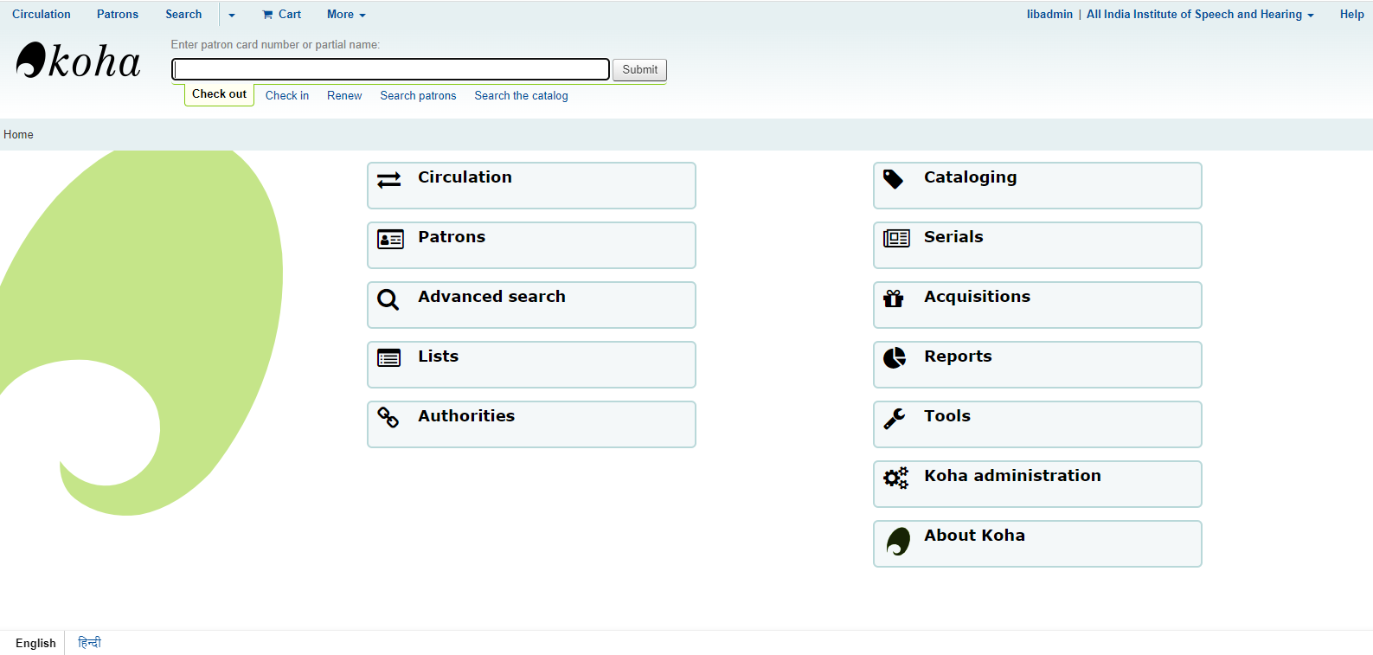
Research Projects
WEB OPAC

Slide 8
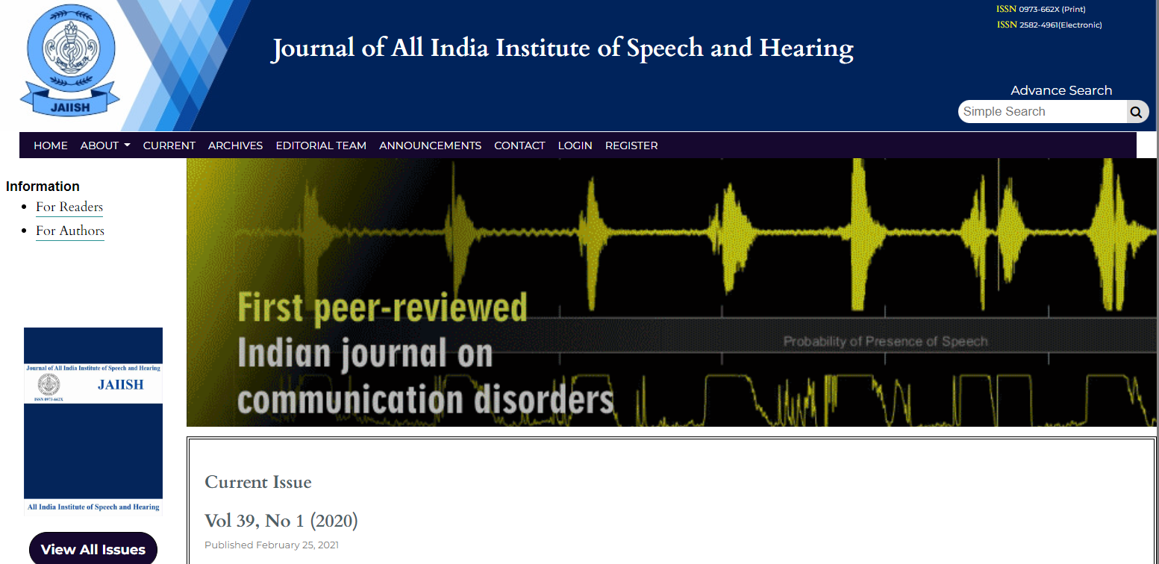
Research Projects
E-JAIISH

Slide 9
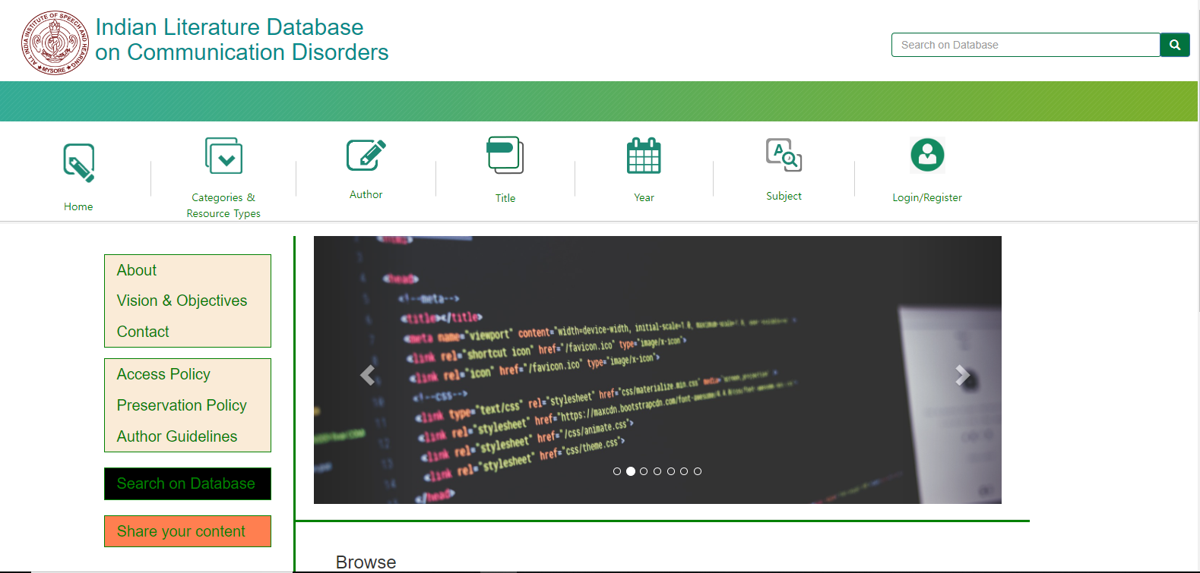
Research Projects
Indian Literature on Communication Disorders

Slide 10
Research Projects
E-Learning@AIISH

Slide 11
Personnel
Core Team
1) Dr.Shijith Kumar C, (Library & Information Officer)
2) Mr. Nandeesha, B, (Asst. Library & Information Officer)
3) Mr. Nidheesh David Kuruvila, (Sr. Library & Information Assistant)
4) Mr. Nanjunda Swamy, M. (Sr. Library & Information Assistant)
5) Mr. Lokesh, P, (Assistant Grade-III)
Support
1) Mr. Mahendra, Clerical Assistant (Out Source- Contract)
2) Ms. Bhanu, Clerical Assistant (Out Source- Contract)
3) Mr. Hanumantha, MTS (Out Source- Contract)
4) Mr. Suresh, MTS (Out Source- Contract)
5) Ms. Rekha, MTS (Out Source- Contract)
6) Mr. Pradeeep, MTS (Out Source- Contract)

Slide 12
Future Plans
Massive Open Online Course-Intellectual Disability
Massive Open Online Courses- Other Area
Research Data Repository

Slide 13
SWOT ANALYSIS
Strength
Weakness
Threat
Opportunity
Lack of support of IT Professionals
Lack of Indian Resources in the field
Reduced physical visit
National Information Centre on Communication Disorders
Dedicated Staff
Availability of Fund
Support from Authority

